Slide 1



Weekly Review
Gobind Sugar Mill, Aira
25th Jan. to 31th Jan. 2026

Slide 2
Production & Sales (Budget vs Actual)
Production (F.Y. 2025-26)
Particulars | Current Month (Jan,26) |  | Last Month (Dec,25) |  | YTD Till Last Month (Up to Dec,25)
 | Budgeted | Actual-till 31st, Jan-26 | Budgeted | Actual | Budgeted | Actual
Sugar (LQ) | 2.77 | 2.80 | 2.73 | 2.89 | 5.59 | 5.51
Power (LU) | 276.05 | 284.06 | 281.23 | 286.80 | 759.33 | 747.19
Ethanol (LL) | 30.00 | 32.55 | 37.20 | 36.17 | 272.91 | 268.60
Sales (F.Y.2025-26)
Particulars | Current Month (Jan ,26) |  | Last Month (Dec,25) |  | YTD Till Last Month (Up to Dec,25)
 | Budgeted | Actual-till 31st, Jan-26 | Budgeted | Actual | Budgeted | Actual
Sugar (LQ) | 1.25 | 1.30 | 0.94 | 0.97 | 10.63 | 10.45
Power (LU) | 163.94 | 169.71 | 165.81 | 167.09 | 382.83 | 382.20
Ethanol (LL) | 30.00 | 33.00 | 37.20 | 37.65 | 272.91 | 269.44
Notes:
Dec-25 Sugar Sale Free 91140 Qtls & Export 6090 Qtl Total=97230 Qtls
Jan-26 Sugar Sale Free-124470 qtl & Export 5030 Qtl Total=129500 qtl

Slide 3

SPE Weekly Snapshot
Production Parameters | Current Week | Last Week | Till Date
Total Sugarcane Crush (LQ) | 7.14 | 7.14 | 99.03
Sugar Recovery | 10.10% | 10.03% | 9.94%
Cane for Syrup (LQ) | 0.60 | 1.14 | 15.68
Sugar Produced (LQ) | 0.66 | 0.63 | 8.31
Ethanol Produced (LL) | 3.77 | 8.17 | 114.12
Power Generation (LU) | 61.30 | 65.27 | 893.39
Power Export (LU) | 36.34 | 38.59 | 529.63
Cane Payment (Cr) | - | 27.16 | 296.20
Capacity Utilization | Current Week | Last Week | Till Date
Season Days | 7 | 7 | 98
Milling PUF | 101.64% | 102.07% | 101.05%
Sugar Bagging (Nos.) | 66441/66179 | 62887/59537 | 831089/828568
Power PUF | 91.22 % | 97.13 % | 94.96%
Distillery PUF | 88.53% | 93.41% | 95.20%
Bagasse Pol % | 1.73% | 1.72% | 1.74%
Bagasse Moisture | 50.20% | 50.16% | 50.13%
3

Slide 4
SPE Weekly Snapshot – Total Losses
This Week | Last Week | Till Date
3.10 | 3.12 | 2.44
4
Notes:
Pol in Cane

Slide 5
Comparison with Nearby as on 31.01.26
5

Slide 6
Pol Balance as on 31.01.26
6

Slide 7
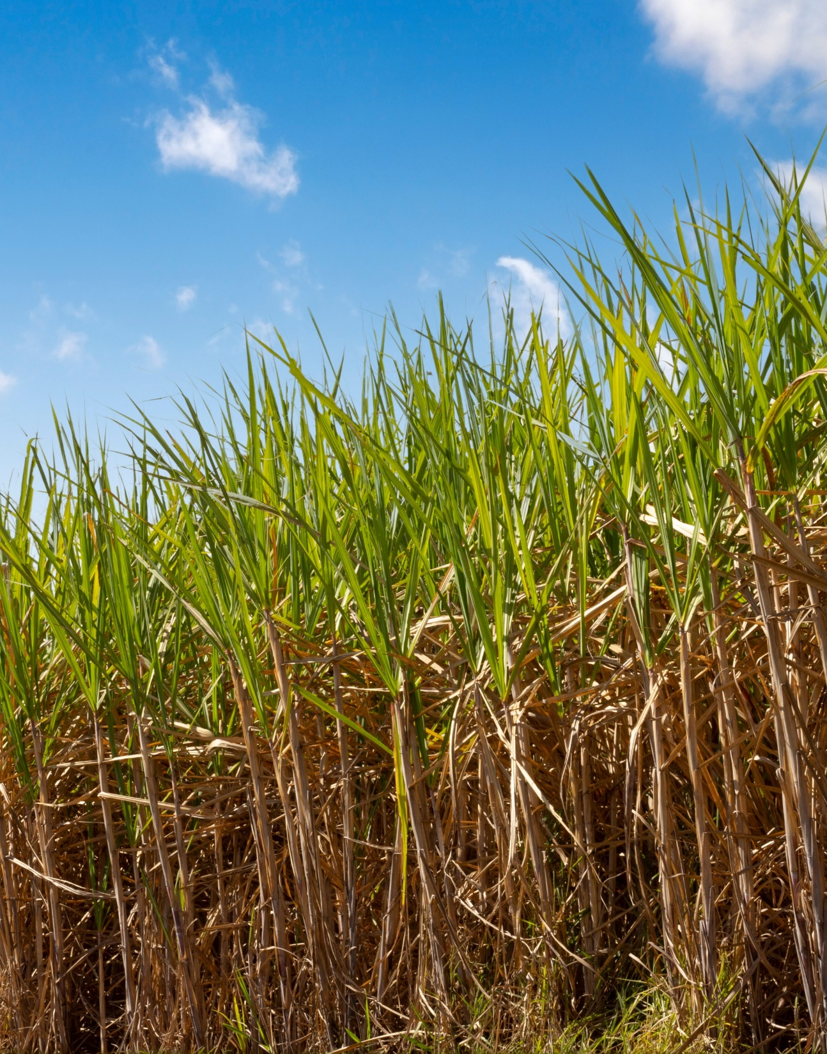
CANE

Slide 8
Action Taken Report
S. No | Discussion Point | Action Taken
1. | Plot wise details of Farmers in Know Your Farmer | Farmer wise number of plots and distribution of variety is visible. Plotting on the map to show individual plot wise activity is pending.
2. | Cumulative Failure of Purchy and conversions due to departmental effort | Total No Purchy Not Honored till 20 Jan :36855 Purchy revalidated : 8992 No. of purchy weighed after revalidation: 3640
3. | PoL Vs Recovery Slider –Three years | PoL Vs Recovery -Yet to be developed Recovery Slider
4. | Tracking of excess Cane received over the indent placed | Indent Vs Purchase data provided
5. | Standing Cane Availability | Format has been shared with the field staff to conduct the survey and share weekly availability.

Slide 9
Weekly Performance Snapshot – Cane
S. No. | Capacity Utilization | Target | Current Week | Last Week | Till Date
1 | Daily Indent Rate Avg. (LQ) | As per requirement | 1.01 | 1.21 | 1.11
2 | Daily Cane Purchased Rate (LQ) | 1.00 | 1.02 | 1.02 | 1.01
3 | Gate Indent Maturity (%) | NA | 110% | 81% | 86%
4 | Center Indent Maturity (%) | NA | 97% | 76% | 89%
5 | Pol in Cane (%) | 13.80 | 13.25 | 13.20 | 12.38
6 | Recovery in Cane (%) | NA | 10.18 | 10.08 | 9.94
7 | Avg. Center Cane Holding Time (Hrs.) | NA | 17.23 | 17.35 | 13.71

Slide 10
Indent, Yard Balance Vs Crushing (Lakh Qtls.) – 01 Jan-31 Jan 2026
Date | Requirement | Indent (lakh qtls) | Purchase (Lakh qtls) | Yard Balance (lakh qtls)
01-Jan-26 | 100000 | 128500 | 106500 | 22423
02-Jan-26 | 100000 | 107700 | 101500 | 11394
03-Jan-26 | 75000 | 123850 | 69500 | 36540
04-Jan-26 | 100000 | 128400 | 105500 | 28437
05-Jan-26 | 100000 | 135800 | 106000 | 32245
06-Jan-26 | 100000 | 112950 | 104000 | 32125
07-Jan-26 | 100000 | 112800 | 103000 | 27834
08-Jan-26 | 100000 | 105600 | 106000 | 19294
09-Jan-26 | 100000 | 129500 | 105500 | 11772
10-Jan-26 | 100000 | 139000 | 107000 | 16399
11-Jan-26 | 100000 | 154900 | 108000 | 25232
12-Jan-26 | 100000 | 187100 | 106000 | 29726
13-Jan-26 | 100000 | 129000 | 100000 | 45355
14-Jan-26 | 100000 | 129000 | 108000 | 32546
15-Jan-26 | 100000 | 115000 | 107000 | 7425
Date | Requirement | Indent (lakh qtls) | Purchase (Lakh qtls) | Yard Balance (lakh qtls)
16-Jan-26 | 100000 | 130400 | 102000 | 6330
17-Jan-26 | 100000 | 137250 | 103500 | 10021
18-Jan-26 | 100000 | 147000 | 107000 | 15629
19-Jan-26 | 100000 | 127000 | 108500 | 19368
20-Jan-26 | 100000 | 136050 | 77000 | 49101
21-Jan-26 | 100000 | 120250 | 107500 | 37917
22-Jan-26 | 100000 | 120250 | 107000 | 38598
23-Jan-26 | 100000 | 116000 | 100500 | 43547
24-Jan-26 | 100000 | 110500 | 107000 | 38092
25-Jan-26 | 100000 | 88950 | 110500 | 34130
26-Jan-26 | 100000 | 91700 | 106000 | 29354
27-Jan-26 | 100000 | 85500 | 109000 | 26313
28-Jan-26 | 100000 | 98000 | 110000 | 3861
29-Jan-26 | 100000 | 91400 | 57000 | 43023
30-Jan-26 | 100000 | 142350 | 110500 | 19178
31-Jan-26 | 100000 | 117600 | 108500 | 17040

Slide 11
Cane Purchase trend till 31 Jan 2026

Slide 12
PoL Vs Recovery % (18.01.26 to 31.01.2026)

Slide 13
Historical Recovery Trend Vs Current (Last 2 years)

Slide 14
Date-wise number of center operation update 1 -31 Jan 2026
Date | Number of centers operated | No. of centers closed | Reason for closure
16-Jan-26 | 98 | 10
17-Jan-26 | 104 | 4
18-Jan-26 | 104 | 4
19-Jan-26 | 104 | 4
20-Jan-26 | 98 | 10
21-Jan-26 | 92 | 16
22-Jan-26 | 100 | 8
23-Jan-26 | 104 | 4
24-Jan-26 | 79 | 29 | Due to the excess cane in the gate yard.
25-Jan-26 | 103 | 5
26-Jan-26 | 70 | 38 | Due to the excess cane in the gate yard.
27-Jan-26 | 103 | 5
28-Jan-26 | 90 | 18
29-Jan-26 | 97 | 11
30-Jan-26 | 94 | 14
31-Jan-26 | 101 | 7
Date | Number of centers operated | No of centers closed | Reason for closure
01-Jan-26 | 98 | 10
02-Jan-26 | 102 | 6
03-Jan-26 | 98 | 10
04-Jan-26 | 90 | 18
05-Jan-26 | 105 | 3
06-Jan-26 | 99 | 9
07-Jan-26 | 99 | 9
08-Jan-26 | 98 | 10
09-Jan-26 | 103 | 5
10-Jan-26 | 104 | 4
11-Jan-26 | 104 | 4
12-Jan-26 | 103 | 5
13-Jan-26 | 97 | 11
14-Jan-26 | 94 | 14
15-Jan-26 | 89 | 19

Slide 15
Indent Maturity (20 Jan -26 Jan 2026)
Bottom 10 Centers |  |  |  |  |  |  | Top 10 Centers
S.No. | CENTRE NAME | SOCIETY NAME | INDENT (QTL) | MATURITY % | Remark |  | CENTRE NAME | SOCIETY NAME | INDENT (QTL) | MATURITY %
1 | GANJ | MAHMOODABAD | 1233 | 29.30% | The villages linked to this center have low land area, and due to the rains, there are difficulties in harvesting the cane. |  | MAJHRAPURAB | BELRAYAN | 6453 | 114.58%
2 | BELTUA | AIRA | 3762 | 47.46% | The farmers of Beltua village had uprooted the ratoon cane crop, and according to departmental rules, 100 % of the crop has been converted to plant cane. |  | SABAI GAURHI II | NANPARA | 2997 | 112.86%
3 | RATANGANJ II | MAHMOODABAD | 3546 | 49.24% | The villages linked to this center have low land area, and due to the rains, there are difficulties in harvesting the cane. |  | DANDOORI | BELRAYAN | 4149 | 111.94%
4 | URRA BAZAR | NANPARA | 6633 | 49.76% | The villages linked to this center have 50-60% low land area, and due to the rains, there are difficulties in harvesting the cane. |  | TAPARPURWA | BELRAYAN | 3546 | 111.15%
5 | BEHNANPURWA | AIRA | 4599 | 53.67% |  |  | BOKARIYA | BELRAYAN | 2637 | 110.95%
6 | NAINAPUR-III | AIRA | 4545 | 54.18% |  |  | JALLAPUR MAHSI | HARGAON | 3384 | 109.05%
7 | HARKHAPUR | NANPARA | 7983 | 54.54% |  |  | BHAUVAPUR KALAN | AIRA | 4563 | 108.11%
8 | LAHBARI | AIRA | 5598 | 55.05% |  |  | BELAWA II | BELRAYAN | 6210 | 107.65%
9 | SUJAI KUNDA | AIRA | 4968 | 56.41% |  |  | GATE (NANPARA) | NANPARA | 7110 | 107.63%
10 | AMRITPUR | NANPARA | 7218 | 57.24% |  |  | BIRSINGHPUR | AIRA | 8793 | 107.51%
Notes:
Good: >= 90% Average: >=70% and <90% Poor: <70%

Slide 16
Average Vehicle Holding time at Purchase Center (25.01.26 to 31.01.26)

Slide 17
Average Truck Holding Time at Purchase Centers (25.01.26 to 31.01.26)

Slide 18
Zone wise Target V/S Cane supply 2025-26 up 31.01.2026

Slide 19
Society Wise Indent And Supply (25.01.2026 to 31.01.26)
S.No. | Society | Quota (Qtls.) | Indent (Qtls.) | Supply (Qtls.) | %
1 | Aira | 11729032 | 450450 | 449764 | 99.85
2 | Arnikhana | 834291 | 29700 | 33869 | 114.04
3 | Hargaon | 1136094 | 47050 | 44838 | 95.30
4 | Lakhimpur | 1219430 | 37900 | 42826 | 113.00
5 | Nanpara | 1650178 | 74400 | 76436 | 102.74
6 | Belrayan | 943618 | 47900 | 39717 | 82.92
7 | Mahmoodabad | 245310 | 10200 | 8519 | 83.52
Total |  | 17757953 | 697600 | 695969 | 99.77

Slide 20
Indent Failure Analysis
 |  | Before 20-01-2026
Purchy Not Honored | Purchy Not Honored Qty (Qtls) | Revalidated No of purchy | Revalidated Purchy Qty (Qtls) | No. of Purchy weighed | Weighed Qty (Qtls) | Not Weighed | Not Weighed Qty (Qtls)
20/01/2026 | 20/01/2026
36855 | 1127322 | 8992 | 286794 | 3640 | 160227.2 | 5352 | 155151
Purchy Not Honored | Purchy Not Honored Qty | Total No Purchy Not Honored | Total Purchy Not Honored Qty (Qtls)
26/01/2026 |  | 26/01/2026 | 26/01/2026
327 | 52497 | 37182 | 1179819
Notes:
Total No Purchy Not Honored till 20 Jan :36855
Purchy revalidated : 8992
No. of purchy weighed after revalidation: 3640

Slide 21
CoLk 9709 (Duplicate) Analysis

Slide 22
CoLk 9709 (Duplicate) Analysis
COLK 9709 -Duplicate- Survey 2025 (Ha)
Society | AUTUMN | PLANT | RATOON | RATOON II | Total Area in Ha
AIRA | 10.581 | 294.951 | 101.913 | 3.767 | 411.212
ARNIKHANA |  | 11.049 | 2.448 |  | 13.497
BELRAYAN | 0.715 | 8.379 | 1.832 |  | 10.926
HARGAON | 0.272 | 19.329 | 8.495 | 1.297 | 29.393
LAKHIMPUR | 0.358 | 66.221 | 26.667 | 0.741 | 93.987
MAHMOODABAD |  | 5.686 | 3.949 |  | 9.635
NANPARA | 0.747 | 47.906 | 12.566 |  | 61.219
Grand Total | 12.673 | 453.521 | 157.87 | 5.805 | 629.869
Top 10 Villages
Village | Total Area in Ha
BELAGADHI | 110.784
OJHAPURVA | 35.495
DIUHA KALAN | 24.62
KAIRATIPURVA | 21.213
MAHADEV | 19.492
TULSIRAMPURVA | 19.487
SABAI GAURHI | 18.569
ATKOHNA SARSWA | 18.541
NAINAPUR | 15.746
NAUBASTA | 15.229

Slide 23
Comparative Pol in Cane of Neighboring Sugar Factories (31.01.26)

Slide 24
COMPARATIVE DATA OF NEIGHBOURING FACTORY UP TO 31.01.26
SL. NO | NAME OF FACTORY | VARIETAL % IN CRUSHING |  | PRIMARY JUICE ANALYSIS |  |  | POL IN CANE (This Year ) |  | POL IN CANE (Last Year) |  | RECOVERY % |  | D.M.F | R.S% per 100BX | FIBER % CANE | EST. MOL. % CANE | REMARK
 |  |  |  | BRIX % | POL % | PTY.
 |  |  |  |  |  |  | DAY | Diiff. | DAY | Diff. | DAY | TODATE
1 | Aira | Co-0238 | 21 | 19.12 | 16.12 | 84.31 | 13.25 | 0.06 | 13.83 | 0.73 | 10.18 | 9.94 | 71.42 | 4.84 | 13.36 | 5.70 | B-HEAVY
 |  | Co-15023 | 5
 |  | Co-0118 | 33
 |  | COLK-14201 | 7
 |  | CoLk-94184 | 17
 |  | Co-98014 | 11
 |  | CoS 13235 | 1
 |  | CoS 13231 | 3
 |  | Other | 2
2 | HARGAON | CO-0238 | 10 | 18.31 | 15.49 | 84.60 | 13.19 | 0.00 | 13.10 | 0.00 | 10.18 | 9.28 | 71.64 | 3.78 | 14.01 | 5.62 | B-HEAVY & Syrup
 |  | CO-15023 | 4
 |  | Co-0118 | 32
 |  | COLK-14201 | 4
 |  | CoS-8436 | 10
 |  | CoLk-94184 | 13
 |  | COS-13235 | 7
 |  | COLK-98014 | 6
 |  | CoH-160 | 8
 |  | Other | 6
3 | JAWAHARPUR | CO-0238 | 33 | 18.16 | 15.20 | 83.7 | 13.25 | 0.06 | 13.52 | 0.42 | 7.90 | 7.42 | 71.70 | 3.40 | 14.17 | 2.58 | C Heavy & Thick juice
 |  | CO-15023 | 1
 |  | Co-0118 | 2
 |  | COLK-14201 | 4
 |  | Cos-8436 | 4
 |  | CoLk-94184 | 54
 |  | Other | 2
4 | RAMGARH | CO-0238 | 61 | 18.75 | 15.78 | 84.16 | 13.60 | 0.41 | 14.15 | 1.05 | 11.68 | 11.14 | 72.73 | 3.73 | 13.00 | 4.33 | C Heavy
 |  | Co-15023 | 3
 |  | Co-0118 | 3
 |  | COLK-14201 | 6
 |  | CoS-8436 | 3
 |  | COS-13235 | 3
 |  | CoLk-94184 | 20
 |  | Other | 1

Slide 25
COMPARATIVE DATA OF NEIGHBOURING FACTORY UP TO 31.01.26
SL. NO | NAME OF FACTORY | VARIETAL % IN CRUSHING |  | PRIMARY JUICE ANALYSIS |  |  | POL IN CANE (This Year ) |  | POL IN CANE (Last Year) |  | RECOVERY % |  | D.M.F | R.S% per 100BX | FIBER % CANE | EST. MOL. % CANE | REMARK
 |  |  |  | BRIX % | POL % | PTY.
 |  |  |  |  |  |  | DAY | Diiff. | DAY | Diff. | DAY | TODATE
5 | KUMBHI | CO-0238 | 7 | 17.93 | 15.00 | 83.64 | 12.82 | -0.37 | 13.50 | 0.40 | 10.06 | 9.47 | 73.94 | 3.65 | 12.91 | 4.94 | B-HEAVY
 |  | Co-15023 | 1
 |  | Co-0118 | 19
 |  | COLK-14201 | 4
 |  | CoLk-94184 | 12
 |  | Colk-98014 | 8
 |  | CoJ- 85 | 14
 |  | Other | 35
6 | GULARIYA | CO-0238 | 3 | 18.13 | 15.29 | 84.34 | 13.01 | -0.18 | 13.58 | 0.48 | 9.91 | 9.53 | 74.08 | 3.84 | 12.79 | 5.83 | B-HEAVY
 |  | Co-15023 | 3
 |  | Co-0118 | 47
 |  | COLK-14201 | 5
 |  | CoLk-94184 | 5
 |  | Co- 98014 | 21
 |  | Other | 16
7 | AJBAPUR | CO-0238 | 26 | 18.39 | 15.51 | 84.35 | 12.82 | -0.37 | 12.98 | -0.12 | 11.10 | 10.48 | 72.12 | 4.52 | 13.56 | 4.46 | C-HEAVY
 |  | Co-15023 | 1
 |  | Co-0118 | 3
 |  | COLK-14201 | 3
 |  | CoS-8436 | 6
 |  | CoLk-94184 | 18
 |  | COS-13235 | 12
 |  | Co- 98014 | 16
 |  | CoJ- 85 | 2
 |  | Other | 13
8 | Khmbharkhera | Co-0238 | 6 | 17.73 | 14.81 | 83.53 | 12.43 | -0.76 | 12.96 | -0.14 | 10.70 | 10.23 | 72.95 | 4.15 | 12.98 | 4.42 | C-HEAVY
 |  | Co-15023 | 1
 |  | Co-0118 | 15
 |  | COLK-14201 | 2
 |  | colk-94184 | 2
 |  | CoJ- 85 | 1
 |  | CO-98014 | 10
 |  | CoS 13231 | 1
 |  | Cos-13235 | 3
 |  | Other | 59
9 | BISWAN | Co-0238 | 43 | 19.07 | 16.27 | 85.32 | 13.03 | -0.16 | 12.82 | -0.28 | 8.26 | 9.89 | 71.02 | 4.92 | 14.11 | 3.17 | C-HEAVY & Syrup
 |  | Co-15023 | 1
 |  | CO-0118 | 27
 |  | COLK-14201 | 6
 |  | CoLk-94184 | 15
 |  | Cos-8272 | 2
 |  | Co-98014 | 1
 |  | Other | 5

Slide 26
AGRI EXPERTS VISIT: JAN. 2026

Slide 27
Details of loading at the center by the loader

Slide 28
CANE LOADER PERFORMANCE (25.01.26 to 31.01.26)
Category of Issue | No. of Cases | % of Total | Remarks
Hydraulic claw broken | 2 | 40% | Affected Nakha 3rd and Semariya 1st; both repaired same day.
Pressure pipe burst | 1 | 20% | Occurred at Bokariya; pipe repaired and loading resumed same day.
Spindle broken | 1 | 20% | Longest downtime (25 hrs 20 min) at Goorh 1st; resolved on 31-01-2026.
Axle broken | 1 | 20% | Occurred at Khajuha bazar 1st; repaired and loading resumed same day.
Total | 5 | 100% | Total non-working time across all centers: 36 hrs 40 min.
High downtime centers
Center | Downtime
Goorh 1st | 25 hrs 20 min
Khajuha bazar 1st | 5 hrs 05 min
Nakha 3rd | 2 hrs 30 min
Semariya 1st | 2 hrs 00 min
Bokariya | 1 hr 45 min

Slide 29
Yield Assessment(Ratoon) – 01 Nov 25 to 31 Jan 26
Overall Average Yield: 555 q/ha
Total Plots Assessed: 2256
Yield dispersion is significant, ranging from ~406 q/ha to ~727 q/ha
Variety | No. of plot | Average of Yield (QTL /Hec)
Cos-8436 | 1 | 987.50
Colk-14201 | 263 | 595.97
Cos-13235 | 83 | 593.12
co-0238 | 287 | 576.36
Co-0118 | 951 | 565.28
Co-15023 | 109 | 557.71
Colk-16202 | 2 | 550.67
Cos-13231 | 56 | 531.45
Cos-17231 | 2 | 519.56
Colk-94184 | 319 | 501.62
Cos-95255 | 1 | 500.00
co-98014 | 155 | 499.45
Cos-8272 | 12 | 476.69
Coj-85 | 10 | 467.15
Cos-18231 | 4 | 417.18
UP 5125 | 1 | 358.41
Grand Total | 2256 | 555.41
S.N. | Society Name | No. of plot | Avg. Yield (QTL /Hec)
1 | BELRAYAN | 64 | 727.87
2 | MAHMOODABAD | 81 | 578.87
3 | AIRA | 1473 | 574.92
4 | HARGAON | 199 | 540.16
5 | NANPARA | 161 | 539.55
6 | ARNIKHANA | 102 | 458.26
7 | LAKHIMPUR | 176 | 406.58
 | Grand Total | 2256 | 555.41

Slide 30
Yield Assessment(Ratoon Demo 2024)
Overall Average Yield: 744.41 q/ha
Total Plots Assessed: 37
Yield dispersion is significant, ranging from ~564.69 q/ha to ~903.75 q/ha
Zonal Manager | Area Manager | No. of Plot | Area (ha) | Avg.Yield (QTL /Hec)
Ajendra Singh | Ajay Dixit | 6 | 2.900 | 675.75
 | Nahar Singh | 2 | 0.800 | 564.69
 | Shyam Kishor Tripathi | 6 | 3.360 | 716.58
Ajendra Singh |  | 14 | 7.060 | 677.38
Dheeraj Singh | Dinesh Singh | 3 | 1.200 | 778.97
 | Ranjeet Singh | 4 | 1.600 | 820.67
 | Sheetla Prasad | 4 | 1.600 | 903.75
Dheeraj Singh |  | 11 | 4.400 | 841.39
Pankaj Shrivastava | Anil Dixit | 2 | 0.800 | 593.75
 | Awanish Singh | 4 | 1.480 | 897.67
Pankaj Shrivastava |  | 6 | 2.280 | 776.10
Y.P Rao | Brijesh Kumar | 3 | 1.366 | 660.63
 | Gajendar Singh | 1 | 0.800 | 675.00
 | Satender Tomar | 2 | 0.900 | 809.75
Y.P Rao |  | 6 | 3.066 | 712.73
Grand Total |  | 37 | 16.806 | 744.41
Variety | Total Plot Area (ha) | Average of Yield (QTL /Hec)
Co 0118 | 8.060 | 735.79
Co 15023 | 3.100 | 739.57
CoLk 14201 | 4.380 | 718.24
CoS 13235 | 1.266 | 874.30
Grand Total | 16.806 | 744.41

Slide 31
Soil Sample Collection by Saksham App up to 31.01.2026
Zonal Manager | Target | Achievement | %
Y.P. Rao | 2750 | 1544 | 56%
Ajendra Singh | 3000 | 1816 | 61%
Pankaj Shrivastav | 2000 | 1194 | 60%
Dheeraj Singh | 3250 | 1064 | 33%
Total | 11000 | 5618 | 51%
Last Year Soil Sample- 8080

Slide 32
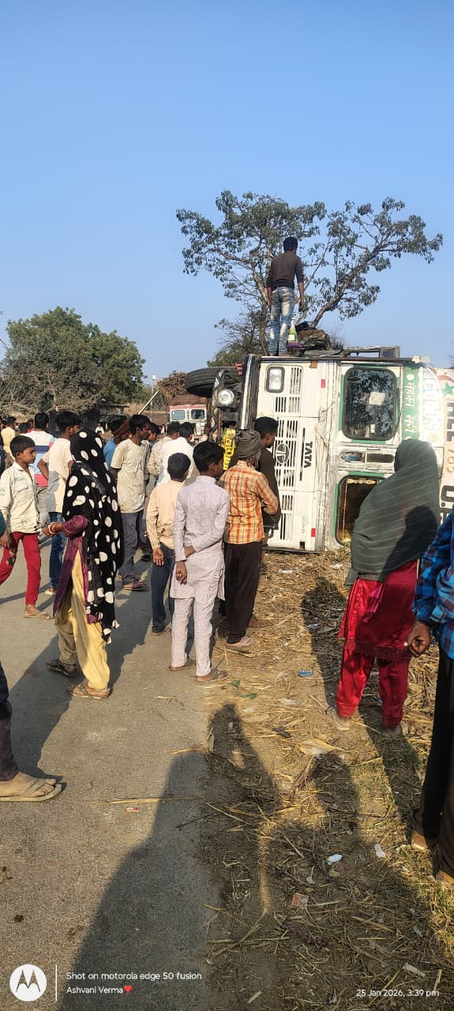
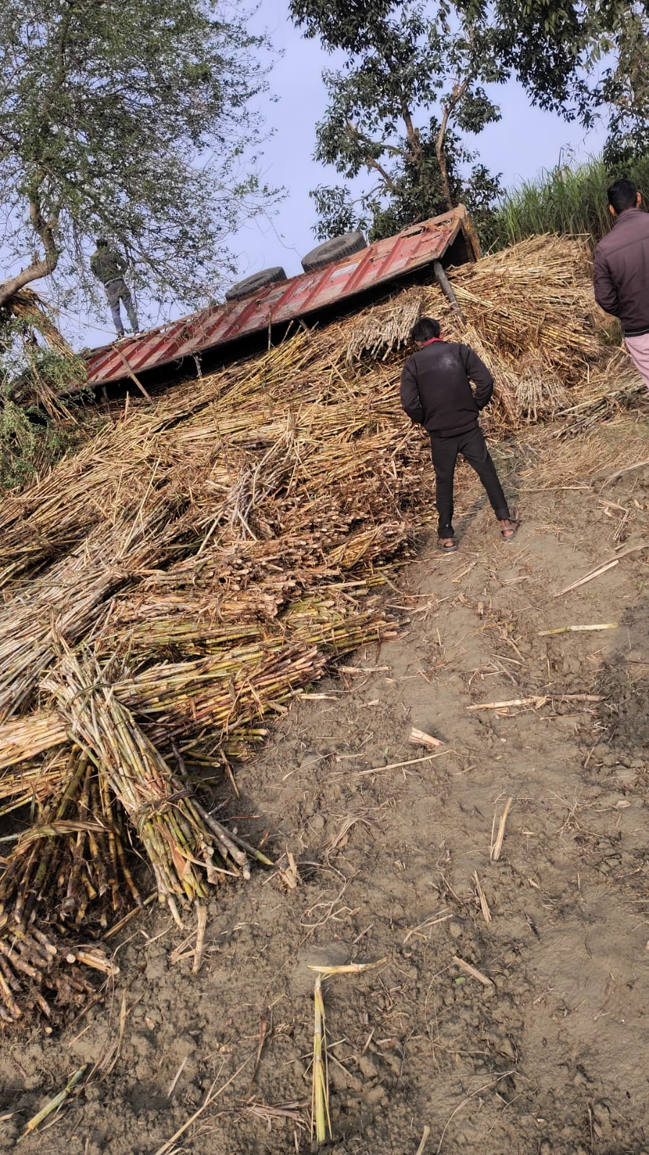
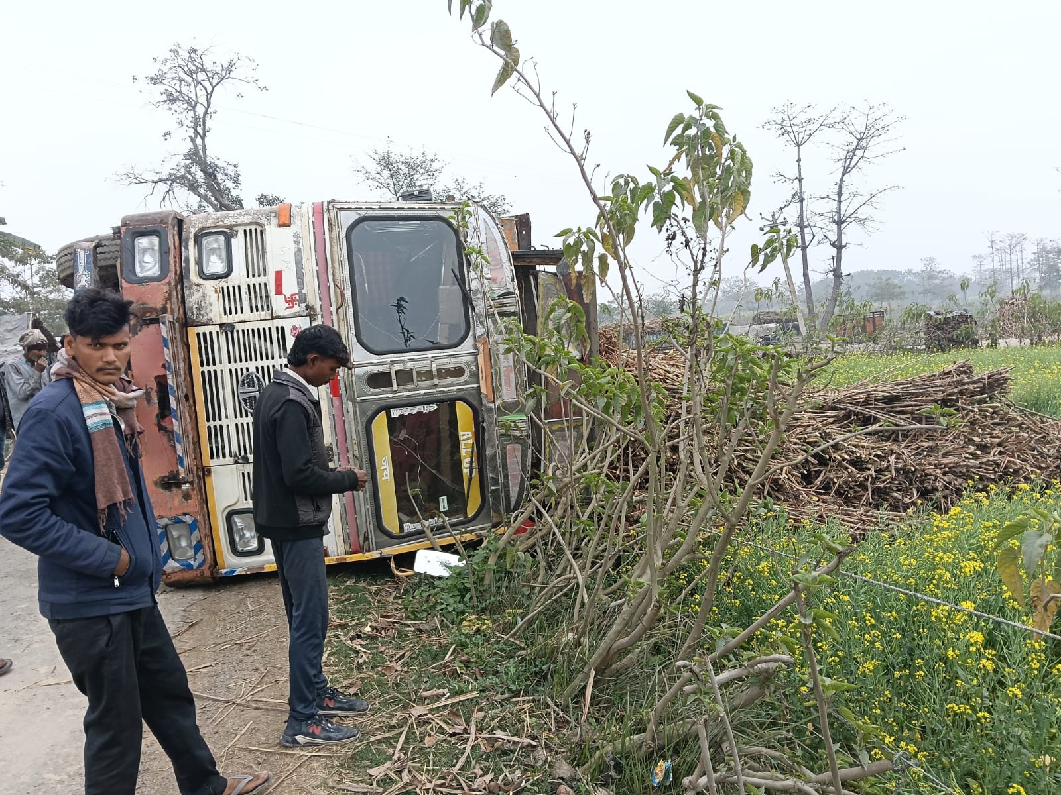
ROAD SAFETY (25.01.26 to 31.01.26)

Slide 33
Call Center Update (25.01.26 to 31.01.26)
Banners at all 106 centres displayed
Category | No. of Cases | % of Total | Remarks
Purchey expired | 10 | 58.80% | Most common issue; involved revalidating dates (Jan 26–29) for fresh cane supply.
Additional bonding | 3 | 17.60% | Related to standing Ratoon cane; growers requested extra bonding/purchey.
Logistics / Truck Availability | 2 | 11.80% | Specifically at Jungle Matera and Khajuhabazar III; resolved by starting loading.
Operational Delays | 1 | 5.90% | Center closed or late start at Kiratipurva-IV.
Payment Query | 1 | 5.90% | Individual inquiry regarding last payment advice date at Gate (Aira).
Total | 17 | 100% | All cases are marked as Resolved.

Slide 34
Seed Reservation new variety for Spring planting by Saksham App
S.N. | Variety Name | AIRA | ARNIKHANA | BELRAYAN | HARGAON | LAKHIMPUR | MAHMOODABAD | NANPARA | Grand Total (Qtls)
1 | CO 15023 | 31410 | 0 | 1725 | 1590 | 1220 | 100 | 4000 | 40045
2 | COLK 16202 | 4312 | 0 | 525 | 260 | 365 | 0 | 275 | 5737
3 | COS 13231 | 0 | 100 | 0 | 0 | 0 | 0 | 300 | 400
4 | COS 13235 | 69259 | 300 | 4390 | 11375 | 2980 | 0 | 9453 | 97757
5 | Cos 18231 | 0 | 0 | 0 | 0 | 70 | 0 | 150 | 220
6 | Cos17231 | 2010 | 0 | 250 | 100 | 820 | 50 | 690 | 3920
 | Grand Total | 106991 | 400 | 6890 | 13325 | 5455 | 150 | 14868 | 148079

Slide 35
Comparative Payment Figures of Neighboring Mills (As on 31.01.2026)
Name of Factory | Date of Start | Payment Up to
Aira | 26.10.2025 | 08.01.2026
Ajbapur | 27.10.2025 | 19.01.2026
Kumbhi | 31.10.2025 | 26.01.2026
Gularia | 31.10.2025 | 24.01.2026
Belrayan | 12.11.2025 | 08.01.2026
Gola | 05.11.2025 | 08.03.2025
Pallia | 07.11.2025 | 11.03.2025
Khambharkhera | 05.11.2025 | 12.11.2025

Slide 36
KOLHU AND CRUSHERS cane crush in our allocated area
Particulars | Total (No’s) | Rate/ Qtl. (Rs.) | Running (No’s) |  | Crushing (Qtls.) |  | Recovery (%)
 |  |  | This week | To Date (31.01.26) | This week | To Date (31.01.26)
Kolhu | 192 | 380-440 | 0 | 140 | 73500 | 1512510 | 12.80%
Crushers | 15 | 370-390 | 0 | 13 | 418600 | 3218437 | NA
 | Total: |  |  |  | 492100 | 4730947

Slide 37
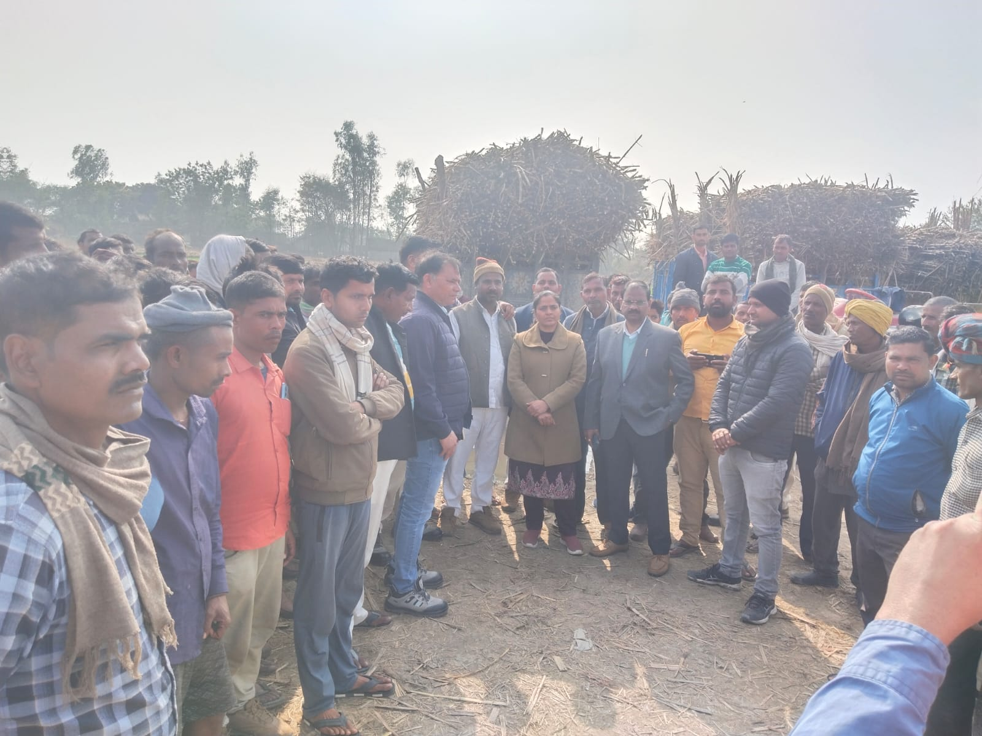
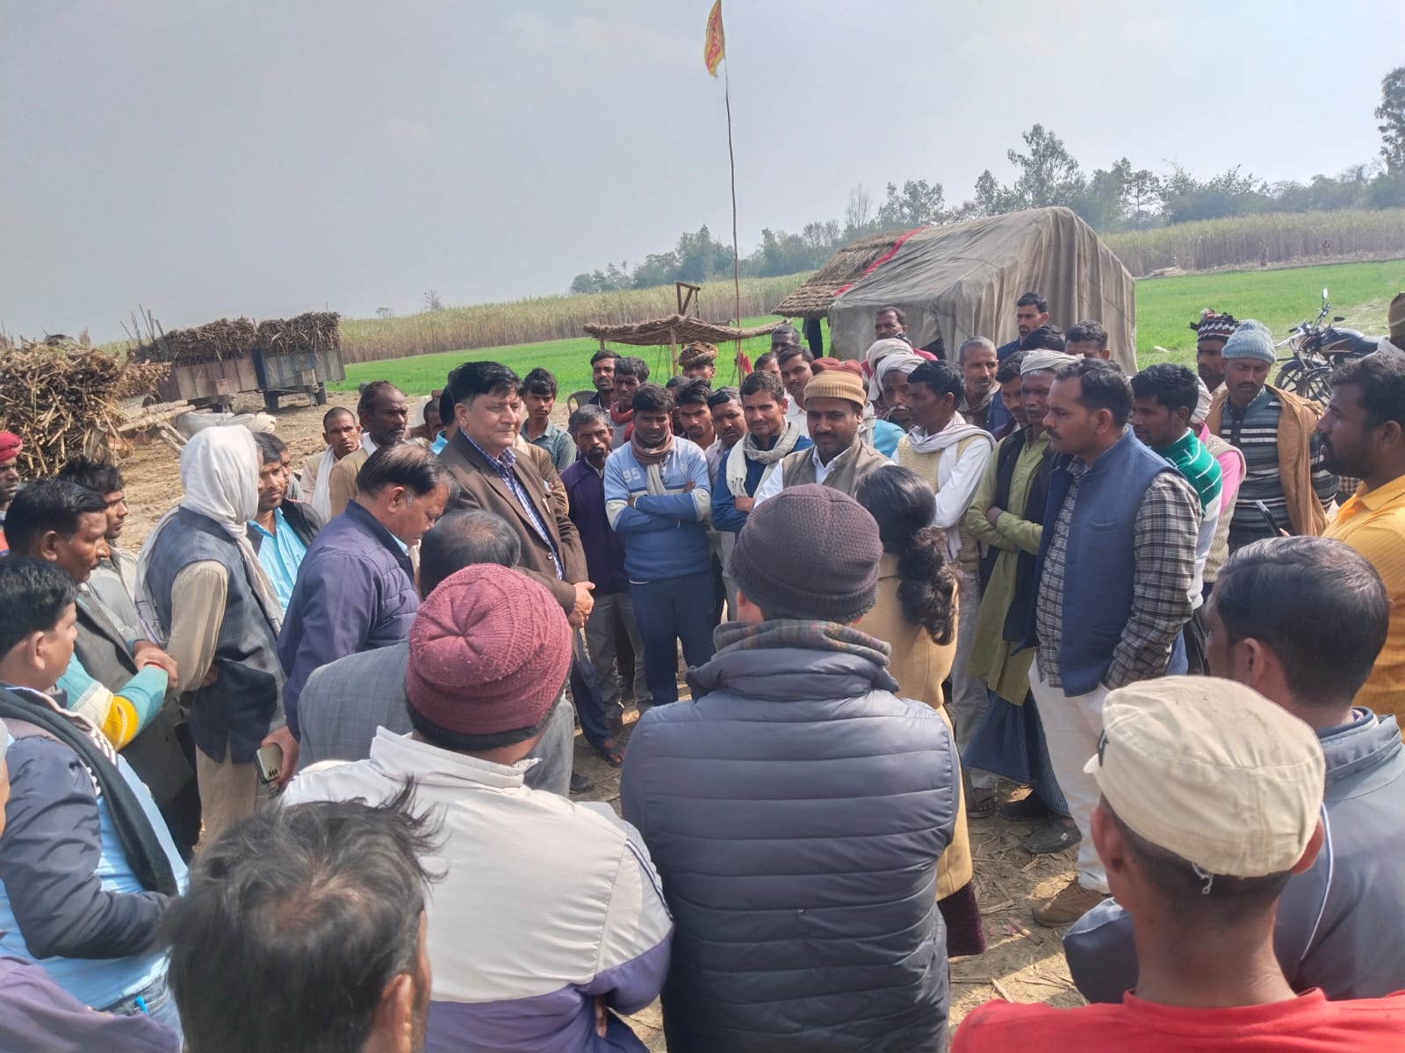
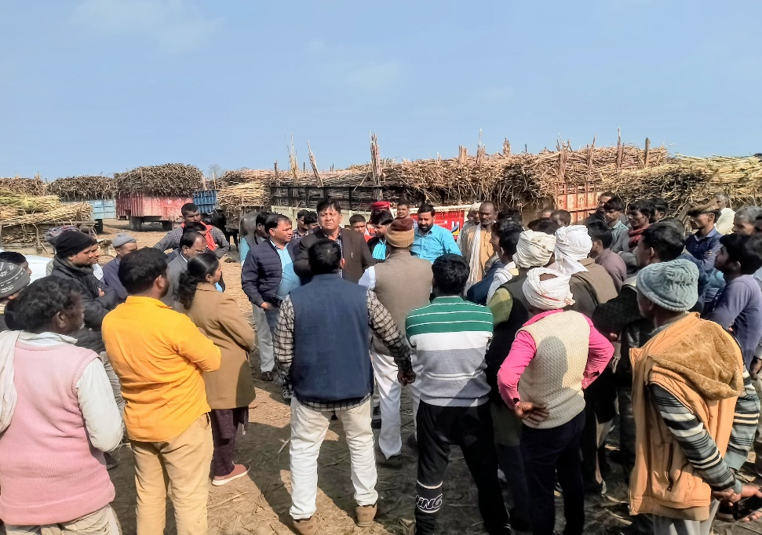
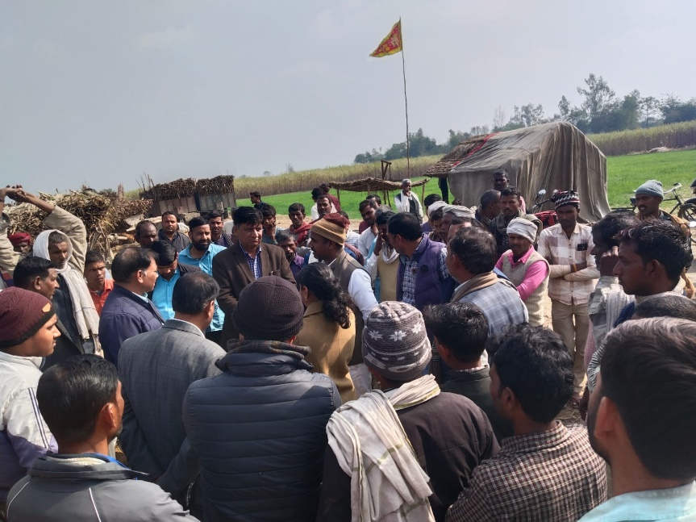
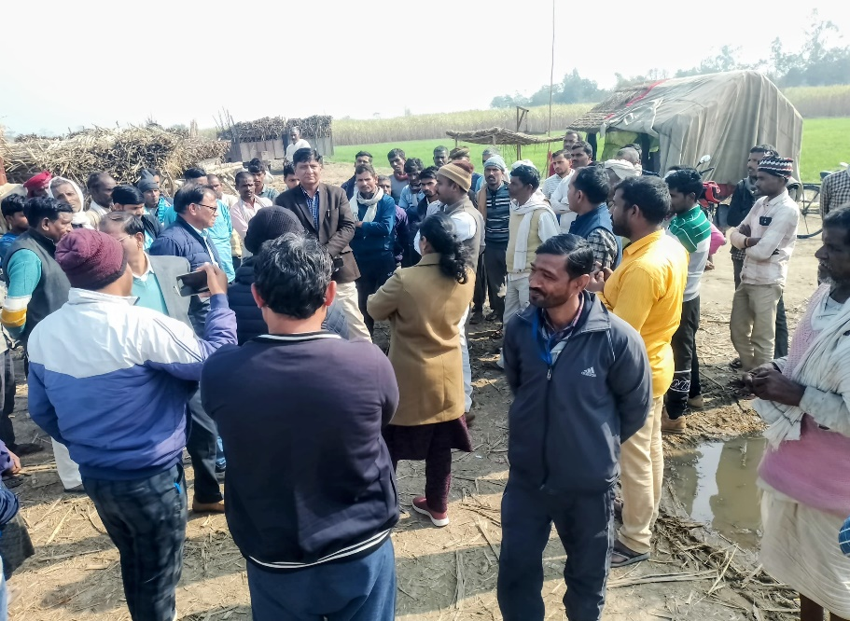
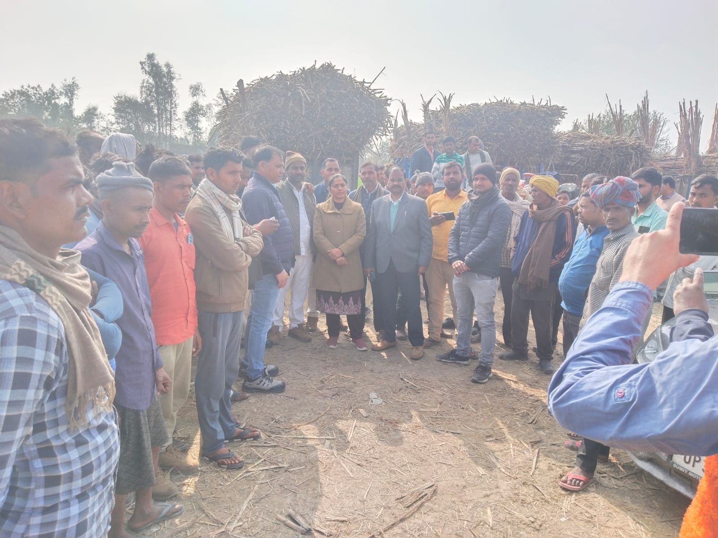
Field Visit By Dr. Manager Singh, Dr. Fawzia Tarannum

Slide 38
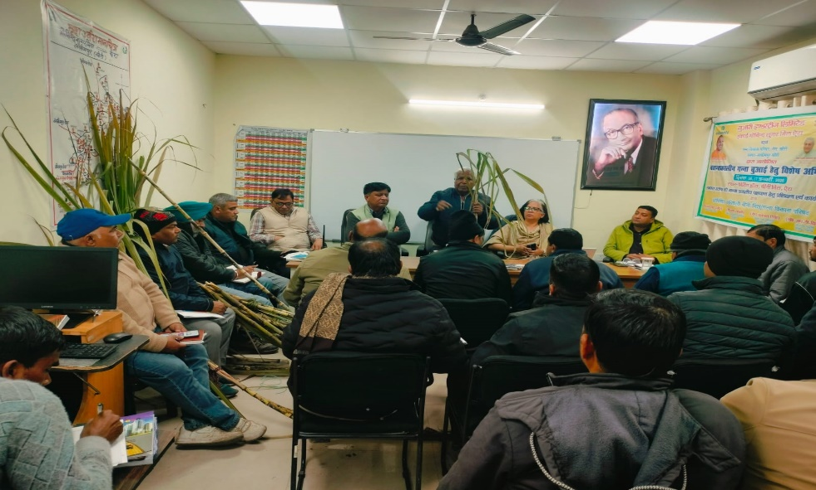
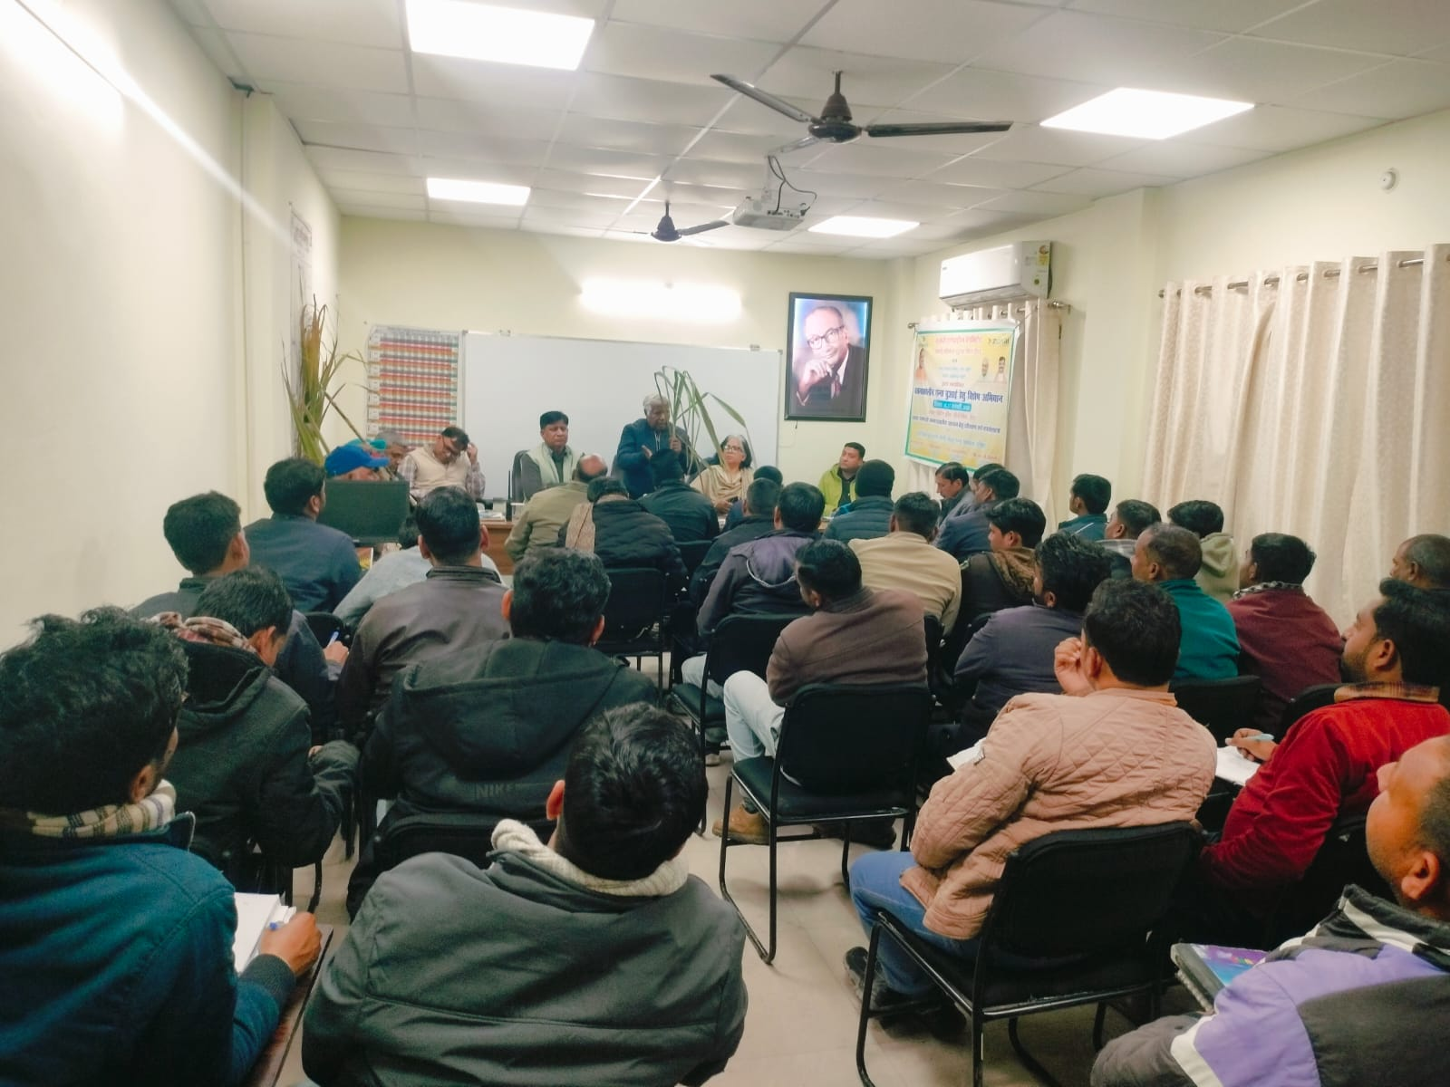
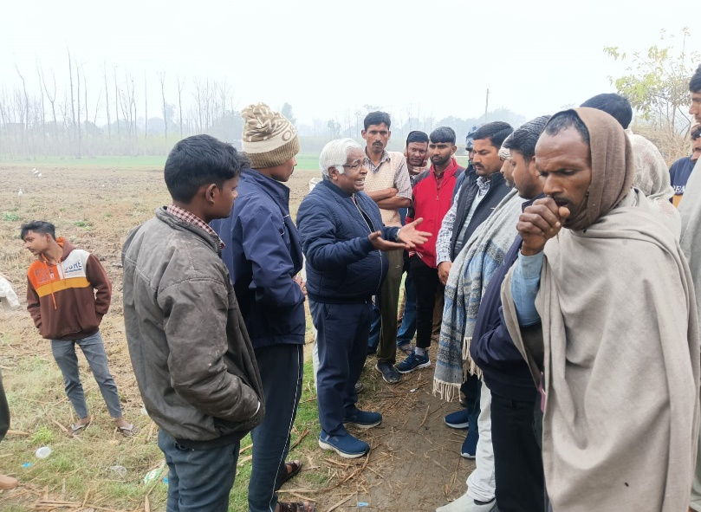
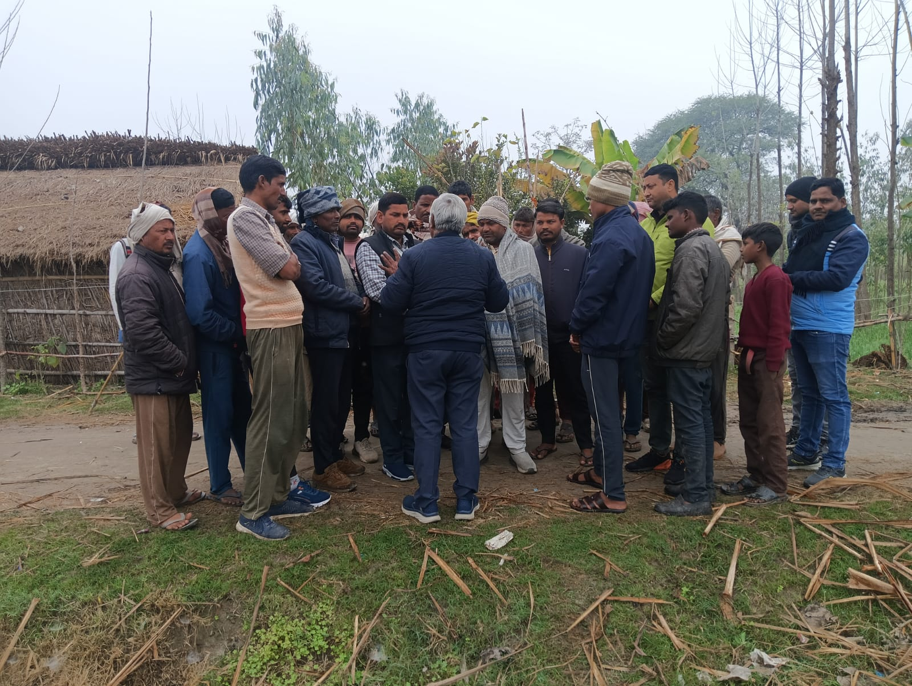
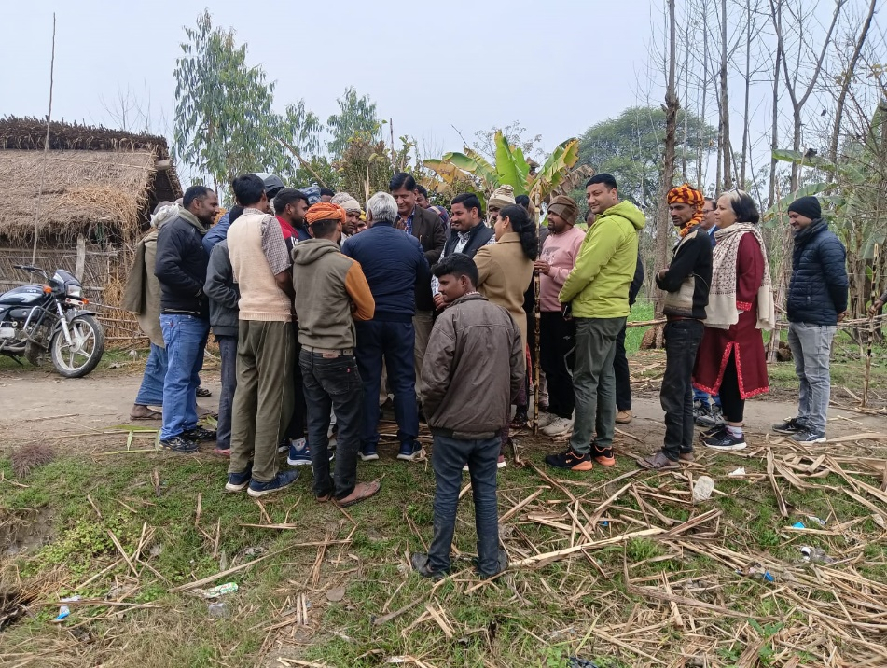
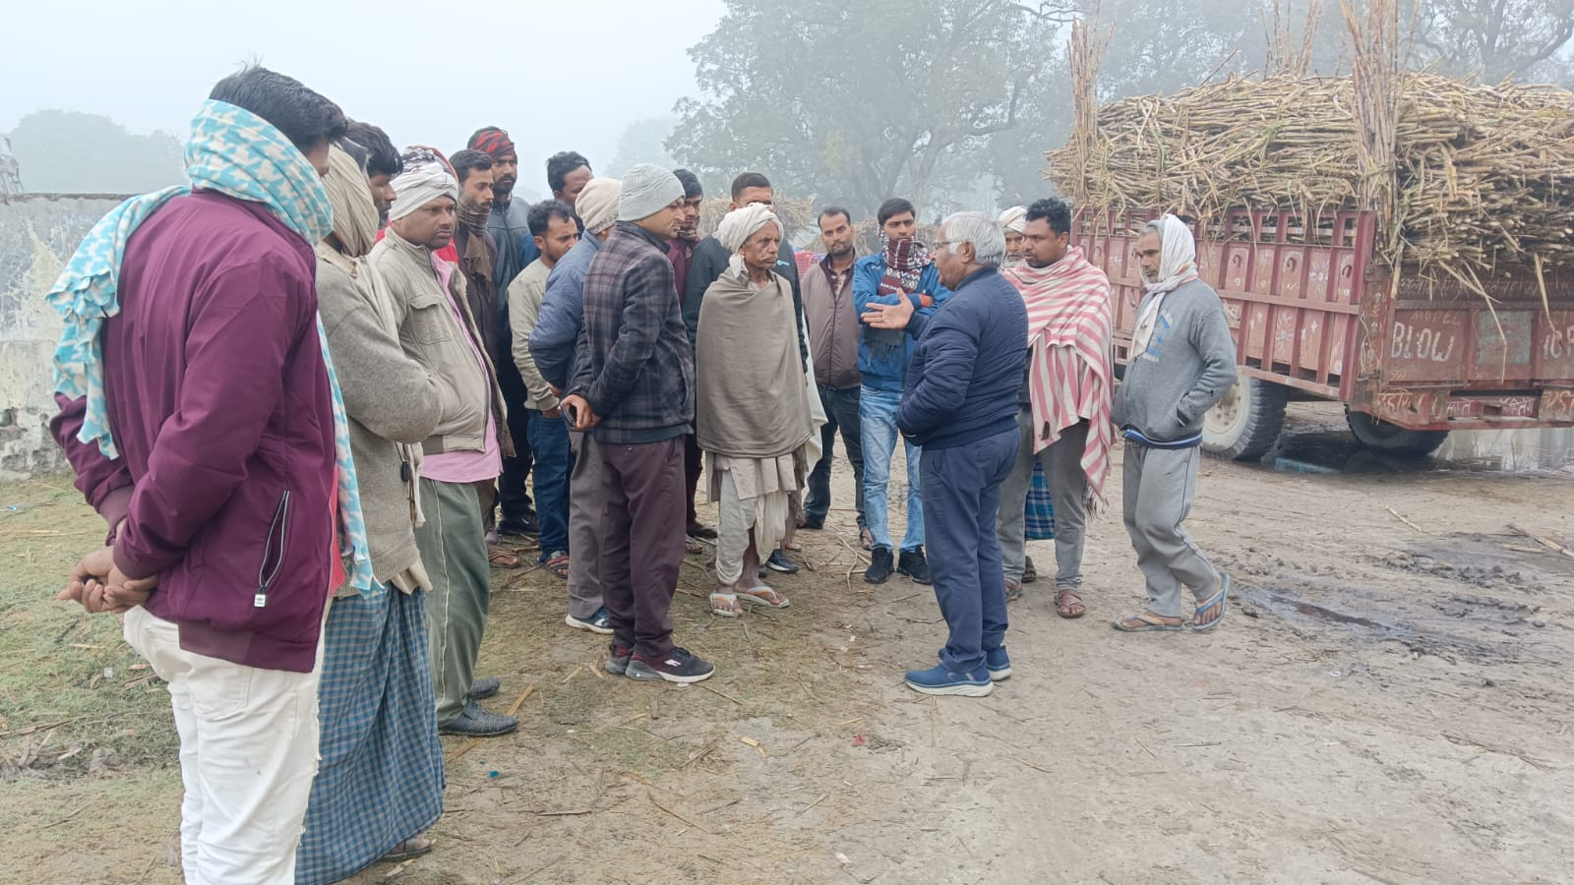
Field Visit and Staff Meeting By Dr. Manager Singh, Dr. Fawzia Tarannum

Slide 39
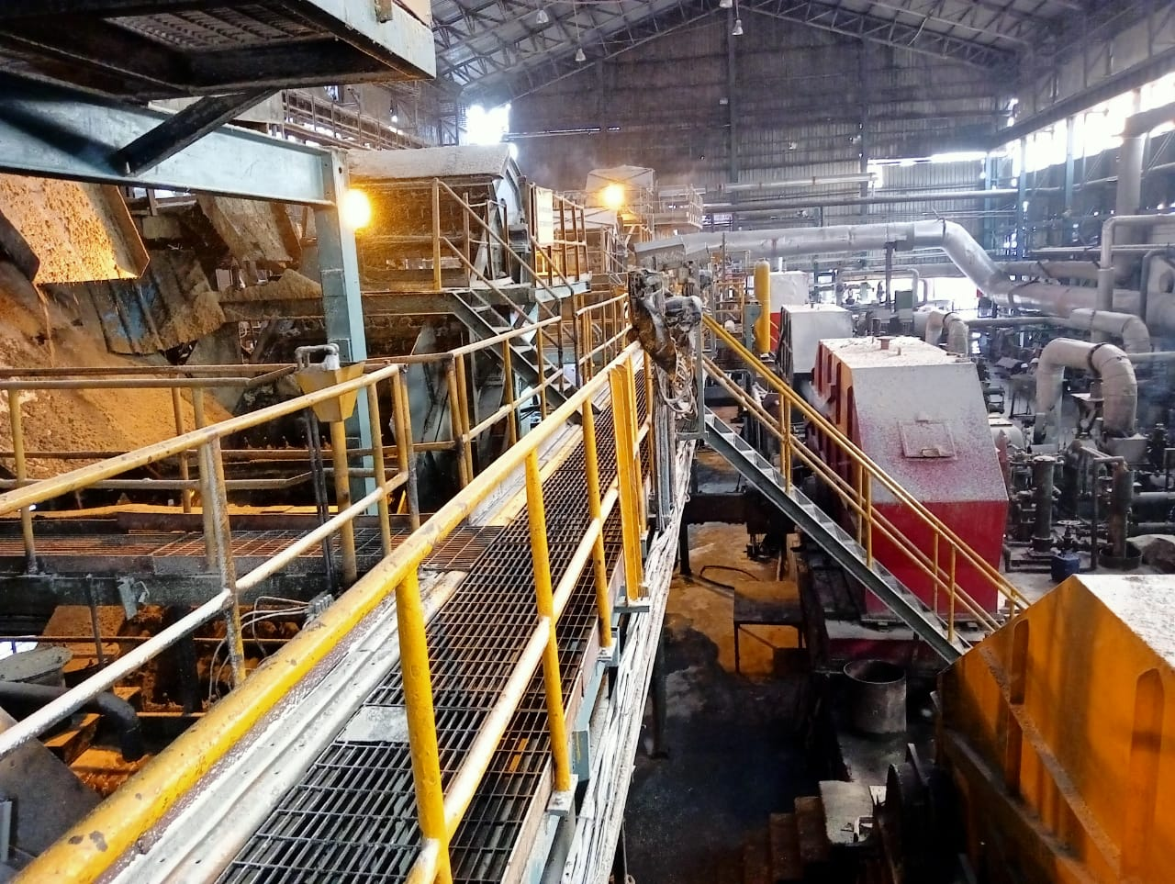
ENGINEERING

Slide 40
Mill No-3 both jiuce line to Mill No-2 found choked with bagasse and Cleaned.
Mill No-3 both jiuce line to Mill No-2 found choked with bagasse and Cleaned.
Mill No-3 both jiuce line to Mill No-2 found choked with bagasse and Cleaned.
Mill No-3 both jiuce line to Mill No-2 found choked with bagasse and Cleaned.
General Observations of the Week
The plant operation was smooth and consistent in last week.
In Last week Ever Highest Crush 1.105 was done on 25.01.26, except this
on dated 27.01- 1.09, 28.01- 1.10, 30.01-1.105, 31.01-1085 cane crushed @ JF 500 T/Hr.
On dated 29.01.26- General cleaning was done which was planned to be done on 01.02.26 but managed on 29.01 as cane availability was less due to rain in previous day. (Planned duration 8-9 Hrs., Actual- 7.48 Hrs.)
Juice flow may be maintained above 500 T/Hr in view of tank level at 500 JF ( at 500 JF- Tank level are max time above 90% and at this level carrier speed reduced)
Propose to issue work order for conversion of Cane Unloaders ( Mech- Hydraulic)- Approved in Capex 25-26
Long Delivery items with specification given to purchase on 23.01.26 to invite offers. As per last year we propose to issue PO in 1st week of March 26 so that all required materials may be received in June 26.
Mill secondary Gear Box SBN 630- Proposed to be procured new as all old ( 04 nos) aged, backlash increased and pitting found on teeth . (Details in next page….)

Slide 41
Key Operational Parameter- Current Season Vs Last Season
Particulars | Weekly |  | Till Date
 | SN. 25-26 | SN. 24-25 | SN. 25-26 | SN. 24-25
Hours Worked | 159.57 | 158.10 | 2300.18 | 2300.41
Hours Available | 168.00 | 168.00 | 2352.00 | 2352.00
Hours Utilized (%) | 95.21 | 94.15 | 97.80 | 97.82
Particulars | Weekly |  | To date
 | SN 25-26 | SN 24-25 | SN 25-26 | SN 24-25
Cane Crushed (In Qtls.) | 711500 | 689000 | 9903200 | 9280100
Rate of Crush | 101643 | 98429 | 101053 | 94695
Pol % Bagasse | 1.73 | 1.74 | 1.74 | 1.76
Loss in Bagasse % Cane | 0.49 | 0.47 | 0.49 | 0.48
Moisture % Bagasse | 50.20 | 49.34 | 50.13 | 49.97
Total Power kw/ Ton of cane | 32.38 | 31.29 | 31.89 | 32.42
Total Power MWH (Sugar) | 10.91 | 9.99 | 10.97 | 10.20
Lubricant Consumption. | 0.04 | 0.04 | 0.04 | 0.04

Slide 42
Weekly Performance Snapshot - Engineering
S.No. | Capacity Utilization | Target 2025-26 | Current Week. ( 25.01.26 to 31.01.26) | Last Week | Till Date (31.01.2026)
1 | Cane Crushed (LQ) (192 Days) | 179.00 | 7.115 | 7.145 | 99.032
2 | Hours Utilized (%) | 99.17 | 95.21 | 96.10 | 97.80
3 | Downtime (Hrs.) | 72.00 | 8.01 | 6.33 | 36.24
4 | Planned Stoppage (Hrs.) | 48.00 | 7.48 | 0.00 | 25.31
5 | Forced Shutdown (Hrs.) | 24.00 | 0.13 | 6.27 | 23.07
6 | Capacity Utilization in Uptime @ 1 LQ / Day Base (%) | 94.71 | 106.76 | 106.21 | 103.32
7 | Capacity Utilization incl. Stoppage (%) | 93.22 | 101.64 | 102.07 | 101.05
 | Quality
1 | Pol % Bagasse | 1.65 - 1.70 | 1.73 | 1.72 | 1.74
2 | Moisture % Bagasse | 49 - 49.5 | 50.20 | 50.16 | 50.13
 | Consumption
1 | Steam Consumption (KG/Qtl Cane) | 5.0-6.0 | 4.60 | 5.02 | 4.91
2 | Power Consumption (KW/T Cane) | 31.5 - 32 | 32.38 | 32.51 | 31.89
3 | Lubricant Consumption (Kg/100 Qtl Cane) | 0.04 | 0.04 | 0.04 | 0.04
42

Slide 43
Monthly figure
Plant Performance in Season 25-26
Sr No | Particulars | Unit | Season 25-26
 |  |  | Target | Achieved (31.01.2026)
1 | Total Cane Crushed | Qtls | 17900000 | 9903200
2 | Date of Start | Date | 20/10/2025 | 26/10/2025
3 | Date of Finish | Date | 23/04/2026 | -
4 | Gross Season Days | Nos | 192 | 98
5 | Crushing rate Including Stoppage | Qtls | 93229 | 101053
6 | Crushing rate Excluding stoppage | Qtls | 94709 | 103324
7 | Capacity Utilization | % | 94.71 | 103.32
8 | Total Stoppage Hours | Hrs. | 72.00 | 51.42
9 | Planned Shutdown | Hrs. | 48.00 | 25.31
10 | Forced Shutdown | Hrs. | 24:00 | 23.07
11 | Preparatory index | % | 90.0-91.0 | 90.18
12 | Primary Extraction | % | 70.5-71.0 | 71.34
13 | Mill Extraction ( ME) | % | 96 - 96.5 | 96.04
14 | Reduced mill Extraction (RME) | % | 96.4 - 96.80 | 96.33
15 | Bagasse % Cane | % | 29.00 | 28.14
16 | Pol % Bagasse | % | 1.65-1.70 | 1.74
17 | Moisture % Bagasse | % | 49.0 - 49.5 | 50.13
18 | Imbibition % Cane | % | 40 Max | 37.62
19 | Imbibition % Fibre | % | 290 - 295 | 281.79
20 | Dry Milling Factor | % | 71.25 | 71.45
21 | Grease & Lubricants Kg/100 Qtls Cane | % | 0.04 | 0.04
22 | Power Consumption ( KW/T Cane) | % | 31.5 - 32 | 31.89
23 | Steam Consumption Sugar (Kg/Q of Cane) | % | 5.0-6.0 | 4.91
43

Slide 44
Stoppages, Actions & RCA for the Week
Stoppage Details Crushing Season 2025-26
S NO | Report Date | Head | Section | Equipment Name | Type | From | To | Duration in Hrs | Stoppages Reason
129 | 26/01/2026 | Mechanical | SRC & IRC | IRC No-1 | Forced Shutdown | 26/01/2026 15:13 | 26/01/2026 15:20 | 0:07:00 | IRC No-1 tripped due to overload.
130 | 26/01/2026 | Mechanical | Cane Preparation | Feeder Drum | Forced Shutdown | 26/01/2026 18:15 | 26/01/2026 18:17 | 0:02:00 | Feeder Drum Tripped Due to high load
131 | 27/01/2026 | Miscellaneous | Cane Preparation | Magnetic Separator | Miscellaneous | 27/01/2026 17:44 | 27/01/2026 17:46 | 0:02:00 | Foreign Material found in Magnet.
132 | 28/01/2026 | Mechanical | Cane Preparation | Feeder Drum | Forced Shutdown | 29/01/2026 06:07 | 29/01/2026 06:10 | 0:03:00 | Feeder Drum Tripped Due to high load
133 | 29/01/2026 | General Cleaning | General Cleaning | General Cleaning | Planned Stoppage | 29/01/2026 10:24 | 29/01/2026 18:12 | 7:48:00 | General Cleaning ( Shortage of Cane due to rainy Weather) Hammer with tips Replaced by new , Mill No-3 Top Scrapper Replaced by new & Mill No-2 Discharge Scrapper Teeth Repairing done.
134 | 31/01/2026 | Mechanical | Cane Preparation | Feeder Drum | Forced Shutdown | 01/02/2026 02:34 | 01/02/2026 02:35 | 0:01:00 | Feeder Drum Tripped Due to high load
 |  |  |  |  |  |  | Total Hrs | 8.03

Slide 45
Total Stoppages CONPARETIVE SUMMARY - INCIDENCE REPORT Mill Stoppage.
S.NO | PARTICULAR | SEASON 2019-20 | SEASON 2020-21 | SEASON 2021-22 | SEASON 2022-23 | SEASON 2023-24 | SEASON 2024-25 | SEASON 2025-26
A | Mechanical Stoppage Details
1 | CANE UNLOADER | 00:00:00 | 00:45:00 | 00:13:00 | 00:15:00 | 00:00:00 | 00:00:00 | 00:00:00
2 | CANE CARRIER | 68:17:00 | 01:51:00 | 08:48:00 | 07:19:00 | 00:18:00 | 01:56:00 | 01:16:00
3 | CANE JAMMING NEAR CANE KICKER | 01:01:00 | 00:52:00 | 00:00:00 | 00:19:00 | 00:00:00 | 00:28:00 | 00:00:00
4 | FEEDER DRUM TRIPPED | 02:40:00 | 02:07:00 | 00:08:00 | 00:00:00 | 00:17:00 | 01:46:00 | 03:27:00
5 | SHREDDER | 01:39:00 | 07:31:00 | 00:40:00 | 38:46:00 | 105:00:00 | 02:29:00 | 03:33:00
6 | SHREDDER KICKER | 03:28:00 | 00:00:00 | 00:00:00 | 00:00:00 | 00:00:00 | 00:00:00 | 00:00:00
7 | CANE BELT CONVEYOR | 00:12:00 | 01:10:00 | 00:00:00 | 00:00:00 | 12:48:00 | 00:12:00 | 00:00:00
8 | RAKE CARRIER & INTER CARRIER | 26:35:00 | 05:00:00 | 17:43:00 | 09:30:00 | 09:08:00 | 03:13:00 | 10:59:00
9 | MILLS | 04:30:00 | 20:56:00 | 08:01:00 | 02:00:00 | 03:54:00 | 00:34:00 | 01:13:00
10 | DONALLY CHUTE | 00:00:00 | 10:26:00 | 06:29:00 | 02:22:00 | 00:50:00 | 01:58:00 | 00:08:00
11 | JUICE TRAY JAMMING | 00:00:00 | 01:38:00 | 00:00:00 | 00:00:00 | 00:00:00 | 00:00:00 | 00:00:00
12 | TURBINE | 03:28:00 | 00:50:00 | 01:29:00 | 00:00:00 | 00:24:00 | 00:00:00 | 00:29:00
13 | BOILING HOUSE | 03:57:00 | 00:00:00 | 05:21:00 | 00:49:00 | 01:15:00 | 00:00:00 | 00:00:00
14 | Total Mechanical (MILL & BH) | 115:47:00 | 53:06:00 | 48:52:00 | 61:20:00 | 133:54:00 | 12:36:00 | 21:05:00
B | Total Stoppage Details
1 | NO CANE | 162:44:00 | 101:22:00 | 63:23:00 | 43:36:00 | 42:40:00 | 32:55:00 | 0:00:00
2 | WEATHER | 00:00:00 | 00:00:00 | 20:39:00 | 00:00:00 | 00:00:00 | 0:00:00 | 0:00:00
3 | CRUSH REDUCE | 00:00:00 | 01:51:00 | 02:43:00 | 04:05:00 | 15:55:00 | 0:00:00 | 0:00:00
4 | MECHANICAL | 115:47:00 | 53:10:00 | 48:52:00 | 61:20:00 | 135:54:00 | 12:36:00 | 21:05:00
5 | PROCESS | 00:40:00 | 00:24:00 | 02:00:00 | 00:00:00 | 00:00:00 | 0:00:00 | 0:00:00
6 | GENERAL CLEANING | 41:31:00 | 45:05:00 | 54:09:00 | 97:53:00 | 58:04:00 | 35:15:00 | 20:08:00
7 | GROWER STRIKE | 56:48:00 | 12:00:00 | 00:00:00 | 00:00:00 | 00:00:00 | 0:00:00 | 0:00:00
8 | MISE | 20:39:00 | 00:55:00 | 02:40:00 | 00:45:00 | 02:41:00 | 4:37:00 | 6:12:00
9 | ELECTRICAL | 05:29:00 | 04:45:00 | 03:00:00 | 11:33:00 | 02:13:00 | 9:12:00 | 0:29:00
10 | BOILER | 23:00:00 | 11:59:00 | 06:23:00 | 29:48:00 | 00:26:00 | 2:53:00 | 2:10:00
11 | INSTRUMENT | 00:56:00 | 00:30:00 | 00:00:00 | 00:12:00 | 02:04:00 | 0:18:00 | 1:38:00
12 | TOTAL STOPPAGE | 427:34:00 | 232:01:00 | 203:49:00 | 249:12:00 | 259:57:00 | 97:46:00 | 51:42:00

Slide 46
Monthly Comparative Data (Season 2023-24 to 2025-26)
S No | Description | Unit | Crushing Season 2025-26 |  |  | Crushing Season 2024-25 |  |  | Crushing Season 2023-24
 |  |  | November | December | January | November | December | January | November | December | January
1 | Total Cane Crushed | Qtls. | 3055700 | 3247100 | 3175000 | 2777600 | 3062400 | 3097600 | 862300 | 2724600 | 2902400
2 | Gross Season Days | Nos | 30 | 31 | 31 | 30 | 31 | 31 | 15 | 31 | 31
3 | Crushing rate Including Stoppage | Qtls | 101857 | 104745 | 102419 | 92587 | 98787 | 99923 | 57487 | 87890 | 93626
4 | Crushing rate Excluding stoppage | Qtls | 103620 | 106419 | 106106 | 93869 | 100877 | 103476 | 63146 | 97583 | 96082
5 | Total Hrs Available | Hrs | 720:00 | 744:00 | 744:00 | 720:00 | 744:00 | 744:00 | 360:00 | 744:00 | 744:00
6 | Days Worked | Nos | 29.49 | 30.51 | 29.92 | 29.59 | 30.36 | 29.94 | 13.66 | 27.92 | 30.21
7 | Hrs Worked | Hrs | 707:45 | 732:18 | 718:09 | 710:10 | 728:35 | 718:27 | 327:44 | 670:06 | 724:59
8 | Capacity Utilization | % | 98.30 | 98.43 | 96.53 | 98.63 | 97.93 | 96.57 | 91.04 | 90.07 | 97.44
9 | Total Stoppage Hours | Hrs. | 12:15 | 11:42 | 25:51 | 9:50 | 15:25 | 25:33 | 32:16 | 73:54 | 19:01
10 | Above 100000 Qtls Cane Crushing | Days | 25 | 30 | 28 | 19 | 22 | 26 | 0 | 13 | 20
11 | Highest Cane Crushing in Days | Qtls | 108500 | 110000 | 110500 | 102000 | 104000 | 109000 | 90200 | 101000 | 102500
12 | Pol % Bagasse | % | 1.76 | 1.71 | 1.72 | 1.80 | 1.72 | 1.73 | 1.86 | 1.91 | 1.93
13 | Moisture % Bagasse | % | 50.18 | 50.05 | 50.14 | 50.34 | 49.73 | 49.50 | 51.39 | 50.38 | 49.89
14 | Power Consumption ( KW/T Cane) | % | 32.21 | 32.05 | 31.74 | 33.07 | 32.71 | 31.73 | 37.00 | 31.55 | 32.67

Slide 47
Sugar Power Consumption Breakup ( MWH)
Sugar Power Consumption Breakup ( MWH)
S No | Date | Cane Crushed (QTLS) |  | SHREDDER-1&2 (MW/Hrs.) |  | Zero & 4th Mill (MW/Hrs.) |  | DS House (MW/Hrs.) |  | Raw & Ref. House (MW/Hrs.) |  | Total Power Consumption
 |  | 24-25 | 25-26 | 24-25 | 25-26 | 24-25 | 25-26 | 24-25 | 25-26 | 24-25 | 25-26 | 24-25 | 25-26
91 | 25-Jan | 104000 | 110500 | 4.05 | 4.38 | 0.84 | 0.84 | 2.04 | 2.24 | 1.96 | 2.07 | 11.01 | 11.79
92 | 26-Jan | 105600 | 106000 | 4.08 | 4.36 | 0.85 | 0.82 | 2.02 | 2.24 | 2.03 | 2.12 | 11.12 | 11.81
93 | 27-Jan | 102400 | 109000 | 4.07 | 4.43 | 0.84 | 0.83 | 2.00 | 2.26 | 2.05 | 2.06 | 11.15 | 11.81
94 | 28-Jan | 59000 | 110000 | 1.68 | 4.53 | 0.47 | 0.79 | 1.53 | 2.37 | 1.54 | 2.16 | 6.95 | 12.06
95 | 29-Jan | 109000 | 57000 | 3.07 | 1.78 | 0.86 | 0.42 | 2.00 | 1.74 | 1.96 | 1.73 | 10.11 | 7.31
96 | 30-Jan | 104200 | 110500 | 3.00 | 3.22 | 0.81 | 0.81 | 2.02 | 2.27 | 1.98 | 2.03 | 10.01 | 10.67
97 | 31-Jan | 105000 | 108500 | 3.17 | 3.42 | 0.83 | 0.81 | 2.03 | 2.38 | 2.07 | 2.03 | 10.28 | 10.92

Slide 48
Milling Data
Crop Day | Date | Cane Crush in Qlts |  | Av Crush Rate Excl Stopp |  | Imbibition % Fiber |  | Maceration % Cane |  | Bag Pol |  | Bag Moisture |  | Power kw / T Cane |  | Stoppage
 |  | On date | To date | On Day | To date | On date | To date | On date | To date | On date | To date | On date | To date | On date | To date | To date | Reduce Crush
 | Target | 93229 | 17900000 |  |  | 290-295 |  | 40% Max |  | 1.65-1.70 |  | 49.00-49.5 |  | 31.50-32.00 |  | 72
92 | 25/01/2026 | 110500 | 9302200 | 110500 | 103150 | 291.14 | 280.95 | 39.86 | 37.48 | 1.72 | 1.74 | 50.20 | 50.13 | 31.06 | 31.89 | 0:00 | 0
93 | 26/01/2026 | 106000 | 9408200 | 106667 | 103188 | 294.10 | 281.11 | 40.42 | 37.52 | 1.72 | 1.74 | 50.15 | 50.13 | 32.41 | 31.90 | 0:09 | 0
94 | 27/01/2026 | 109000 | 9517200 | 109151 | 103253 | 294.71 | 281.27 | 39.95 | 37.54 | 1.72 | 1.74 | 50.23 | 50.13 | 31.58 | 31.89 | 0:02 | 0
95 | 28/01/2026 | 110000 | 9627200 | 110230 | 103328 | 292.69 | 281.41 | 39.55 | 37.57 | 1.71 | 1.74 | 50.12 | 50.13 | 31.79 | 31.89 | 0:03 | 0
96 | 29/01/2026 | 57000 | 9684200 | 84445 | 103192 | 298.54 | 291.50 | 39.70 | 37.58 | 1.80 | 1.74 | 50.42 | 50.13 | 41.27 | 31.95 | 7:48 | Mill Started at 6.12PM, DS 150 & Ref 160 Juice Flow & Increase 260 & 240 at 5.39 AM due to 70 TPH Boiler W S Cleaning work.
97 | 30/01/2026 | 110500 | 9794700 | 110500 | 103268 | 289.41 | 281.61 | 39.06 | 17.60 | 1.72 | 1.74 | 50.07 | 50.13 | 28.71 | 31.91 | 0:00 | DS Side Juice Flow reduced due to low Steam Pressure.
98 | 31/01/2026 | 108500 | 9903200 | 108575 | 103324 | 298.33 | 281.79 | 39.85 | 37.62 | 1.72 | 1.74 | 50.20 | 50.13 | 29.82 | 31.89 | 0:01 | DS Side Juice Flow Reduced due to Syrup overload

Slide 49
Vibration & Motor Power Data for Shredder Rotor
Crop Day | Date | Crush |  | Shredder Vibration & Bearing Temp ( LHS ) -1 |  |  |  |  | Shredder Vibration & Bearing Temp (RHS)-2
 |  | On date | To date | Motor LHS Power | Brg Temp (Avg) | V (Avg) | H (Avg) | A (Avg) | Motor RHS Power | Brg Temp (Avg) | V (Avg) | H (Avg) | A (Avg)
92 | 25/01/2026 | 110500 | 9302200 | 117.34 | 55.21 | 2.12 | 1.19 | 4.55 | 120.62 | 56.26 | 1.68 | 1.04 | 3.38
93 | 26/01/2026 | 106000 | 9408200 | 117.89 | 55.28 | 1.76 | 1.11 | 3.38 | 120.89 | 55.94 | 1.46 | 1.01 | 2.77
94 | 27/01/2026 | 109000 | 9517200 | 118.70 | 55.04 | 1.89 | 1.14 | 3.72 | 121.55 | 56.05 | 1.47 | 1.00 | 2.69
95 | 28/01/2026 | 110000 | 9627200 | 121.70 | 57.05 | 1.61 | 1.22 | 3.40 | 124.48 | 56.39 | 1.58 | 1.06 | 2.74
96 | 29/01/2026 | 57000 | 9684200 | 50.71 | 44.34 | 2.60 | 2.57 | 2.90 | 50.55 | 42.55 | 0.85 | 0.92 | 1.62
97 | 30/01/2026 | 110500 | 9794700 | 86.67 | 57.49 | 1.74 | 0.76 | 2.95 | 87.99 | 54.87 | 1.41 | 1.19 | 2.69
98 | 31/01/2026 | 108500 | 9903200 | 91.71 | 58.25 | 1.77 | 1.57 | 3.18 | 93.29 | 53.58 | 1.50 | 1.35 | 2.88

Slide 50
Comparative Data Season 2024-25 Vs Season 2025-26 on crop day
Crop Day | Date | CRUSHING |  | POL % |  | MOIST % |  | SHREDDER MOTOR LOAD IN AMP Avg |  | FIBER %
 |  | Season 2025-26 | Season 2024-25 | Season 2025-26 | Season 2024-25 | Season 2025-26 | Season 2024-25 | Season 2025-26 | Season 2024-25 | Season 2025-26 | Season 2024-25
87 | 20/01/2026 | 77000 | 105800 | 1.75 | 1.74 | 50.5 | 49.23 | 71.13 | 106.96 | 13.79 | 12.96
88 | 21/01/2026 | 107500 | 103500 | 1.71 | 1.72 | 50.07 | 49.43 | 88.03 | 107.57 | 14.00 | 12.93
89 | 22/01/2026 | 107000 | 101300 | 1.72 | 1.74 | 50.05 | 49.50 | 89.70 | 106.99 | 13.88 | 12.90
90 | 23/01/2026 | 100500 | 103500 | 1.71 | 1.73 | 50.18 | 49.18 | 87.58 | 106.19 | 13.74 | 13.04
91 | 24/01/2026 | 107000 | 105000 | 1.73 | 1.75 | 50.15 | 49.17 | 91.81 | 109.22 | 13.76 | 13.06
92 | 25/01/2026 | 110500 | 104000 | 1.72 | 1.76 | 50.2 | 49.35 | 93.44 | 109.83 | 13.69 | 12.97
93 | 26/01/2026 | 106000 | 105600 | 1.72 | 1.74 | 50.15 | 49.25 | 92.92 | 110.71 | 13.74 | 13.06
94 | 27/01/2026 | 109000 | 102400 | 1.72 | 1.74 | 50.23 | 49.35 | 93.55 | 110.64 | 13.56 | 13.05
95 | 28/01/2026 | 110000 | 59000 | 1.71 | 1.80 | 50.12 | 49.30 | 95.34 | 45.76 | 13.51 | 12.96
96 | 29/01/2026 | 57000 | 109000 | 1.8 | 1.71 | 50.42 | 49.13 | 47.38 | 83.34 | 13.30 | 13.10
97 | 30/01/2026 | 110500 | 104200 | 1.72 | 1.73 | 50.07 | 49.25 | 77.16 | 82.02 | 13.50 | 13.04
98 | 31/01/2026 | 108500 | 105000 | 1.72 | 1.76 | 50.2 | 49.55 | 81.01 | 86.45 | 13.36 | 12.99

Slide 51
General Cleaning Major Jobs done 29.01.2026 (Mill House)
4th GEN. CLEANING MILL HOUSE on Date 29.01..2026/ No Cane on Today/Night(Any Time/Any day) due to Rainy Time:5-6 Hrs at 8am
 | Responsibility.- Chief Manager / DGM -Engg
Sl.No | Work Description | Responsibility | Material Reqd | Mat status | Approx. time | Engineer | Status 30.01.2026
1 | A. To be change of Shredder Hammers. B. To be checking /replacement of both side coupling pins. Cleaning of oil filters of shredder ,MCC,0 M | Shivpal, Mukesh(CUO), Sunil vishwakarma, Suresh CUO, Ramchandra Shukla, Upender Khalasi, Balister, Rajkumar Pandey, Jamuna, Rishi, Ramnaresh Yadav, Ramparvesh , Naresh Khalasi, Satish Pandey & Hari Singh 4 nos labour(2 LH/RH side) | New Hammers /Torq Wrench | Available | 5-6 hrs | Devesh Kumar | Work Completed ( All Hammer Replaced by New)
 | LHS Out side for Manki | Sunil Vishwakarma, Ramnaresh Yadav, Ramparvesh Yadav, Naresh Kh.& Ramavtar & 2 labour harisingh
 | RHS Outside for Manki | Balister, Jamuna, Rishi, Upendra, Rajkumar Pandey & 2 labour harisingh
 | Inside | Mukesh, Satish Pandey, Ramchandra Shukla, Suresh(CUO)
2 | A. Slat cleaning brush drive chain to be replacement. B. Belt skirting replacement of slat clng brush. | Daharamdev, Dharmendra, Ramnaresh Murli |  |  | 2-3 Hrs | do | Work Completed
 | C.Both side angle guide to be check under Shredder. | Shivpal,Thrayil Contractor. | ISA | Available | 2-3Hr | do | Work Completed
3 | a.Routine checking of Shredder Elevator & all IRC. B.To be checking /replacement of Missing /loose bolts of SRC/IRC No 2. C. Spokes length to be increase of IRC 2. | Chottey, Babunand, Balakram, Sher Singh Welder, Tharayil Gang(Distillery gang) | Bolts & tool tackles etc | Available | 4-5 hrs | Faizan | IRC No-1, 8 Nos Bend fingers pending for Straightening. IRC No-3 Loosining rake pad bolt pending) Remaining all work completed.
4 | A.To be change of delivery NRV of DS pump. B.Checking & gland packing filling of all pumps & valves throughly.(Sply Hot Water Pump & Valve) | Karamchand,Manoj,Premkant(Pump Attd), Hyadra |  | Available | 3-4hrs |  | Work Completed
5 | A. To be checking of Mill No 2 T.Gear out put brg. B. Gen.Checking of all Mill transmission gear. C.Greasing of Input shaft of T.Gearing. | Gurmeet, Mohit, Sunil Pd for EOT | Grinder etc | Available | 3 hrs | Dinesh Kushwah | Work Completed
6 | A.Repairing/Replacement Disch scrapper of Mill No 2. B.Routine checking of Mill 0,1,2 ,TUFR Scrapers gap of Mill, trash plate, scrapper end teeth cutting,& meschart knives incl transmission gearing bolt and Specially All Notch Plate gap. C.To be throughly checking & fitting of 2 bolts of TUFR Roller bearin block & checking of TUFR scrapper gap of Mill no 2. D.To be tightning of RLD scrapper of zero mill. | Nekram, Ramashish, Manoj welder, Dhanajay Rai foreman, Rajkumar, Sunil, Rampal. | Hard facing & ss electrode,meschart knives. | Available | 4-5 Hrs |  | Mill No-2 Discharge scrapper teeth repairing work completed
 | E.To be checking Notch plate gap of Mill 1&2.(First priority) | do | do | do |  | do | Done

Slide 52
General Cleaning Major Jobs done 29.01.2026 (Mill House)
4th GEN. CLEANING MILL HOUSE on Date 29.01.2026/ No Cane on Today/Night(Any Time/Any day) due to Rainy Time:5-6 Hrs at 8am
 | Responsibility.- Chief Manager / DGM -Engg
Sl. | Work Description | Responsibility | Material Reqd | Mat status | Approx. time | Engineer | Status 30.01.2026
 | E.To be checking Notch plate gap of Mill 1&2.(First priority) | do | do | do |  | do | Done
7 | Arcing of Zero,M1 Top & 4th Mill top roller on priority. | Ramkishore, Ankur & Vijay , Deena | Azucar 80 | Available | 5-6 hrs | do | Zero & 4th Mill Arcing done
8 | a. All Mill Rope Coupling /Messeheart knife checking work | Udesh sharma,Tejpratap, Dhanjay formen | BOLT & NUT M24,20 | Available | 3 Hrs | Dinesh Kushwah | Work Completed
9 | a. Replacement of 3rd Mill top scraper.(First Priority) b. Routine checking of 3rd & 4th as 3rd TUFR Scraper, Trash plate, scrapper side teeth cutting & Nose Plate etc . c. To be tightening of RLD Scraper of 4th Mill. | Gajendra, Papu, Manoj Welder, Dhanjay Rai, Sunil & Rampal Khalasi | Top scraper &Electrodes 6006 | Available | 4-5Hrs | Dinesh Kushwah | 3rd Mill Top Scrapper replaced by new. Other work Done
 | d.To be checking Notch plate gap of Mill No 3(First priority) | do | do | do | 3-4 Hrs |  | Work Completed
10 | Kicker knives checking, MCC & ACC chain tightening as reqd etc. | Dharamdev, Dharmendra, Ram Naresh murli | HT Bolt with nylock nut 24x110 | Available | 1-1.5 hrs | Ravi saxsena | Work Completed
11 | A. All Mill bearings checking specially M1F, 2D & M3F incl leaking. B.To be greasing of input T.Gear brg and couplings. | Jagdish (oilman), Anil (CUO), Hari singh labour no.1 |  | Available | 3-4 hrs | Dinesh kushwah | Bearing checking done found OK . Greasing done.
12 | A. To be checking of thrust wheel brackets bolts of Big rotary screen. B.Rotary screen Washing by Caustik firstly Primery and than both Secondary. C.To be cleaned nozzles of water washing header of all rotary screen. | Suresh Sharma, Baburam Sajjan & Hari Singh Contractor manpower | Caustic, Tool &tackles | Available | 4-5 hrs | Raviraj Saxsena | Work Completed
13 | A. All Juice tanks dummy to be open/boxup after washing. B.To be flushing of both imbibition header. | Santosh Fitter, Kurendra |  | Available | 3 hrs |  | Work Completed
14 | MCC slat Wear pad welding work, (to be attend on priority) | Shaban, Shersingh, Chandra Prakash(W/S), Ramjiwan Cont, | Two Welding Machines (Tharayil), 1 Cane Dept, 1 W/s & Wear Pads | Available | 5-6 hrs |  | 90% work completed

Slide 53
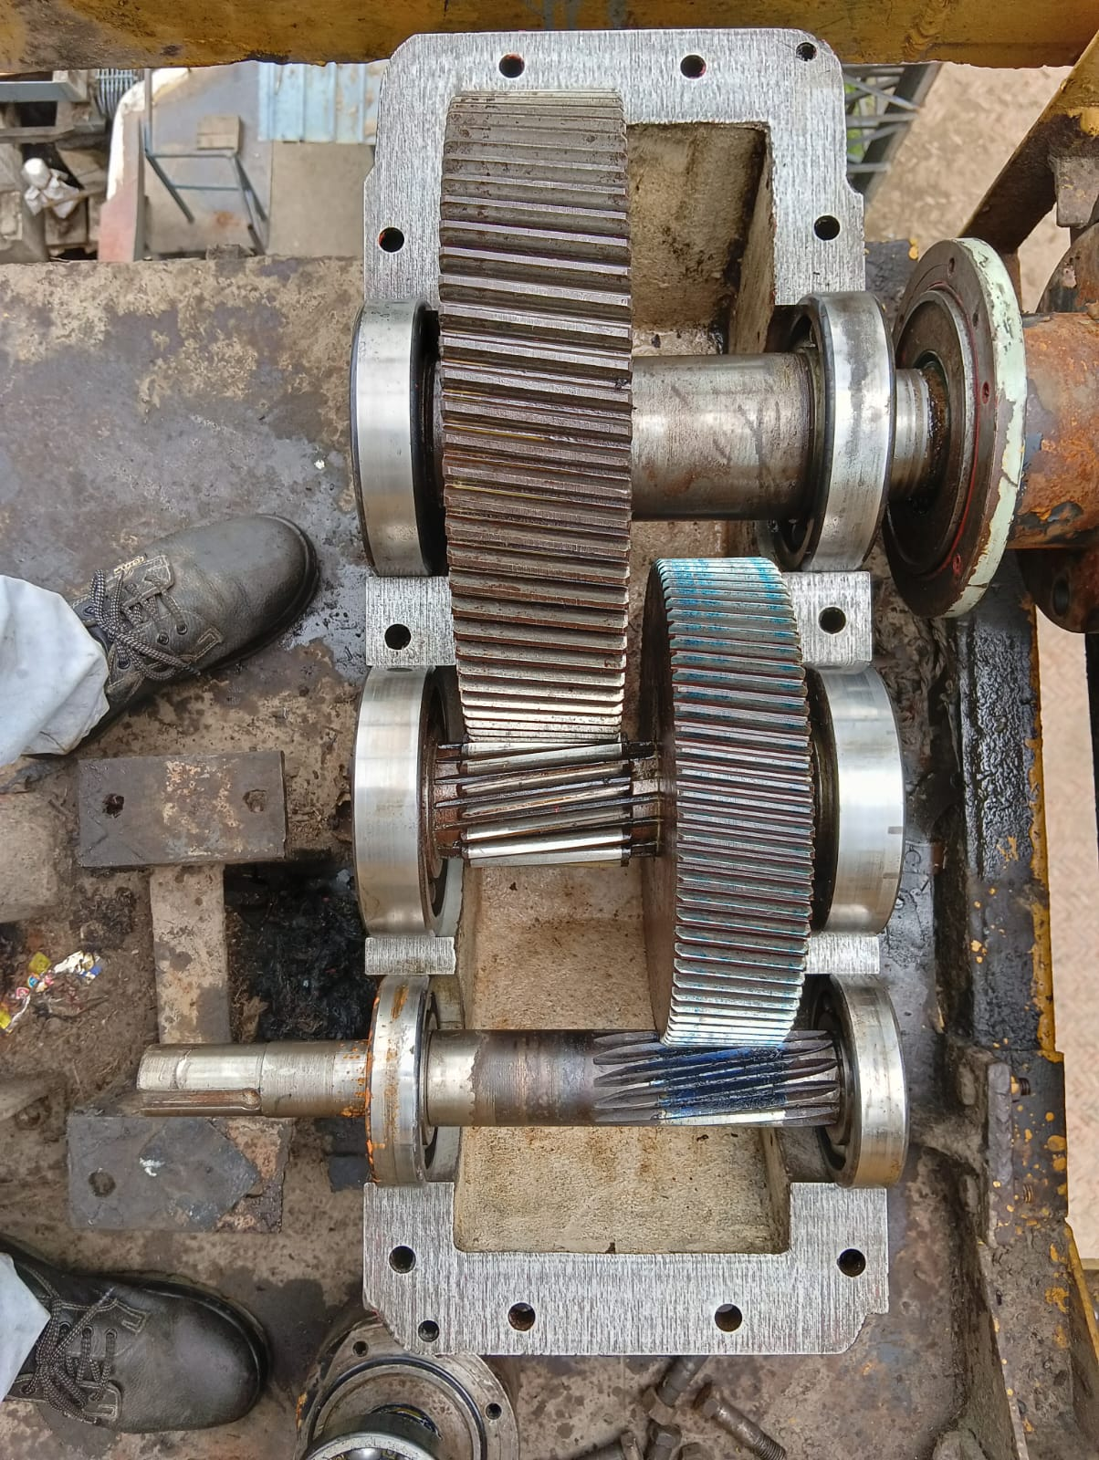
Capex Job
SBN 630 Gear Box for Mill No-1,2,3,& 4 Report (off Season 2025)
Observation Noted
Heavy pitting found output shaft at mill & turbine side bottom cover bearing seat for all mill FMG.
Minor pitting found of out put shaft top bearing cover bearing seat for all mill FMG
Minor pitting found at gear & Pinion teeth of output shaft for all mill FMG
Minor pitting on gear & Pinion Teeth 02 Nos out of 18 nos.
Minor Chip out on gear teeth 09 nos. out of 61 nos. teeth
Impression also found on bearing outer race. Bearing Rollers found OK. Present bearing 23064 b clearance 0.27 mm/0.35 mm(T/M)
Pitting found at mill side top cover bearing seat.
Gear teeth condition found okay (Minor Scratch

Slide 54
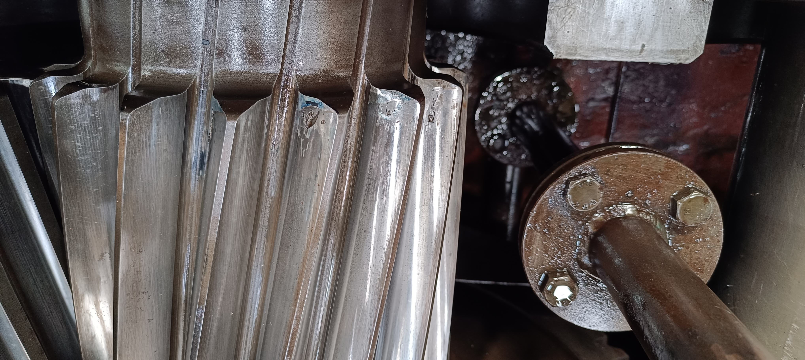
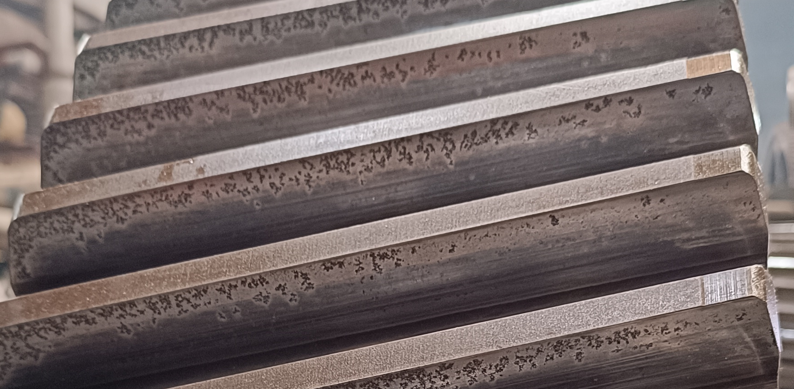
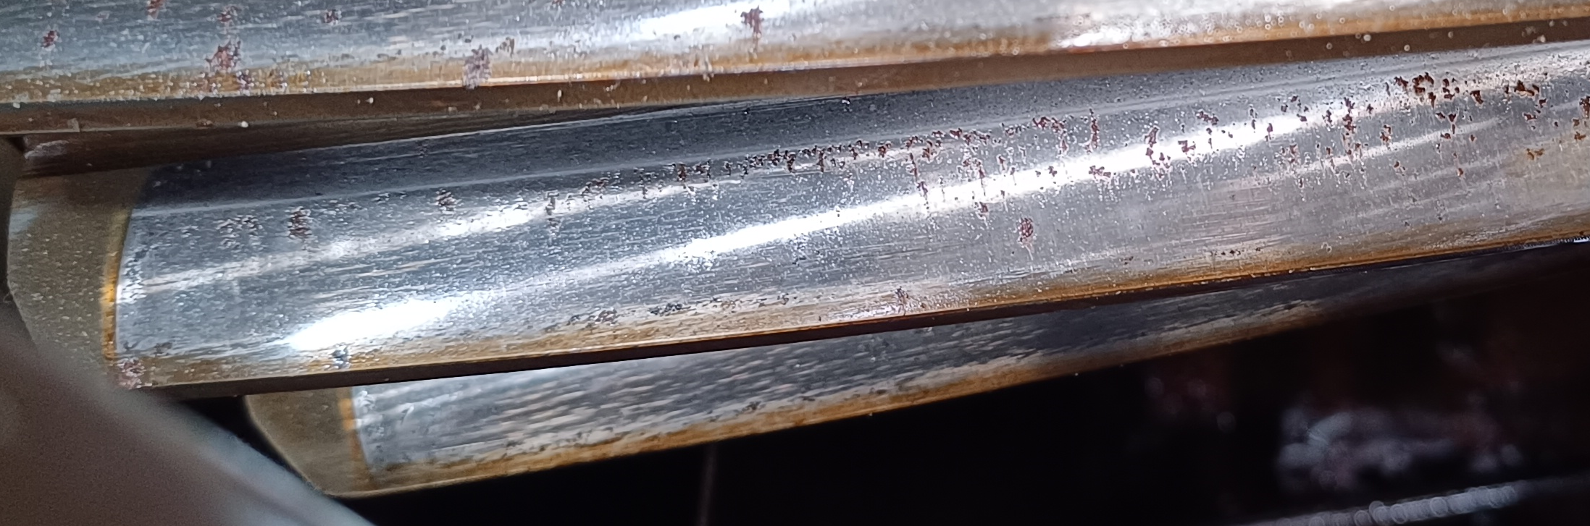
SBN 630 Gear Box for Mill No-1 & 2 Report (off season 2025 )
1ST MILL INTERMEDIATE SHAFT
Minor teeth chip out 9 Nos out of 18 teeth .
2ND MILL INTERMEDIATE GEAR SHAFT
Pitting found on pinion teeth 3Nos out of 18
2ND MILL INTERMEDIATE GEAR SHAFT
Pitting found on Gear teeth 13Nos out of 69 Teeth

Slide 55
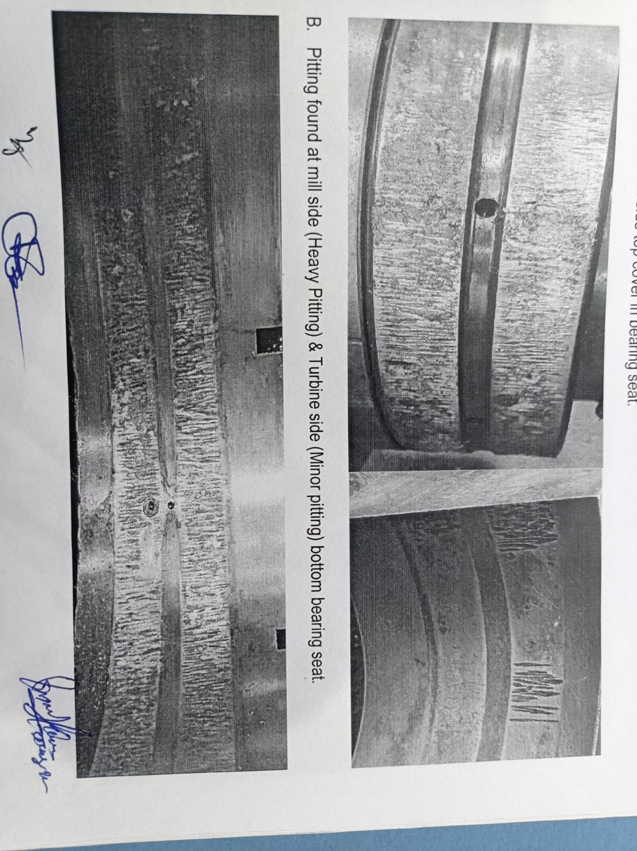
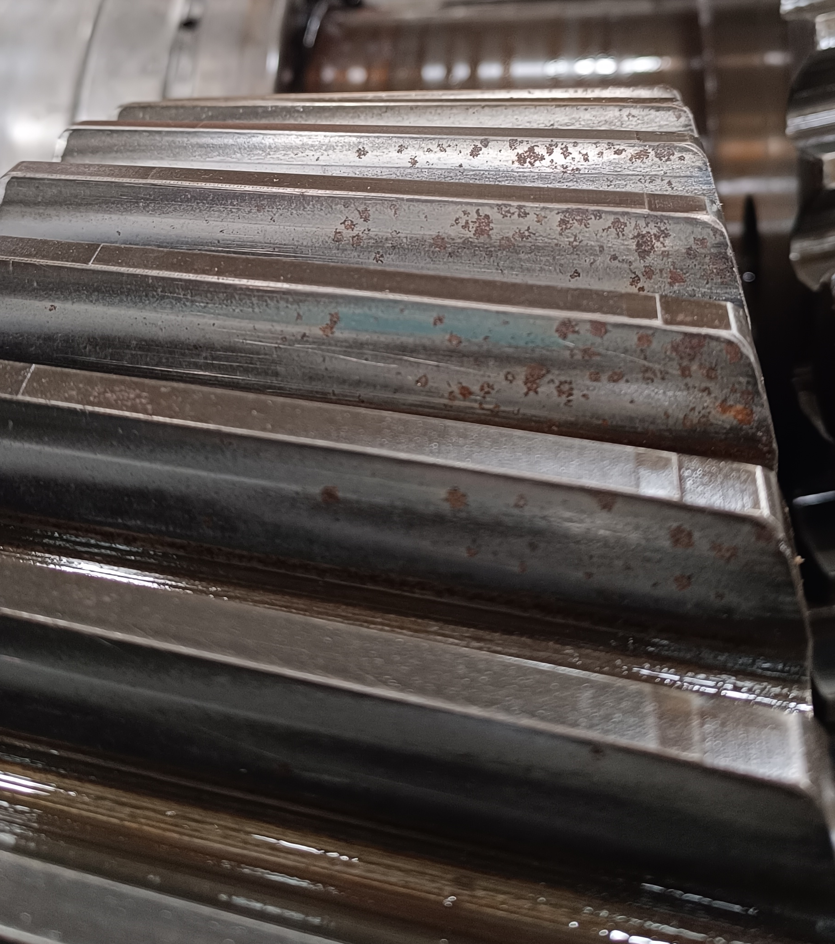
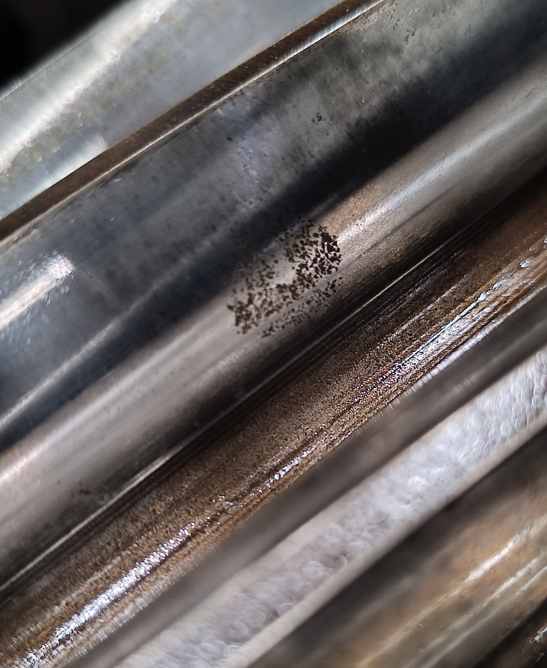
SBN 630 Gear Box for Mill No-3 Report (off season 2024 & 2025 )
3rd MILL OUTPUT SHAFT
Outer race impression & Bearing Roller minor pitting Found
Heavy pitting found at mill side & turbine side bottom bearing seat.
Inspection Report 2024 off Season
3rd MILL INTERMEDIATE GEAR SHAFT
Pitting found at gear teeth 9 out off 61 teeth.
Inspection Report 2025 off Season
3rd MILL INTERMEDIATE PINION SHAFT
Pitting found on pinion teeth 2Nos out of 18 Teeth.

Slide 56
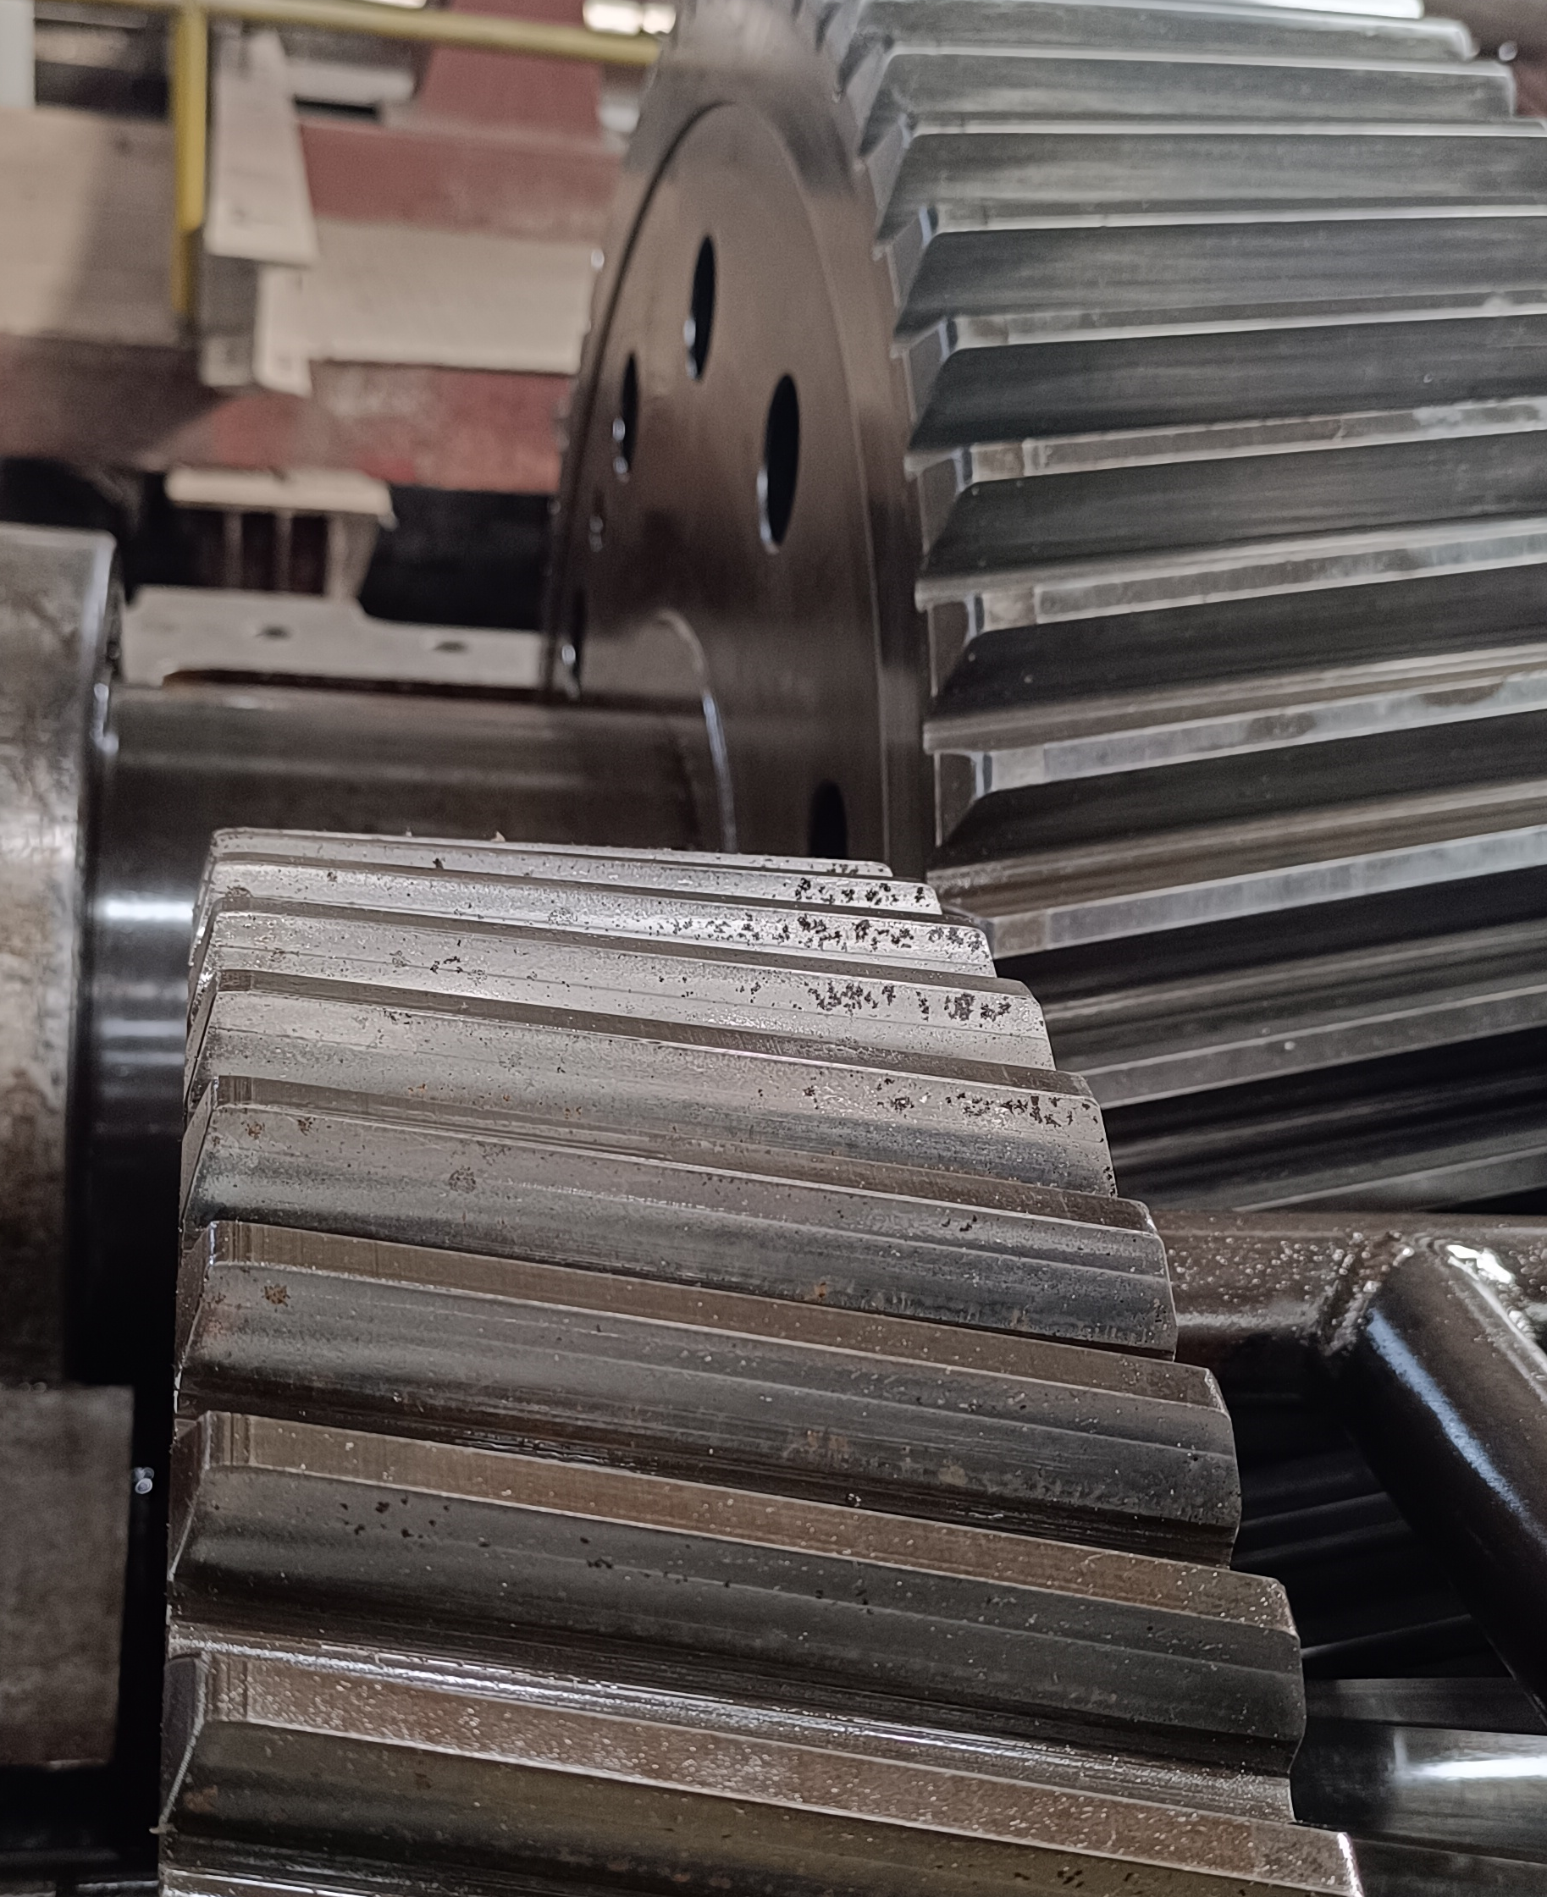
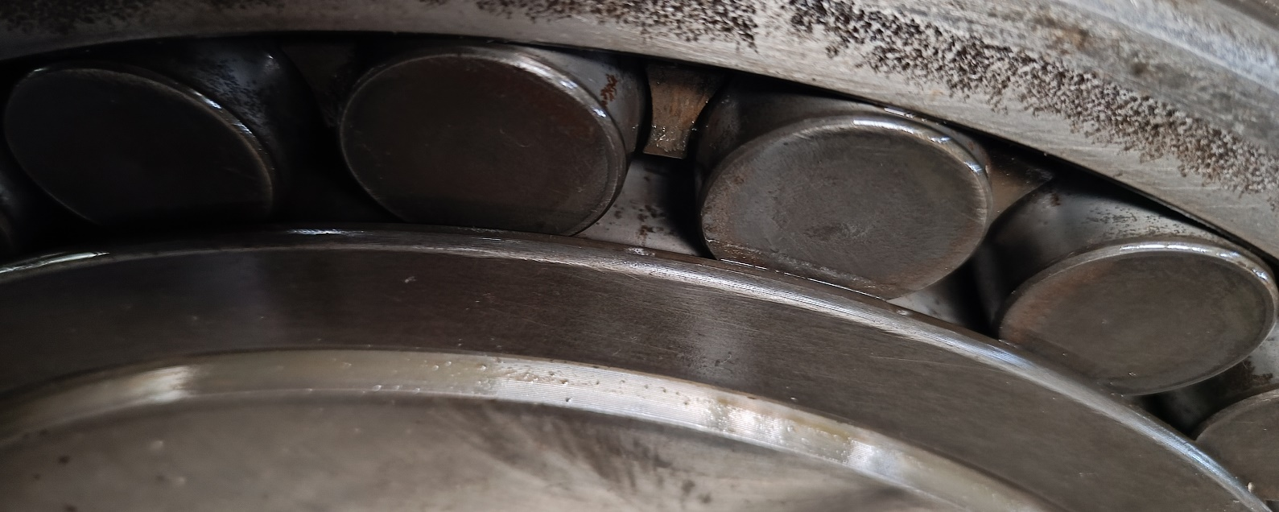
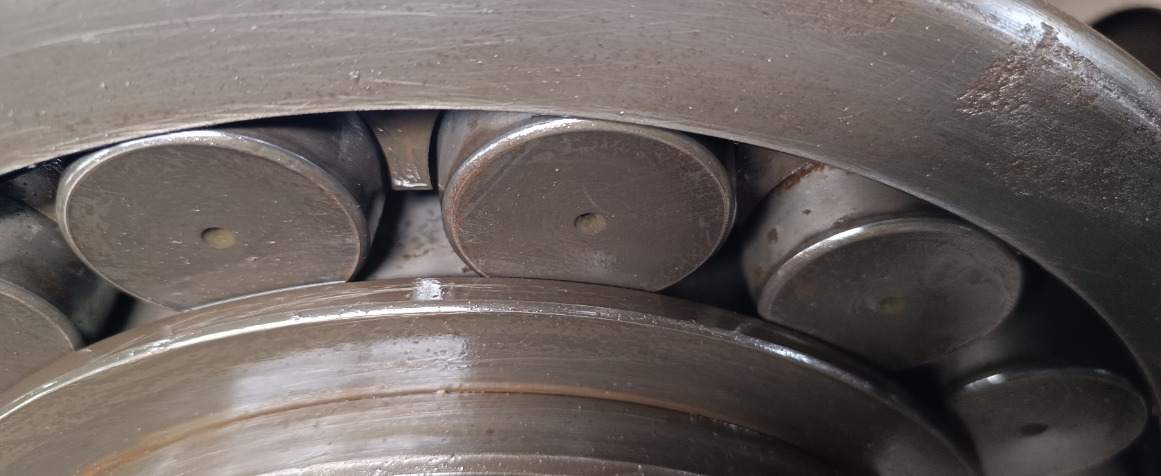
SBN 630 Gear Box for Mill No-4 Report (off season 2025)
4th MILL INTERMEDIATE GEAR SHAFT
Pitting found at gear teeth 16 out off 61 teeth.
4th output gear shaft
Outer race impression & Bearing Roller minor pitting Found
Heavy pitting found at mill side & turbine side bottom bearing seat.
4th MILL INTERMEDIATE PINION SHAFT
Pitting found on pinion teeth 4 Nos out of 18 Teeth.

Slide 57
SBN 630 Gear Box for Mill No-1,2,3,& 4 Overhauling Report off season 2023 to 2025
Sr. No. | Item Description | Observation O/S 2025 | Observation O/S 2024 | Observation O/S 2023 | Remark
1 | MILL NO. 1 FMG GEAR BOX (SBN-630) Sr.No.WHG16569LH
A | Input pinion
i | Input pinion Bearing Seat ,Top Cover Seat & pinion teeth | Minor pitting | Minor pitting | Minor pitting
B | Intermediate Gear
i | Intermediate pinion | Minor pitting / chip out 9 teeth out of 18 | Minor pitting | Minor pitting | Increase to last year
C | Output Gear
i | Output gear bearing seat in top cover DE | Minor pitting | Minor pitting | Minor pitting
ii | Output gear bearing seat in bottom cover DE | Heavy pitting | Heavy pitting | Heavy pitting
ii | Output gear bearing seat in top cover NDE | Minor pitting | Minor pitting | Minor pitting
iv | Output gear bearing seat in bottom cover NDE | Heavy pitting | Heavy pitting | Heavy pitting
v | Output gear teeth | Minor pitting / Scratch | Minor pitting / Scratch | Minor pitting / Scratch
2 | MILL NO. 2 FMG GEAR BOX (SBN-630) Sr.No.WHG16559LH
A | Input pinion
i | Input pinion Bearing Seat ,Top Cover Seat & pinion teeth | Minor pitting Starting stage | Minor pitting Starting stage | Minor pitting Starting stage
B | Intermediate Gear
i | Intermediate pinion | Minor pitting out 3 teeth out of 18 Starting stage | Minor pitting | Minor pitting out Starting stage | Increase to last year
C | Output Gear
i | Output gear bearing seat in top cover DE | Minor pitting | Minor pitting | Minor pitting
ii | Output gear bearing seat in bottom cover DE | Heavy pitting | Heavy pitting | Heavy pitting
ii | Output gear bearing seat in top cover NDE | Minor pitting | Minor pitting | Minor pitting
iv | Output gear bearing seat in bottom cover NDE | Heavy pitting | Heavy pitting | Heavy pitting
v | Output gear teeth | Minor pitting / chip out 13 teeth out of 69 | Minor pitting Starting stage | Minor pitting Starting stage | Increase to last year

Slide 58
SBN 630 Gear Box for Mill No-1,2,3,& 4 Overhauling Report off season 2023 to 2025
Sr. No. | Item Description | Observation O/S 2025 | Observation O/F 2024 | Observation O/F 2023 | Remark
3 | MILL NO. 3 FMG GEAR BOX (SBN-630) Sr.No.WHG16422 LH Make
A | Input pinion
i | Input pinion gear teeth | Minor pitting | Minor pitting | Minor pitting
B | Intermediate Gear
i | Intermediate gear teeth | Minor pitting / chip out 09 teeth out of 61 | Minor pitting | Minor pitting | Increase to last year
ii | Intermediate pinion | Minor pitting / chip out 02 teeth out of 18 | Minor Scratch | Minor Scratch | Increase to last year
C | Output Gear
i | Output gear bearing seat in top cover DE | Minor pitting | Minor pitting | Minor pitting
ii | Output gear bearing seat in bottom cover DE | Heavy pitting | Heavy pitting | Heavy pitting
ii | Output gear bearing seat in top cover NDE | Minor pitting | Minor pitting | Minor pitting
iv | Output gear bearing seat in bottom cover NDE | Heavy pitting | Heavy pitting | Heavy pitting
v | Output gear teeth | Minor Scratch/ pitting | Minor Scratch/ pitting | Minor Scratch/ pitting
4 | MILL NO. 4 FMG GEAR BOX (SBN-630) Sr.No.WHG16393 LH Make
A | Input pinion
i | Input pinion gear teeth | Minor pitting | Minor pitting | Minor pitting
B | Intermediate Gear
i | Intermediate gear teeth | Minor pitting / chip out 16 teeth out of 61 | Minor pitting | Minor pitting | Increase to last year
ii | Intermediate pinion | Minor pitting / chip out 04 teeth out of 18 | Minor pitting | Minor pitting | Increase to last year
C | Output Gear
i | Output gear bearing seat in top cover DE | Pitting Found | Pitting Found | Minor pitting
ii | Output gear bearing seat in bottom cover DE | Heavy pitting | Heavy pitting | Minor pitting
ii | Output gear bearing seat in top cover NDE | pitting Found | pitting Found | Pitting Found
iv | Output gear bearing seat in bottom cover NDE | Heavy pitting | Heavy pitting | Heavy pitting
v | Output gear teeth | Minor Scratch | Minor Scratch | Pitting Found

Slide 59
COMPLETIVE PRICE LIST OF GEAR BOX SPARE AND NEW SBN-630
Sr. No | Description of Material | Unit | Total Qty. (Nos.) | Elecon Unit Ex- works Price In Rs. | Elann Drive | Remark
A | Service |  |  |  |  | Ref no. EECL/NZ/DL/0153 Date. 26.12.2025 Ref No. Elann Drive QUOTE # EDAPL/25-26/N451 Date 08-01-2026
1 | Charges for dismantle, inspection, testing and painting of existing Coupling at our works. Elecon Make Coupling Type & Size: SBN-630 Sr. No. 16393 | Nos | 1 | 5,00,000 | 1,00,000
2 | Rectification/Replacement of bearing seating area (per bearing seating area) | Nos | 1 | 50000 (One Side) | 2,75,000 (Both Side)
B | Item Description |  |  |  |  | Ref. No.: D04/NZ/G-2857/R1 Date: 16th December 2025
1 | Input Pinion (Part No. 102) suitable for Elecon Make Gearbox Type & Size: SBN-630, Ratio 14:1 as per existing Sr. No. WHG 16559 LH. (HSN Code: 84839000) | Nos | 1 | 12,05,710/- | 1,56,744
2 | 1 st Intermediate Wheel (Part No. 103) suitable for Elecon Make Gearbox Type & Size: SBN-630, Ratio 14:1 as per existing Sr. No. WHG 16559 LH. (HSN Code: 84839000) | Nos | 1 | 12,05,710/- | 2,88,428
3 | 1 st Intermediate Pinion (Part No. 302) suitable for Elecon Make Gearbox Type & Size: SBN-630, Ratio 14:1 as per existing Sr. No. WHG 16559 LH. (HSN Code: 84839000) | Nos | 1 | 13,02,170/- | 2,19,709
4 | Output Wheel (Part No. 303) suitable for Elecon Make Gearbox Type & Size: SBN-630, Ratio 14:1 as per existing Sr. No. WHG 16559 LH. (HSN Code: 84839000) | Nos | 1 | 12,05,710/- | 7,92,185

Slide 60
COMPLETIVE PRICE LIST OF GEAR BOX SPARE AND NEW SBN-630
Sr. No | Description of Material | Unit | Total Qty. (Nos.) | Elecon Unit Ex- works Price In Rs. | Elann Drive | Remark
5 | Output Shaft (Part No. 202) suitable for Elecon Make Gearbox Type & Size: SBN-630, Ratio 14:1 as per existing Sr. No. WHG 16559 LH. (HSN Code: 84839000) | Nos | 1 | 3,85,830/ | 3,20,585
6 | Elecon Make Gearbox Type & Size: SBN-630 with CI Casing & Internal Piping but, without Force Lubrication System (FLS) & any other Accessories, Ratio 14:1 as per existing Sr. No. WHG 16559 LH.(HSN Code: 84834000) | Nos | 1 | 65,10,850/- | 34,00,000 | Ref. No.: D04/NZ/G-2857 Date: 27th November 2025
7 | Complete Set of Internals without Gear Casing, Bearings, Oil Seals, All C-Class Items & any other Accessories suitable for Elecon Make Gearbox Type & Size: SBN-630, Ratio 14:1 as per existing Sr. No. WHG 16559 LH. (HSN Code: 84839000) | Nos | 1 | 53,05,140/- | 17,77,651
8 | Complete fabricated Housing of Gearbox | Nos | 1 | NA | 11,92,515
Terms & Conditions:
 | Price Basis: |  |  | Ex-Works Vallabh Vidhyanagar
 | Packing & Forwarding: |  |  | 3% | 3%
 | GST: |  |  | 18% | 18%
 | TDS: |  |  | 0.1% >10 Cr.
 | Payment Term: |  |  | 30%Adv+GST | 50% Advance and balance against PI Prior to dispatch
 | Delivery: |  |  | 5-6 Months | 2-3 Month
 | Guarantee / Warranty: |  |  | 18 Month Supply/12 Month Insallation | 12 Month Installation

Slide 61
Long Delivery Items Procurement Initiated on Dated 23.01.2026
As per last year, we have initiated procurement of long deliver items to receipt of the same by July 26 for timely completion of R & M activities
Conversion of Cane Unloaders from mechanical to Hydraulic ( approved under Fy 26 Capex Budget)
Roller re-shelling
Chain and Chain Spares
Scrapper
Trash Plate & Trash Beam
GM Liners for Rollers
Shredder Hammer's & Tips
Note: we propose to initiate BH consumables items like Mills
MS Plates, MS Piping’s, Consumables items, Rubber seats, Valves Spares, Centrifugal machines spares etc

Slide 62
LONG DELEVERY ITEM REQUIRED FOR OFF SEASON 2026
Sl.NO | ITEM DECRIPTION | UOM | Rate /unit | Ins Qty | OFF SEASON |  |  |  | Stock |  | Net Req. | Total value Rs | Remark | Status
 |  |  |  |  | 2026 | 2025 | 2024 | 2023 | Store | Mill
1 | Deshelling/Re-shelling Of Mill Roller Shell Top Roller KCP | Nos | 8.6 | 2 | 1 | 1 | 1 | 1 |  |  | 1 | 8.6 |  | All Drawing & list sent to purchase department for Enquiry on dated 23.01.26
2 | Deshelling/Re-shelling Of Mill Roller Shell Bottom Roller KCP | Nos | 8.6 | 2 | 1 | 1 | 1 | 0 |  |  | 1 | 8.6
3 | Deshelling/Re-shelling Of Mill Top Roller Shell 50.8 Mm Pitch | Nos. | 8.6 | 3 | 1 | 2 | 1 | 2 |  |  | 1 | 8.6
4 | Deshelling/Re-shelling Of Mill Disch. Roller Shell 50.8 Mm | Nos | 7.35 | 3 | 1 | 2 | 2 | 1 |  |  | 1 | 7.35
5 | Deshelling/Re-shelling Of Mill Feed Roller Shell 50.8 Mm | Nos | 6.3 | 3 | 2 | 0 | 1 | 2 |  |  | 2 | 12.6
6 | Deshelling/Re-shelling Of TUFR Roller Shell Of Mill No 3 | Nos | 12 | 3 | 1 | 2 | 0 | 0 |  |  | 1 | 12 | Shell thick worn out and tooth thick & height decrease
7 | Deshelling/Re-shelling Of Under Feed Roller Zero Mill | Nos | 10.5 | 2 | 1 | 0 | 0 | 0 |  |  | 1 | 10.5 | Roller dia & length less of under feed roller
8 | Trash Plate For Taxmaco Mill | Nos. | 1.28 | 3 | 1 | 0 | 0 | 2 |  | 0 | 1 | 1.28
9 | Trash Beam For Taxmaco Mill | Nos. | 4.03 | 3 | 2 | 1 | 0 | 0 |  |  | 2 | 8.06 | due to more worn-out & less thickness
10 | Bearing Bracket For Trash Beam | Nos. | 0.355 | 6 | 4 | 2 | 0 | 0 |  |  | 4 | 1.42 | due to more worn-out & less thickness

Slide 63
LONG DELEVERY ITEM REQUIRED FOR OFF SEASON 2026
Sl.NO | ITEM DECRIPTION | UOM | Rate /unit | Ins Qty | OFF SEASON |  |  |  | Stock |  | Net Req. | Total value | Remark | Status
 |  |  |  |  | 2026 | 2025 | 2024 | 2023 | Store | Mill
11 | TRASH BEAM BOLT WITH SS NUT FOR TAXMACO MILL. | NOS. | 0.06 | 36 | 24 | 12 | 0 | 12 |  |  | 24 | 1.44 |  | All Drawing & list sent to purchase department for Enquiry on dated 23.01.26
12 | TOP SCRAPER BRACKET FOR TEXMACO MILL | NOS. | 0.135 | 6 | 2 | 4 | 0 | 0 |  |  | 2 | 0.27 | due to more worn-out & less thickness
13 | DISCHARGE SCRAPER BRACKET FOR TEXMACO MILL | NOS. | 0.135 | 6 | 6 | 0 | 0 | 0 |  |  | 6 | 0.81 | due to more worn-out & less thickness
14 | C. S. SCRAPPER FOR TOP ROLLER DRG-TM-GEN-12/07 WITH GROOVING | NOS. | 0.679 | 3 | 6 | 6 | 5 | 3 |  | 0 | 6 | 4.074
15 | C.S. SCRAPPER FOR DISCHARGE ROLLER DRG-TM-GEN-12/07 WITH | NOS. | 0.711 | 3 | 3 | 3 | 4 | 3 |  | 0 | 3 | 2.133
16 | TOP SCRAPER FOR KCP MILL AS PER DRG. NO M-KCP-40-19 | NOS. | 1.02 | 2 | 2 | 1 | 1 | 2 |  | 0 | 2 | 2.04
17 | BOTTOM SCRAPER FOR KCP MILL AS PER DRG. NO. M-KCP-41-19 | NOS. | 1.02 | 2 | 2 | 1 | 1 | 2 |  | 0 | 2 | 2.04
18 | HOLDER FOR TOP SCRAPER OF KCP MILL APD | NOS | 1.5 | 2 | 1 | 0 | 0 | 0 |  |  | 1 | 1.5
19 | HOLDER FOR BOTOM SCRAPER OF KCP MILL APD | NOS | 1.5 | 2 | 1 | 0 | 0 | 0 |  |  | 1 | 1.5
20 | MILL ROLLER SHAFT,596 MM DIAX 4925 MM LONG | NOS. | 19.58 | 9 | 1 | 1 | 1 | 1 |  |  | 1 | 19.58 | In Capex

Slide 64
LONG DELEVERY ITEM REQUIRED FOR OFF SEASON 2026
Sl.NO | ITEM DECRIPTION | UOM | Rate /unit | Ins Qty | OFF SEASON |  |  |  | Stock |  | Net Req. | Total value | Remark | Status
 |  |  |  |  | 2026 | 2025 | 2024 | 2023 | Store | Mill
21 | INLINE SHREDDER HAMMER WITHOUTBUSH,DRG NO M-KCP-47-20 | NOS. | 0.103 | 136 | 280 | 280 | 276 | 414 |  |  | 280 | 28.84 |  | All Drawing & list sent to purchase department for Enquiry on dated 23.01.26
22 | INLINE SHREDDER HAMMER WITHOUTBUSH,DRG NO M-KCP-48-20 | NOS. | 0.103 | 36 | 82 | 82 | 78 | 114 |  |  | 82 | 8.446
23 | INLINE SHREDDER HAMMER PIN,DRG NO M-KCP-11-16 | NOS | 0.463 | 8 | 8 | 8 | 8 | 8 |  |  | 8 | 3.704
24 | Pivot plate for Shredder APD | NOS | 10 | 1 | 1 | 0 | 0 | 0 |  |  | 1 | 10 | due to more worn-out & less thickness
25 | SHREDDER DOMITE HAMMER TIP,80X56 MM,WITH HT BOLT & WASHER | NOS. | 0.016 | 172 | 720 | 720 | 547 | 720 |  |  | 720 | 11.52
26 | 300 MM PITCH CHAIN FORGED BLOCK TYPE,DRG NO.- TM-CHN-RC-2/06 | MTR | 0.167 | 138 | 45 | 45 | 45 | 45 |  |  | 45 | 7.515
27 | 229 MM PITCH DROP FORGED LINK CHAIN,AS DRG TM-CHN-IC-03/06 | MTR | 0.072 | 143 | 50 | 50 | 50 | 50 |  |  | 50 | 3.6
28 | BUSH FOR 300 MM PITCH CHAIN AS PER DRG TM CHN-RC-02/06 | NOS. | 0.0027 | 462 | 0 | 0 | 0 | 0 |  | 0 | 0 | 0
29 | LINK WITH ATTACHMENT FOR 300 MM PITCH DROP FORGED LIN CHAIN | NOS. | 0.0348 | 154 | 40 | 40 | 40 | 30 |  | 0 | 40 | 1.392
30 | PIN WITH NYLOC NUT FOR 300 MM PITCH LINK CHAIN, | NOS. | 0.0087 | 462 | 200 | 200 | 140 | 200 |  | 0 | 200 | 1.74

Slide 65
LONG DELEVERY ITEM REQUIRED FOR OFF SEASON 2026
Sl.NO | ITEM DECRIPTION | UOM | Rate /unit | Ins Qty | OFF SEASON |  |  |  | Stock |  | Net Req. | Total value | Remark | Status
 |  |  |  |  | 2026 | 2025 | 2024 | 2023 | Store | Mill
31 | LINK WITHOUT ATTACHMENT FOR 300 MM PITCH DROP FORGED LINK CH | NOS. | 0.03 | 308 | 50 | 50 | 50 | 0 |  | 0 | 50 | 1.5 |  | All Drawing & list sent to purchase department for Enquiry on dated 23.01.26
32 | BUSH FOR 229 MM PITCH DROP FORGE LINK CHAIN AS PER DRG. NO.- | NOS. | 0.0012 | 600 | 0 | 0 | 0 | 0 |  | 0 | 0 | 0
33 | PIN WITH NYLOC NUT FOR 229 MM PITCH DROP FORGED LINK CHAIN, | NOS. | 0.0028 | 600 | 300 | 200 | 300 | 200 |  | 0 | 300 | 0.84
34 | LINK WITH ATTACHMENT FOR 229MM PITCH DROP FORGED LINCHAIN | NOS. | 0.02 | 150 | 50 | 50 | 20 | 50 |  | 0 | 50 | 1
35 | LINK WITHOUT ATTACHMENT FOR 229 MM PITCH | NOS. | 0.015 | 450 | 100 | 100 | 40 | 50 |  | 0 | 100 | 1.5
36 | CHAIN ASSBLY FOR CANE CARRIER 200 MM PITCH | MTR | 0.115 | 784 | 520 | 0 | 520 | 0 |  |  | 520 | 59.8
37 | PIN FOR CANE CARRIER CHAIN 200 MM PITCH ITEM NO-4 | NOS | 0.0025 | 2600 | 650 | 2600 | 650 | 3000 |  | 0 | 650 | 1.625
38 | BUSH FOR CANE CARRIER CHAIN 200 MM PITCH ITEM NO-5 | NOS | 0.0011 | 2600 | 1000 | 2600 | 1000 | 3200 |  | 0 | 1000 | 1.1
39 | ROLLER FOR CANE CARRIER CHAIN 200 MM PITCH ITEM NO-6 | NOS | 0.0027 | 2600 | 600 | 2600 | 600 | 3000 |  | 0 | 600 | 1.62
40 | CASTLE NUT FOR CANE CARRIER CHAIN 200 MM PITCH ITEM NO-7 | NOS | 0.00034 | 2600 | 500 | 500 | 0 | 500 |  |  | 500 | 0.17

Slide 66
LONG DELEVERY ITEM REQUIRED FOR OFF SEASON 2026
Sl.NO | ITEM DECRIPTION | UOM | Rate /unit | Ins Qty | OFF SEASON |  |  |  | Stock |  | Net Req. | Total value | Remark | Status
 |  |  |  |  | 2026 | 2025 | 2024 | 2023 | Store | Mill
41 | OUTER LINK ITEM NO-2 FOR CANE CARRIER CHAIN 200 MM PITCH (Slotted) | NOS | 0.008 | 1300 | 350 | 350 | 0 | 350 |  | 0 | 350 | 2.8 |  | All Drawing & list sent to purchase department for Enquiry on dated 23.01.26
42 | OUTER LINK ITEM NO-3 FOR CANE CARRIER CHAIN 200 MM PITCH(Round) | NOS | 0.008 | 1300 | 350 | 350 | 0 | 350 |  | 0 | 350 | 2.8
43 | INNER LINK ITEM NO-1 FOR CANE CARRIER CHAIN 200 MM PITCH | NOS | 0.008 | 2600 | 700 | 700 | 0 | 700 |  | 0 | 700 | 5.6
44 | SLATES M.S.FOR CANE CARRIER CHAIN 200 MM PITCH | NOS | 0.039 | 980 | 300 | 250 | 250 | 250 |  | 0 | 300 | 11.7
45 | FORGED STEEL INTERMDIATE SHAFT FOR MILL TRANSMISSION GEAR | NO. | 5.5 | 4 | 1 | 0 | 1 | 0 |  |  | 1 | 5.5
46 | G.M. LINER FOR KCP MILL (BOTTOM ROLLER),Drg No : M-KCP-14-16 ,MOC LTB 1 with test certificate on Conversion Basis ,Appx Wts :550 Kg / Each | Nos | 1.25 | 4 | 2 | 2 | 2 |  |  | 0 | 2 | 2.5
47 | G.M. LINER Top Roller Top half FOR KCP MILL(TOP ROLLER),Drg No: M-KCP-45-20 ,MOC: LTB1 with test certificate on Conversion Basis, Appx Wts:360 Kg / Each | Nos | 0.8 | 4 | 2 | 2 | 2 |  |  | 0 | 2 | 1.6
48 | G.M. LINER Top Roller Bottom half FOR KCP MILL(TOP ROLLER),Drg No: M-KCP-46-20 MOC: LTB1 with test certificate on Conversion Basis, Appx Wts :242 Kg / Each | Nos | 0.5 | 4 | 2 | 2 | 2 |  |  | 0 | 2 | 1
49 | G.M. LINER Top Roller top half & Bottom Roller bottom half FOR TEXMACO MILL Drg No: TM-GEN-07-07,MOC: LTB1 with test certificate on Conversion Basis, Appx Wts:130 Kg/Each | Nos | 0.28 | 24 | 4 | 4 | 4 |  |  | 0 | 4 | 1.12
50 | HOIST DRUM FOR CANE UNLOADER APD | NOS | 1.5 | 6 | 3 | 1 | 0 | 0

Slide 67
LONG DELEVERY ITEM REQUIRED FOR OFF SEASON 2026
Sl.NO | ITEM DECRIPTION | UOM | Rate /unit | Ins Qty | OFF SEASON |  |  |  | Stock |  | Net Req. | Total value | Remark | Status
 |  |  |  |  | 2026 | 2025 | 2024 | 2023 | Store | Mill
51 | BEARING HOUSING BOTTOM HALF OFSIDE ROLLER FOR TEXMACO MILL | NOS | 1.38 | 24 | 4 | 0 | 4 | 0 |  |  | 4 | 5.52 |  | All Drawing & list sent to purchase department for Enquiry on dated 23.01.26
52 | PROOF MACHINE FORGED STEEL,SHAFT SIZE 460MM DIAX2080L(T. Gear) | NOS | 5.5 | 4 | 1 | 1 | 1 | 1 |  |  | 1 | 5.5
53 | NEW PINION SHAFT FOR,TRANSMISSION GEAR OF MILL | NOS | 3.66 | 4 | 1 | 0 | 1 | 1 |  |  | 1 | 3.66
54 | IMPACT IDLER WITH SYNTHETIC,RUBBER AS DRG NO M-KCP-35-21 | NOS. | 0.11 | 5 | 5 | 0 | 0 | 0 |  |  | 5 | 0.55
55 | ANTI MAGNETIC IDLER (SS 304) SIZE 141MM DIA X 2400MM LONG | NOS. | 0.2 | 7 | 7 | 0 | 0 | 0 |  |  | 7 | 1.4
56 | DOUBLE ROW SPHERICAL ROLLER BEARING 239 / 560 BK.MB C3/W33 | NO | 4.76 | 4 | 1 | 1 | 1 | 1 |  |  | 1 | 4.76
57 | GEAR COUPLING GC-114 ,MAKE-NU-TECK | NO. | 4.4 |  | 1 | 0 | 0 | 1 |  |  | 1 | 4.4
58 | GEAR COUPLING GC-D-2008-C | NO. | 0.68 |  |  | 0 | 0 | 1 |  |  | 0 | 0
59 | SPACER TYPE GEAR COUPLING GC-110 ,MAKE-NU-TECK for Shredder APD | NO | 2.5 | 2 | 2 | 0 | 0 | 2 |  |  | 2 | 5
60 | REPLACEMENT OF HEAD STOCK MILL NO.1 |  |  |  |  |  |  |  |  |  | 0 | 0

Slide 68
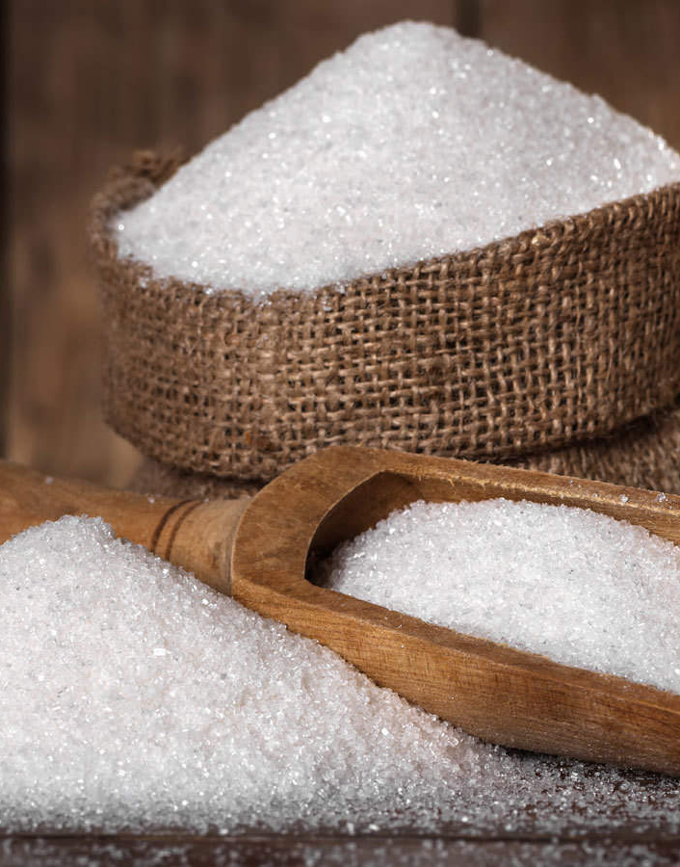
PRODUCTION

Slide 69
General Observation
The mud removal system and R-3 pan boiling system are operating satisfactorily in all respects.
Syrup diversion and B heavy diversion process validation fee has been deposited and NSI team visit is awaited for the same.
The offer for the rotary dryer for brown sugar drying has been received.

Slide 70
Long Delivery Item /Jobs
S No | Equipment | Cost (lacs) | Budget status | Reason for delay during
1 | 35 Ton per hour capacity IC Grader | 37.75 | Last year carryover | Postponed due to Delay in delivery
2 | Mechanical circulator modification of two no’s refinery pan | 16.00 | Used In IER column | Postponed due to Delay in delivery
3 | IER column (Two No's ) installation along with WRS and BRS capacity enhancement | 400.00 | New job
4 | Upgradation of DS house for reducing steam consumption from 40 % on cane to 32 % on cane. | 4000.00 | New job

Slide 71
Weekly Performance Snapshot - Production
No. | Capacity Utilization | Target | Current Week | Last Week | Till Date
1 | Sugar Production (LQ) | 15.26 | 0.66 | 0.63 | 8.31
2 | Sugar Bagging – RS (Qtl) | 824250 | 37857 | 38276 | 504585
3 | Sugar Bagging – DS (Qtl) | 702139 | 28584 | 24611 | 326504
 | Recovery
4 | Sugar Recovery CH – RS (%) | 10.14
5 | Sugar Recovery CH – DS (%) | 10.14
6 | Sugar Recovery BH – RS (%) | 10.69 | 10.20 | 10.05 | 9.97
7 | Sugar Recovery BH – DS (%) | 10.69 | 10.11 | 9.99 | 9.67
8 | B-Mol Recovery – RS (%) | 6.8 | 5.62 | 5.84 | 5.81
9 | B-Mol Recovery – DS (%) | 7.20 | 5.68 | 5.93 | 6.47
 | Quality
10 | B-Mol Purity – RS | < 51.00 | 49.51 | 50.10 | 50.06
11 | B-Mol Purity – DS | < 51.00 | 50.51 | 50.35 | 50.46
12 | Losses in Mol % Cane BH – RS | < 3.00 | 2.44 | 2.47 | 2.51
13 | Losses in Mol % Cane BH – DS | < 3.18 | 2.54 | 2.54 | 2.75
14 | Pol % Filter cake | < 2.00 | 1.7 | 1.7 | 1.93
 | Consumption
15 | Steam Consumption (Kg/Qtl Sugar) | 400 | 418 | 440 | 472
16 | Steam % Cane | <42 | 39.38 | 39.51 | 39.66
17 | Power Consumption (Units/Qtl Sugar) | 11 | 10.92 | 11.71 | 11.02
71

Slide 72
Weekly Sugar Production – DS House
Production Plan for Next Week
SKU | Quantity (Qtls) | % of Total
L | 0 | 0
M | 17754 | 90
S | 1973 | 10
Total | 19,727 | 100

Slide 73
Weekly Sugar Production – RS House
Production Plan for Next Week
SKU | Quantity (Qtls) | % of Total
L | 3282 | 10
M | 22973 | 70
S | 4922 | 15
Pharma | 1641 | 5
Total | 32,818 | 100
Icing | 10 | 0.62
Bura | 200 | 12.46
Sachet | 205 | 12.77
1kg pack | 250 | 15.58
5kg pack | 325 | 20.25
Superfine | 25 | 1.56
Brown 1kg | 40 | 2.49
Pharma | 550 | 34.26
Total | 1,605 | 100%

Slide 74
Sugar Production Quality
Sugar Quality | Season 2025-26 |  |  |  | Season 2024-25
 | Target | Current Week | Last Week | Till Date | Week | Till Date
Sugar Quality - DS
ICUMSA (L-sugar) | <110
ICUMSA (M-sugar) |  | 86 | 80 | 97 | 102 | 115
ICUMSA (S-sugar) |  | 87 | 80 | 98 | 106 | 116
Sugar Quality – RS
ICUMSA (L-sugar) | <30 | 25 | 23 | 30 | 38 | 35
ICUMSA (M-sugar) |  | 26 | 25 | 31 | 39 | 36
ICUMSA (S-sugar) |  | 28 | 27 | 33 | 38 | 37
Sugar Quality Pharma
ICUMSA (SS - Sugar) | <25 |  | 26 | 30
ICUMSA (20/80 - Sugar) |  | 23 | 25 | 29 | 34 | 32
ICUMSA (30/80 - Sugar) |  | 23 | 26 | 29 | 34 | 34

Slide 75
Monthly Performance Snapshot - Production
S.No. | Capacity Utilization | Target | Jan.-26 | Jan.-25 | Dec.-25 | Dec.-24
1 | Sugar Production (LQ) | 15.26 | 2.79 | 2.71 | 2.89 | 2.77
2 | Sugar Bagging – RS (Qtl) | 824250 | 164859 | 160523 | 173434 | 169441
3 | Sugar Bagging – DS (Qtl) | 702139 | 113985 | 110165 | 115599 | 108046
 | Recovery
4 | Sugar Recovery CH – RS (%) | 10.14 | 11.17(01 Jan. to 03 Jan.) | 11.55(01 Jan. to 07 Jan.) | 11.03 | 10.75
5 | Sugar Recovery CH– DS (%) | 10.14 |  |  | 10.63(01 Dec. to 08 Dec.) | 10.45(01 Dec. to 21 Dec.)
 | Sugar Recovery BH – RS (%) | 10.69 | 9.97(04 Jan. to 31 Jan.) | 10.14(08 Jan. to 31 Jan.)
 | Sugar Recovery BH– DS (%) | 10.69 | 9.86 | 10.02 | 9.43(9 Dec. to 31 Dec.) | 9.45(22 Dec. to 31 Dec.)
6 | C-Mol Recovery – RS (%) | 4.8 | 4.61(01 Jan. to 03 Jan.) | 4.57(01 Jan. to 07 Jan.) | 4.34 | 4.77
7 | C-Mol Recovery – DS (%) | 5.2 |  |  | 5.12(01 Dec. to 08 Dec.) | 4.98(01 Dec. to 21 Dec.)
8 | B-Mol Recovery – RS (%) | 6.8 | 5.81(04 Jan. to 31 Jan.) | 6.62(08 Jan. to 31 Jan.)
9 | B-Mol Recovery – DS (%) | 7.2 | 6.11 | 6.90 | 6.96(9 Dec. to 31 Dec.) | 7.45(22 Dec. to 31 Dec.)
 | Quality
10 | C-Mol Purity – RS | <33.00 | 31.26(01 Jan. to 03 Jan.) | 31.19(01 Jan. to 07 Jan.) | 32.08 | 30.80
11 | C-Mol Purity – DS | <32.00 |  |  | 30.31(01 Dec. to 08 Dec.) | 30.68(01 Dec. to 21 Dec.)
12 | B-Mol Purity – RS | <51.00 | 50.06(04 Jan. to 31 Jan.) | 50.16(08 Jan. to 31 Jan.)
13 | B-Mol Purity – DS | <51.00 | 50.37 | 50.21 | 50.52(09 Dec. to 31 Dec.) | 51.10(22 Dec. to 31 Dec.)
14 | Losses in Mol % Cane CH– RS | <1.39 | 1.27(01 Jan. to 03 Jan.) | 1.26(01 Jan. to 07 Jan.) | 1.15 | 1.30
15 | Losses in Mol % Cane CH – DS | <1.46 |  |  | 1.18(01 Dec. to 08 Dec.) | 1.30(01 Dec. to 21 Dec.)
16 | Losses in Mol % Cane BH – RS | <3.00 | 2.51(04 Jan. to 31 Jan.) | 2.90(08 Jan. to 31 Jan.)
17 | Losses in Mol % Cane BH – DS | <3.18 | 2.67 | 2.96 | 2.86(09 Dec. to 31 Dec.) | 3.23(22 Dec. to 31 Dec.)
18 | Pol % Filter Cake | <2.00 | 1.75 | 2.08 | 1.95 | 1.96
 | Consumption
19 | Steam Consumption (Kg/Qtl Sugar) | 400 | 445 | 458.20 | 449 | 457.50
20 | Steam % Cane | 42 | 39.28 | 40.13 | 39.89 | 41.35
21 | Power Consumption (Units/Qtl Sugar) | 11 | 11.71 | 11.41 | 11.85 | 12.05

Slide 76
Steam consumption target Vs actual at different process
At Recovery % | Process option - 1 |  |  | Process option - 2 |  |  |  | Process option - 3
 | RS & DS on C-heavy with 125 KLD Distillery on Syrup |  |  | Both process on B-heavy with 125 KLD Distillery on Syrup |  |  |  | Both process on B-heavy
 | Target | Week actual | Actual till date | Target | Week actual | Last week | Till date | Target | Week actual | Actual Till date
10.50 | 42.00 |  |  | 40.00 | 39.38 | 38.51 | 39.66 | 41.00

Slide 77
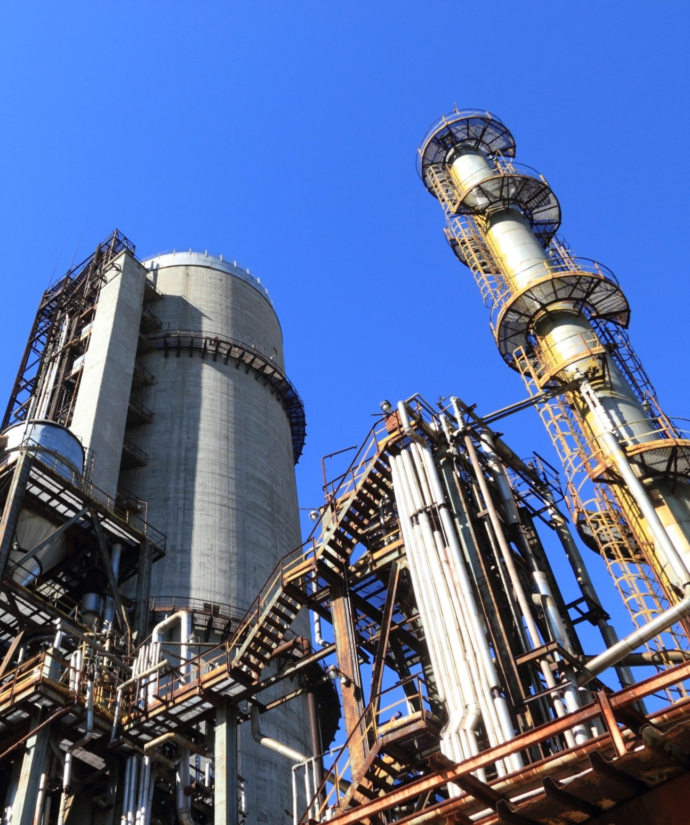
POWER PLANT

Slide 78
HIGHLIGHTS FOR THE WEEK
30.85 MW Power Plant The 30.85 MW Co-generation Plant is operating satisfactorily. All parameters of the 150 TPH Boiler and 30.85 MW Turbine were observed to be within normal limits during full-load operation. Avg. Steam Flow :150.1 TPH & Avg. TG load 29.32 MW. 70 TPH Boiler The 70 TPH boiler was taken under shutdown during the mill’s scheduled cleaning for inspection of the superheater zone. During inspection, slagging and fouling were observed in the superheater inlet zone, resulting in a reduction of main steam temperature by 15–20°C. Necessary cleaning was carried out, after which the boiler was put back into service. Post-normalization, the main steam temperature improved and achieved the design value of 430°C (Under Observation). Avg. Steam Flow : 69.1 TPH. 4.0 MW Distillery Power Plant The 4.0 MW Distillery Co-generation Plant was taken under shutdown during distillery scheduled cleaning. Total stoppage time : 68:48 hrs.(27.01.26 to 30.01.26)

Slide 79
Weekly Performance Snapshot - Power
S.N | Generation & Export | Current Week | Last Week | Till Date
1 | Total Power Generation (LU) | 61.30 | 65.27 | 893.39
2 | Power Export (LU) | 36.34 | 38.59 | 529.63
3 | Power Export (%) | 59.28 | 59.12 | 59.28
 | Power Consumption (% of Gen.) | 40.72 | 40.88 | 40.72
4 | Sugar Plant Process (% of Gen. ) | 29.95 | 28.80 | 28.64
5 | Distillery Plant Process (% of Gen. ) | 2.83 | 4.07 | 3.88
6 | Aux Consumption (% of Gen.) | 7.94 | 8.02 | 8.21
79

Slide 80
Weekly Performance Snapshot – Power
 | Boiler Capacity Utilization | Target | Current Week | Last Week | Till Date (25-26) | Till Date (24-25)
1 | Capacity Utilization - 150 TPH | >144.0 | 150.1 | 150.0 | 150.4 | 143.7
2 | Capacity Utilization – 70 TPH | >64.0 | 64.2 | 69.1 | 67.7 | 66.0
3 | Capacity Utilization – 35 TPH | >33.0 | 18.6 | 33.2 | 31.8 | 32.1
 | Turbine Capacity Utilization
4 | PLF % – 30.85 MW | > 95.00 | 97.74 | 98.37 | 97.35 | 92.77
5 | PLF % – 3.0 MW (O) | > 90.00 | 84.73 | 90.82 | 92.71 | 91.23
6 | PLF % – 3.0 MW (N) | > 75.00 | 82.36 | 87.92 | 86.75 | 82.19
7 | PLF % – 4.0 MW | > 90.00 | 53.90 | 99.48 | 93.46 | 88.93
 | Efficiency
8 | Steam/Fuel Ratio – 150 TPH | ≥2.54 | 2.56 | 2.56 | 2.55 | 2.53
9 | Steam/Fuel Ratio – 70 TPH | ≥2.19 | 2.20 | 2.22 | 2.21 | 2.18
10 | Steam/Fuel Ratio – 35 TPH | ≥1.88 | 2.17 | 2.15 | 2.17 | 2.07
11 | Specific Steam – 30.85 MW | ≤5.20 | 5.08 | 5.08 | 5.12 | 5.12
12 | Specific Steam – 3 MW (O) | ≤9.00 | 8.76 | 8.84 | 8.59 | 8.67
13 | Specific Steam – 3 MW (N) | ≤9.00 | 8.91 | 9.04 | 8.82 | 8.96
14 | Specific Steam – 4 MW | ≤9.20 | 8.48 | 8.35 | 8.53 | 8.95
80

Slide 81
Key Operational Parameters: Overall SPE Division
Plant Availability
Sr. No. | Description | Current Week | Last Week |  | Till Date SS 25 - 26 | Till Date SS 24 - 25
 |  | 25/01/2026 to 31/01/2026 | 18/01/2026 to 24/01/2026 |  | 26/10/2025 to 31/01/2026 | 26/10/2024 to 31/01/2025
1. | 150 TPH Boiler | 100% | 100% |  | 99.99% | 98.20%
2. | 70 TPH Boiler | 91.96% | 100% |  | 99.17% | 99.18%
3. | 35 TPH Boiler | 59.40% | 100% |  | 96.31% | 98.48%
4. | 30.85 MW Turbine | 100% | 100% |  | 99.90% | 96.86%
5. | 4 MW Turbine | 57.95% | 100% |  | 95.95% | 97.26%
6. | 3 MW_Old Turbine | 91.27% | 100% |  | 98.86% | 98.68%
7. | 3 MW_New Turbine | 91.10% | 100% |  | 97.46% | 96.18%
8. | 132 KV GRID | 100% | 99.98% |  | 99.88% | 99.79%

Slide 82
Key Operational Parameters: Overall Power Generation , Export and Consumption of SPE Division
Sr. No. | Particulars | UOM | Target | Current Week |  | Last Week |  | Till date SS 25-26 |  | Till date SS 24-25
 | Operation | Days | Avg. | 7 | Avg. | 7 | Avg. | 98 | Avg. | 97 | Avg.
1. | 30.85 MW STG | MWH | 28.50 | 4926.00 | 29.32 | 4958.00 | 29.51 | 68693.00 | 29.21 | 64788.00 | 27.83
2. | 3 MW _Old STG | MWH | 2.70 | 427.02 | 2.54 | 457.75 | 2.72 | 6341.04 | 2.78 | 6371.57 | 2.74
3. | 3 MW _ New STG | MWH | 2.25 | 415.09 | 2.47 | 443.12 | 2.64 | 5871.39 | 2.60 | 5562.53 | 2.39
4. | 4.0 MW STG | MWH | 3.60 | 362.20 | 2.16 | 668.50 | 3.98 | 8025.10 | 3.74 | 8433.60 | 3.62
5. | Power Exported | MWH | 22.00 | 3634.00 | 21.63 | 3859.00 | 22.97 | 52963.00 | 22.52 | 50292.00 | 21.60
6. | Sugar Plant Consumption | MWH | 10.44 | 1833.11 | 10.91 | 1876.87 | 11.17 | 25879.77 | 11.00 | 23812.10 | 10.23
7. | Distillery Plant Consumation | MWH | 1.60 | 173.40 | 1.03 | 265.45 | 1.58 | 3462.11 | 1.53 | 3564.54 | 1.58
8. | 30 MW Cogen Aux. Cons. | MWH | 2.70 | 406.65 | 2.42 | 412.39 | 2.45 | 5697.76 | 2.42 | 5752.80 | 2.47
9. | 4.0 MW Cogen Aux. Cons. | MWH | 0.80 | 65.90 | 0.39 | 97.05 | 0.58 | 1316.80 | 0.58 | 1349.86 | 0.60

Slide 83
Key Operational Parameters: Overall Power Generation , Export and Consumption of SPE Division
Sr. No. | Particulars | UOM | Target | Current Week | Last Week | Till date SS 25-26 | Till date SS 24-25
 | Operation | Days | Avg. | 7 | 7 | 98 | 97
1. | Capacity Utilization – 30.85 MW STG Set | % | > 95.00 | 97.74 | 98.37 | 97.35 | 92.77
2. | Capacity Utilization – 3.0 MW _ Old STG Set | % | > 90.00 | 84.73 | 90.82 | 92.71 | 91.23
3. | Capacity Utilization – 3.0 MW _ New STG Set | % | > 75.00 | 82.36 | 87.92 | 86.75 | 82.19
4. | Capacity Utilization – 4.0 MW STG Set | % | > 90.00 | 53.90 | 99.48 | 93.46 | 88.93
5. | Aux. Consumption of 30.85 MW | % | < 9.20 | 8.26 | 8.32 | 8.29 | 8.88
6. | Aux. Consumption of 4 MW | % | < 20.00 | 16.39 | 14.52 | 15.47 | 16.82
7. | Power Consumption Per Ton of Cane Crushed | KWH/Ton on Cane | < 31.54 | 31.48 | 32.04 | 31.89 | 32.22

Slide 84
KEY OPERATIONAL PARAMETERS 30.85 MW PP (150 TPH BOILER)
Parameters | UOM | DATE
 |  | 25-Jan | 26-Jan | 27-Jan | 28-Jan | 29-Jan | 30-Jan | 31-Jan
Cane Crushed | QTL | 110500 | 106000 | 109000 | 110000 | 57000 | 110500 | 108500
Steam Gen. | MT/ HR | 150.8 | 150.8 | 151.0 | 151.3 | 144.7 | 151.2 | 151.3
Power Gen. | MWH | 29.67 | 29.71 | 29.58 | 29.17 | 28.00 | 29.58 | 29.54
Bag. Moisture | % | 49.7 | 49.8 | 49.9 | 49.8 | 49.9 | 49.8 | 49.9
GCV : Bagasse | KCal/ Kg | 2293 | 2289 | 2284 | 2289 | 2284 | 2289 | 2284
Gross SHR of PP (Kcal/Kwh) | 25-26 | 2738 | 2778 | 2746 | 2732 | 3127 | 2761 | 2764
 | 24-25 | 2757 | 2767 | 2795 | 3003 | 2720 | 2733 | 2716
Gross Boiler Eff.(71.95as per PG test) | % | 71.69 | 71.46 | 71.55 | 71.50 | 71.36 | 71.45 | 71.32

Slide 85
BAGASSE GENERATION & CONSUMPTION DETAILS
Particulars | UOM
Operation days | NOS.
Cane Crushed | MT
Bagasse Received | MT
Bagasse Stock | MT
Steam% Cane | %
Hourly | Current Week | Last Week | Hourly (Till Date)
Target | SS 25-26 | SS 25-26 | SS 25-26 | SS 24-25
 | 7 | 7 | 98 | 97
416.7 | 423.5 | 425.3 | 421.5 | 394.2
112.5 | 116.5 | 119.2 | 114.3 | 104.1
 | 33289 | 29704 | 33289 | 32089
 | 38.47 | 39.22 | 39.66 | 40.69
Weekly | Current Week | Last Week
Target | SS 25-26 | SS 25-26
7 | 7 | 7
70000 | 71150 | 71450
18900 | 19567 | 20025
Till Date
SS 25-26 | SS 24-25
98 | 97
990320 | 917630
268787 | 242281
Steam Gen. 70 TPH Boiler | MT
Bag. Cons. 70 TPH Boiler | MT
Steam to Fuel Ratio
64.0 | 64.2 | 69.1 | 67.7 | 66.0
29.2 | 29.2 | 31.1 | 30.7 | 30.3
>2.19 | 2.20 | 2.22 | 2.21 | 2.18
10752 | 10793 | 11615
4906 | 4902 | 5232
>2.19 | 2.20 | 2.22
154377 | 153622
69954 | 70610
2.21 | 2.18
Steam Gen. 150 TPH Boiler | MT
Bag. Cons. 150 TPH Boiler | MT
Steam to Fuel Ratio
144.0 | 150.1 | 150.0 | 150.4 | 143.7
56.7 | 58.6 | 58.6 | 58.9 | 56.9
>2.54 | 2.56 | 2.56 | 2.55 | 2.53
24192 | 25224 | 25193
9526 | 9853 | 9841
>2.54 | 2.56 | 2.56
353668 | 334466
138623 | 132428
2.55 | 2.53
Steam Gen. (35 T Boiler) | MT
Bag. Cons. (35 T Boiler) | MT
Slop Cons. (35 T Boiler) | MT
Steam to Fuel Ratio
33.0 | 18.6 | 33.2 | 31.8 | 32.1
12.0 | 7.3 | 12.5 | 12.1 | 12.9
3.0 | 1.3 | 3.0 | 2.6 | 2.6
>1.88 | 2.17 | 2.15 | 2.17 | 2.07
5544 | 3125 | 5583
2016 | 1228 | 2098
504 | 215 | 496
>1.88 | 2.17 | 2.15
71737 | 72465
27286 | 29147
5811 | 5913
2.17 | 2.07

Slide 86
ENERGY SAVING DETAILS DURING CRUSHING SEASON 2025-26
Sr. No. | Week | Name of Equipment/ Area | Reason for Power Saving | Before | After | Per Day Power Saved (KWH) | Amount Saved per day @ 4.85 (Rs.)
 |  |  |  | Running Load (KW/Hrs.) | Running Load (KW/Hrs.)
1- | Current | Cooling Tower area (Cogen Plant) | 06 X 150Watt HPSV Conventional Street lighting replaced by 2 X 100Watt LED light | 0.90 | 0.20 | 7 | 34
2- | Last | Conventional lighting replaced by LED light in Cogen Plant | 15X 150Watt HPSV Conventional Street lighting replaced by 15 X 90Watt LED light | 2.25 | 1.35 | 9 | 44
3- | Last | Boiler Feed Pump of 35TPH | BFP working at delta pressure (DP) , reduced DP set point from 10 - 8 Kg/cm2. | 114 | 109 | 120 | 482
4- | Last | Conventional lighting replaced by LED light in 30.85MW Cogen Plant | 10Nos. 250Watt HPSV Conventional lighting replaced by 90Watt LED light in 30.85MW Cogen Plant | 2.50 | 0.36 | 21 | 104
5- | Last | Boiler Feed Pump of 150 TPH | by the replacement of the ARC valve of Feed Pumps & reduced DP set point . | 1143 | 1046 | 2328 | 11292
6- | Last | Force Recirculation Pump (110KW) in Distillery | Operation shifted from Star - Delta to VFD. | 97 | 81 | 384 | 1862
7- | Last | Boiler Feed Transfer Pump – A of 35TPH | Operation shifted from DOL to VFD | 20 | 13 | 168 | 815
Total Energy Saving per day during Crushing Season = |  |  |  |  |  | 3037 | 14731

Slide 88
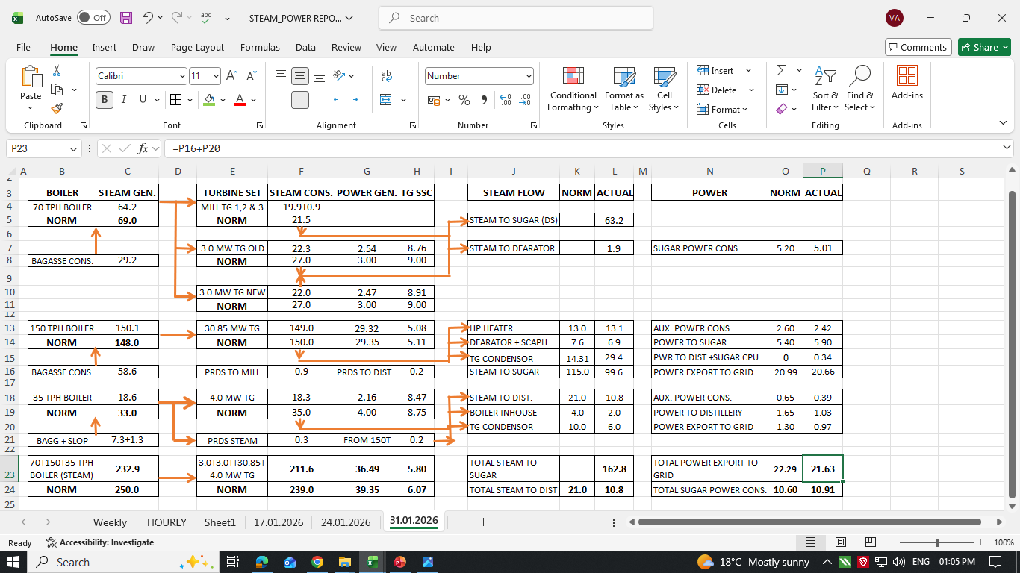
STEAM & POWER FOR THE WEEK

Slide 89
35T BLR-ROUTINE & NON-ROUTINE JOBS ATTENDED DURING SHUTDOWN
S. No. | JOB DESCRIPTION
1. | Boiler Pressure parts cleaning work.
2. | NBC-4 scrapper relocation, Motorized plough fitting & both plough Teflon sheet 19mm scrapper replacement work.
3. | DBC-5 Head pulley side scrapper adjustment work.
4. | Steam drum & Water wall top header air vent replacement work.
5. | Deaerator charging from extraction drain line work.
6. | Screw feeder-2 gearbox replacement work.
7. | Hydraulic drive oil leakage attended work.
8. | BFP-1 ARC valve replacement work.
9. | All auxiliary fan, fuel handling, fuel feeding & ash handling system bearing checking & greasing work.
10. | Oil Cooler, Alternator air cooler & ACW & MCW 1&2 strainer cleaning work.

Slide 90
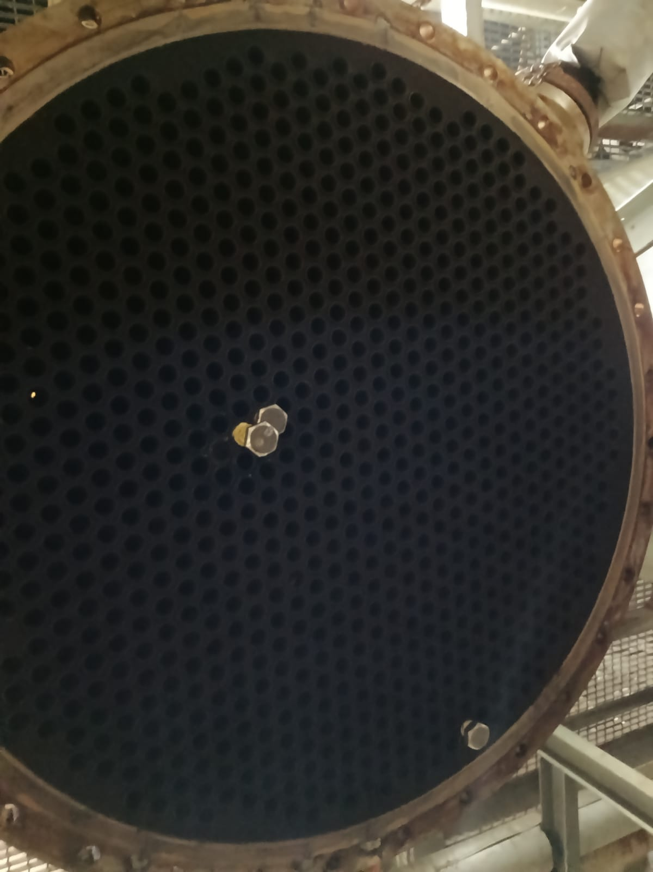
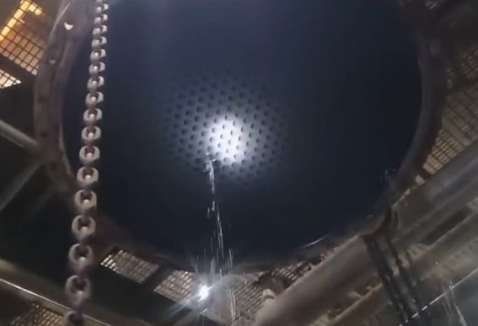
DISTILLATION RECTIFIER COLUMN REBOILER TUBE LEAKAGE
During hydro test of Distillation Reboiler 3 tube leakages out of 758 tubes observed. Same was plugged. Again hydro test conducted all found ok.

Slide 91
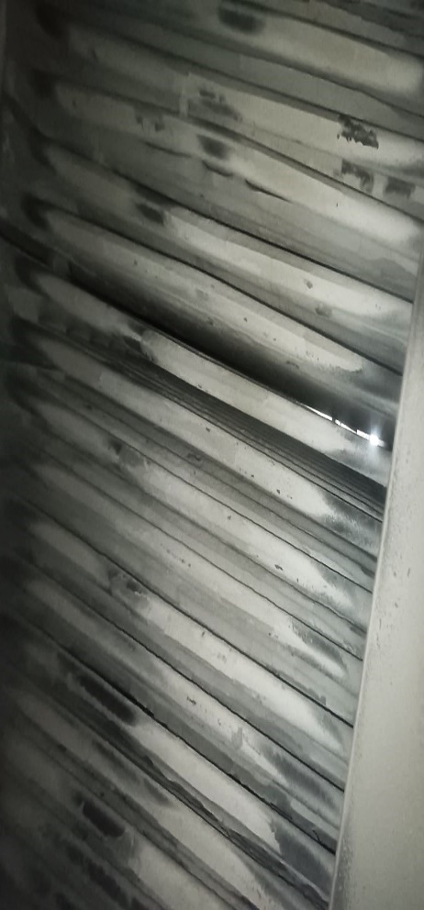
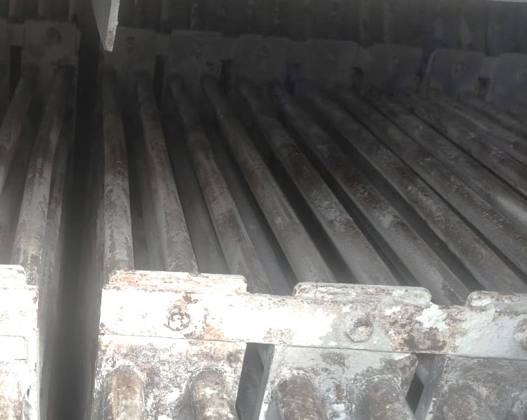

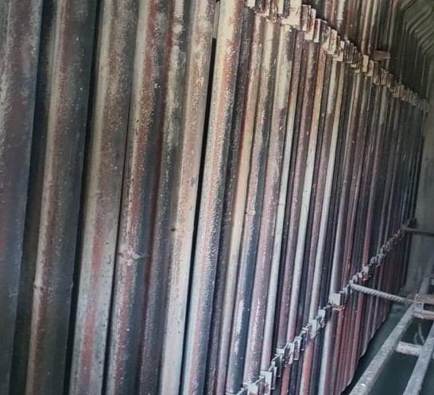

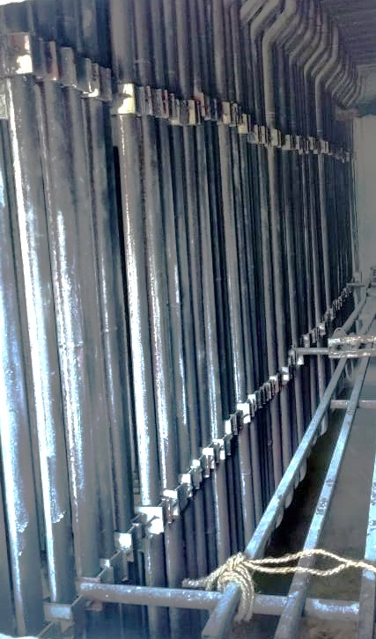
35 TPH BOILER- BOILER PRESSURE PARTS CLEANING
BEFORE
AFTER
BEFORE
AFTER
BEFORE
AFTER
ECONOMIZER
EVAPORATOR
SUPER HEATER

Slide 92
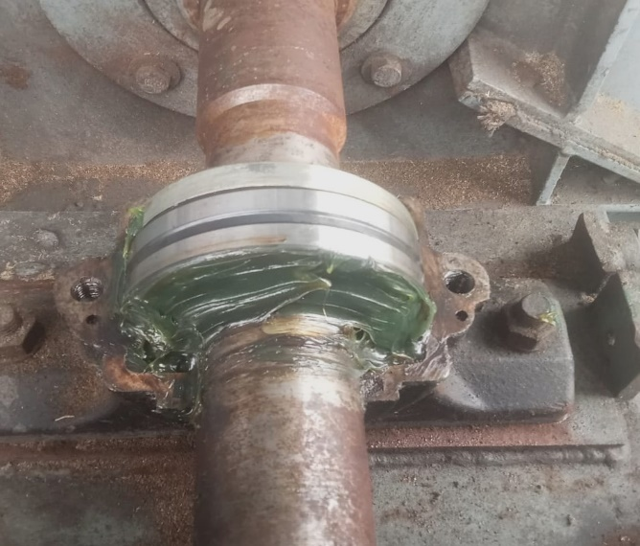
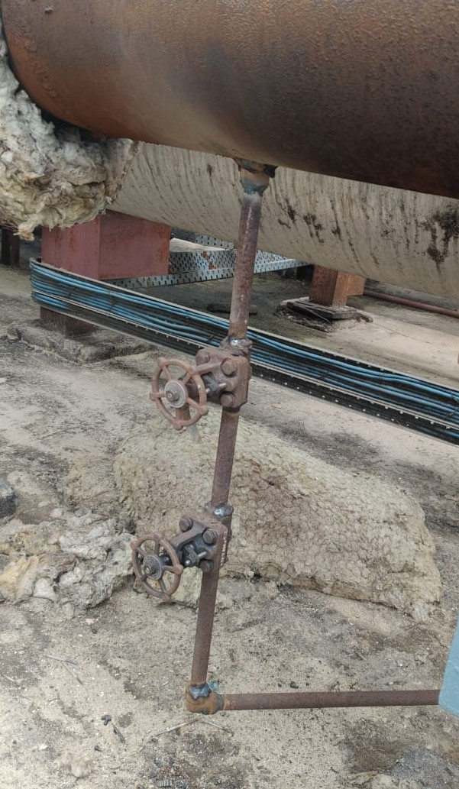
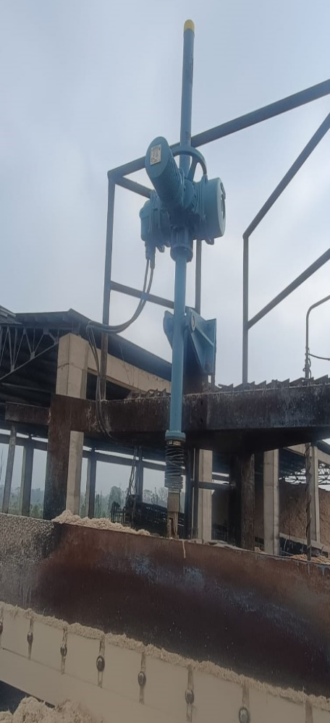
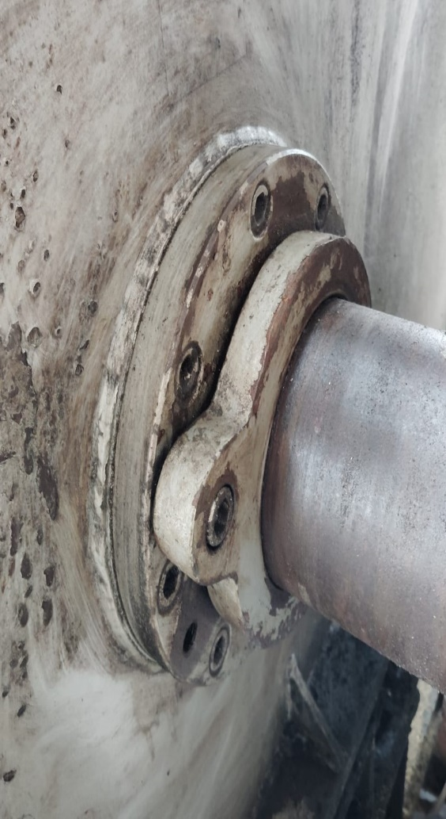
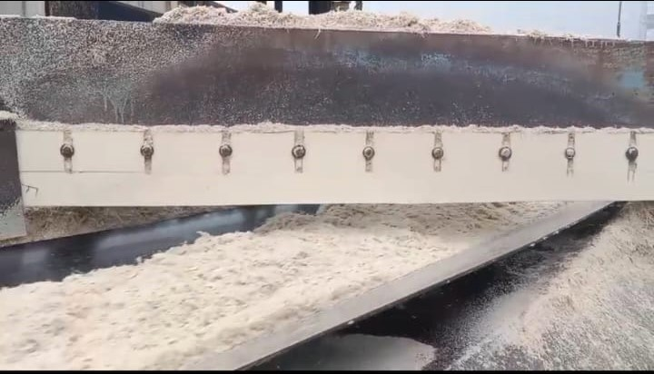
35 TPH BOILER
All Bagasse belt conveyors & fans bearing general cleaning and greasing work, all found in good condition.
Deaerator charging from extraction line drain is provided.
Motorized plough mounted in place of manually operated plough on New Belt Conveyor-4
Travelling grate hydraulic drive oil leakage attended.
NBC-4 Both plough Teflon sheet scrapper replaced as existing sheet was degraded over time.

Slide 93
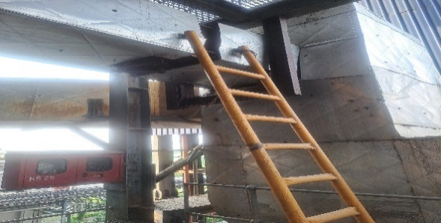
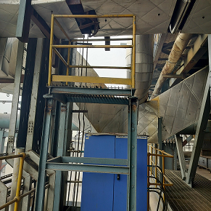
150 TPH BOILER OFA DUCT- UNSAFE CONDITION
Ladder replaced with proper platform for the air damper operate
Cage ring & Handrail not found in monkey ladder
BEFORE
AFTER

Slide 94
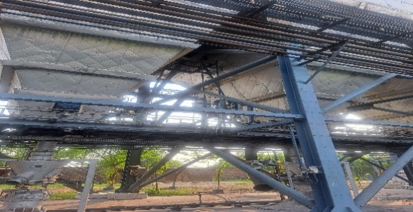
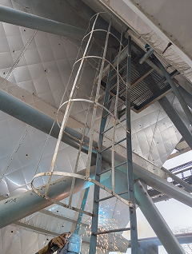
150 TPH BOILER ASH HANDLING SYSTEM - UNSAFE CONDITION
CAGE RING
BEFORE
AFTER

Slide 95
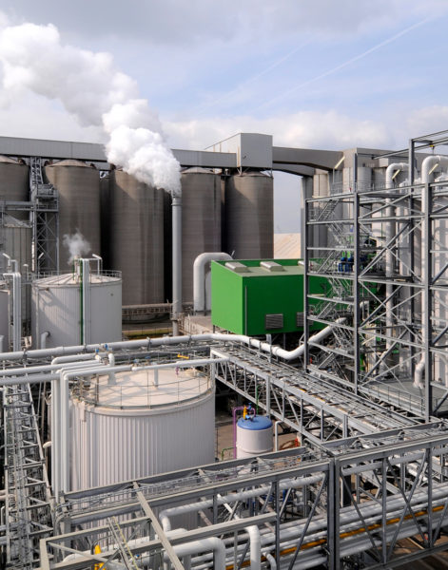
DISTILLERY UNIT

Slide 96
Physical / General Plant observations-
Physical / General Plant observations of the week-
1-Distillery Plant has been closed at 12.15 Am on dated 27.01.2026 for scheduled cleaning & maintenance.
2-Steam applied in distillation plant at 6.15 Am on dated 30.01.2026 .
3- Wash feed applied in distillation plant at 7.50 AM, RS draw at 10.30 AM & AA draw opened in the receiver at 2.30 PM on 30.01.2026.
.

Slide 97
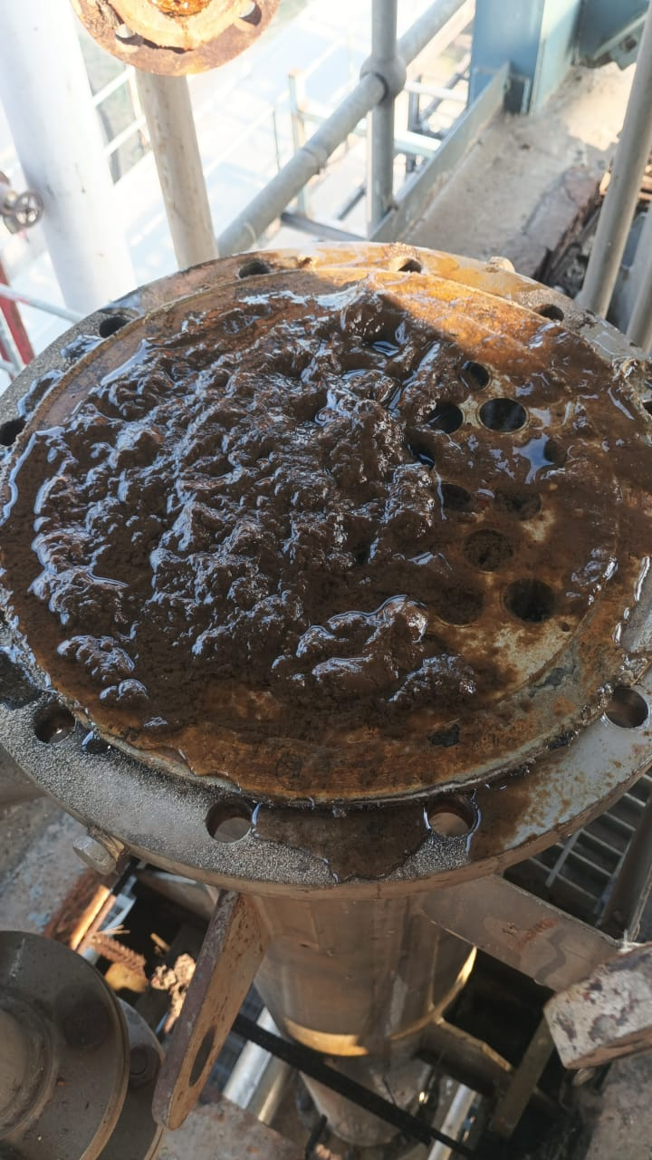
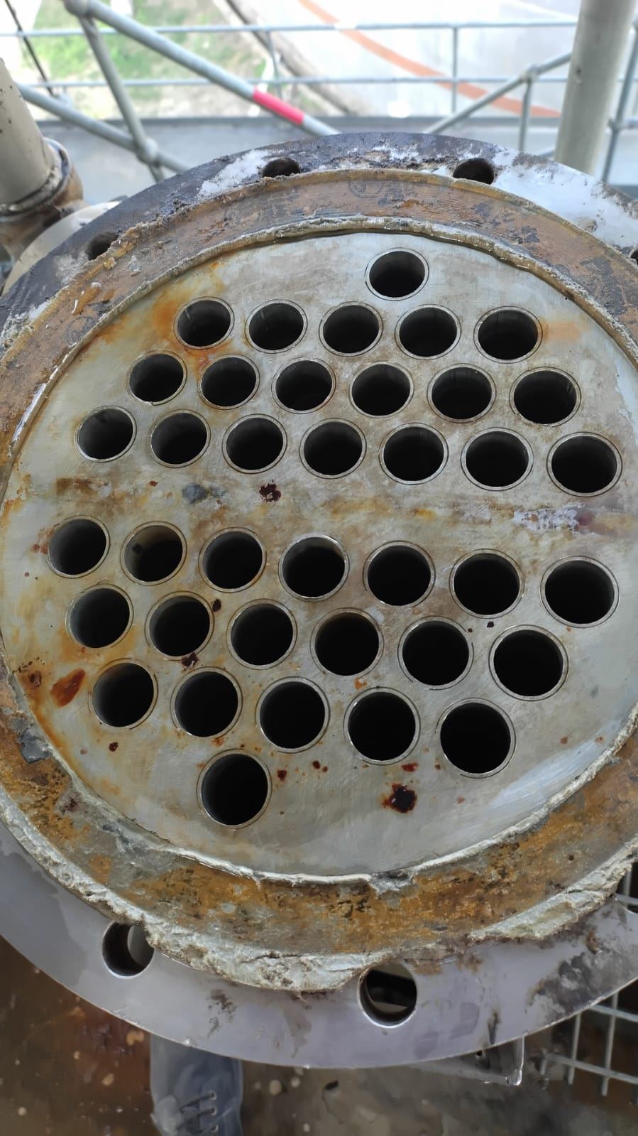
Rectifier column PCV condenser
Before Cleaning
After Cleaning

Slide 98
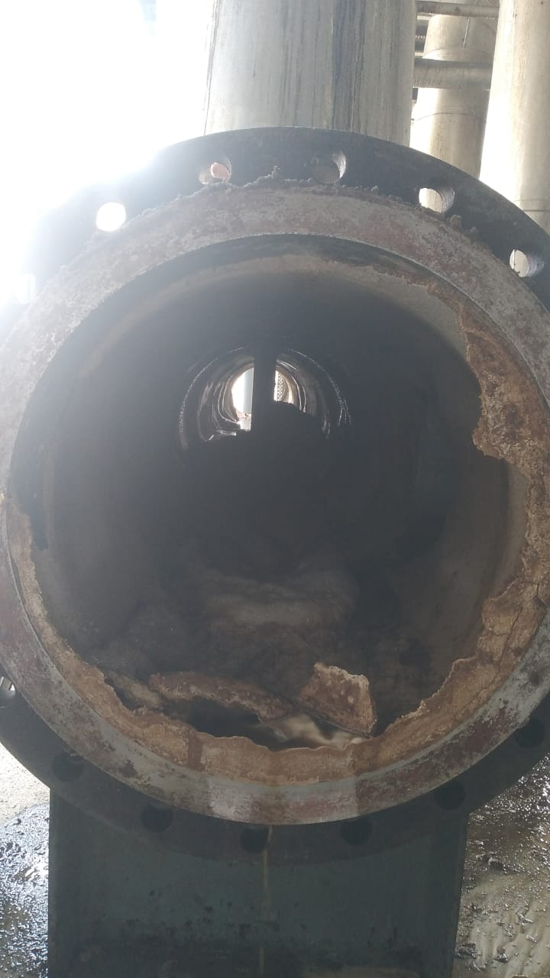
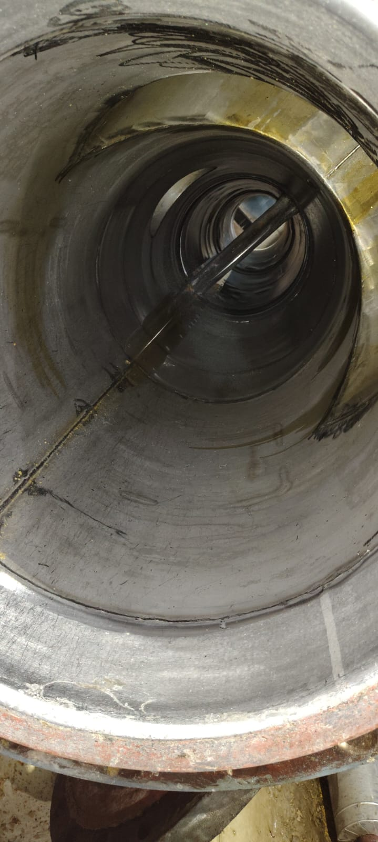
MEE Force Circulation Header
Before Cleaning
After Cleaning

Slide 99


Degasifying Column -1 chamber
Before Cleaning
After Cleaning

Slide 100


Analyser column grid tray
Before Cleaning
After Cleaning

Slide 101




Analyser column(grid tray & down comers)
Before Cleaning
After Cleaning

Slide 102


Evaporation Section
VLS-07 circulation line cleaning status
Before cleaning
After cleaning

Slide 103
Weekly Performance Snapshot - Distillery
S.N | Capacity Utilization | Target | Current Week | Last Week | Till Date
1 | Total Production (Lakh Liters) | 8.40 | 3.77 | 8.17 | 114.12
4 | Downtime (Hrs.) |  | 86.25 | 0 | 589.41
5 | Average Ethanol Prodn./Day (Lakh Liters) | 1.20 | 1.11 | 1.17 | 1.16
 | Efficiency
6 | Ethanol Recovery – Syrup (BL/Qtl Cane) | 7.60 | 7.55 | 7.56 | 7.02
7 | Ethanol Recovery – BH (BL/Qtl) | 31.5 | - | - | 28.17
8 | Ethanol Recovery – Syrup (BL/Qtl) | - | 29.60 | 29.77 | 30.03
7 | Fermentation Efficiency (%) | 91.5 | 91.58 | 91.55 | 91.09
9 | Distillation Efficiency (%) | 98.5 | 98.66 | 98.66 | 98.64
10 | Steam consumed (Kg/BL) | 4.1 | 4.80 | 4.09 | 4.10
11 | Power consumed (KWH/BL) | 0.528 | 0.634 | 0.443 | 0.437
 | Feedstock Quality
11 | Feed Stock | B-Heavy | Syrup | Syrup | Syrup/B-heavy
12 | Total Reducing Sugar % |  | 51.39 | 51.69 | 52.78
13 | Fermentable Sugar % |  | 50.77 | 51.08 | 51.56
14 | UFS % |  | 0.62 | 0.61 | 1.22
103

Slide 104
Last 03 Months Performance Snapshot - Distillery
S.N | Capacity Utilization | Jan-2026 | Dec.-2025 | Jan-2025
1 | Total Production (Lakh Liters) | 32.55 | 36.17 | 38.81
4 | Downtime (Hrs.) | 86.42 | 7.67 | 0
5 | Average Ethanol Prodn./Day (Lakh Liters) | 1.19 | 1.18 | 1.25
 | Efficiency
6 | Ethanol Recovery – Syrup (BL/Qtl Cane) | 7.30 | 7.19 | 7.83
7 | Ethanol Recovery – BH (BL/Qtl) | - | - | -
8 | Ethanol Recovery – Syrup (BL/Qtl) | 29.64 | 30.04 | 31.71
7 | Fermentation Efficiency (%) | 91.52 | 90.98 | 92.69
9 | Distillation Efficiency (%) | 98.65 | 98.62 | 98.76
10 | Steam consumed (Kg/BL) | 4.06 | 4.14 | 3.68
11 | Power consumed (KWH/BL) | 0.449 | 0.441 | 0.420
 | Feedstock Quality
11 | Feed Stock | Syrup | Syrup | Syrup
12 | Total Reducing Sugar % | 51.46 | 52.66 | 54.64
13 | Fermentable Sugar % | 50.88 | 51.89 | 53.68
14 | UFS % | 0.58 | 0.77 | 0.96
104

Slide 105
Key Operational Parameters
Particulars | Current Week | Last Week | Last year Week | Till Date
 | SS 25-26 | SS 25-26 | SS 24-25 | SS 25-26 | SS 24-25
Feed Stock | Syrup | Syrup | Syrup | Syrup | Syrup
Average Ethanol Prodn. / Day | 110660.0 | 116757.0 | 125728.0 | 119000.0 | 124907.0
Capacity Utilization | 88.53 | 93.41 | 100.58 | 95.20 | 99.93
Ethanol Prodn. ( In BL) | 377350.40 | 817300 | 880094.0 | 10638621.70 | 11668794.70

Slide 106
Key Operational Parameters
Particulars | Weekly |  | Till Date
 | SS 25-26 | SS 24-25 | SS 25-26 | SS 24-25
Feed Stock | Syrup | Syrup | Syrup | Syrup
B-heavy/Syrup molasses Utilized(In Qtl) | 12750.0 | 27500 | 354250.0 | 364800
Ethanol Prod. BL / Qtl | 29.60 | 32.00 | 30.03 | 31.99
Total Reducing Sugar % | 51.39 | 54.95 | 52.80 | 54.97
Fermentable Sugar % | 50.77 | 54.13 | 51.77 | 54.16
UFS % | 0.62 | 0.82 | 1.03 | 0.81
Distillation Efficiency | 98.66 | 98.80 | 98.64 | 98.79
Fermentation Efficiency | 91.58 | 92.73 | 91.13 | 92.65

Slide 107
Key Operational Parameters
Sugar Season | 2025-26
Particulars | Budgeted (Week) | Achieved (Week) | Budgeted (To date) | Achieved (To date)
Feed Stock | Syrup |  | Syrup/B-heavy
Ethanol Prodn. ( In BL) | 840000 | 377350.40 | 11520000 | 11411989.30
Steam consumed in (MT) | 3444.0 | 1810.80 | 57821.40 | 46770.40
Steam consumed Kg/BL | 4.10 | 4.09 | 4.10 | 4.10
Power consumed in (Kwh) | 443520 | 239300 | 7286400 | 4991423.0
Power consumed Kwh/BL | 0.528 | 0.443 | 0.528 | 0.437

Slide 108
Analysis of Cane syrup received
Particulars | Current Week |  |  | Last Week |  |  | Last Year Week
Date | Brix | pH | TRS% | Brix | pH | TRS% | Brix | pH | TRS%
25/01/2026 | 61.03 | 6.21 | 51.51 | 58.11 | 6.26 | 52.04 | 62.6 | 6.39 | 55.15
26/01/2026 | 60.24 | 6.28 | 51.26 | 58.54 | 6.25 | 51.51 | 62.2 | 6.36 | 55.15
27/01/2026 | 62.63 | 6.24 | 51.51 | 55.73 | 6.24 | 51.00 | 61.5 | 6.37 | 54.84
28/01/2026 | 0 | 0 | 0 | 60.13 | 6.26 | 51.00 | 60.5 | 6.30 | 54.84
29/01/2026 | 62.68 | 6.27 | 51.78 | 60.32 | 6.23 | 51.26 | 58.9 | 6.34 | 55.00
30/01/2026 | 62.08 | 6.26 | 51.78 | 58.40 | 6.23 | 51.26 | 59.2 | 6.29 | 54.84
31/01/2026 | 62.25 | 6.27 | 51.78 | 60.48 | 6.25 | 51.51 | 58.8 | 6.25 | 54.84
Average | 61.82 | 6.26 | 51.60 | 59.04 | 6.24 | 51.34 | 60.5 | 6.33 | 54.95

Slide 109


TBT

Slide 110


TBT Attendance

Slide 111
Hazardous Observation Activity Report
HAZARDS OBSERVATION - DISTILLERY
S.N | DATE | HAZARDOUS ACTIVITY/ OBSERVATION | LOCATION | ACTION REQUIRED/ TAKEN | TARGET DATE | RESPONSIBILITY | STATUS
1. | 25.01.2026 | Open caustic bag placed on ground floor of fermentation house near CIP Tank. | Fermentation house | Caustic bags shifted to proper place. | Immediate | Mr. Harpal Singh | Completed
2. | 27.01.2026 | MEE plant scale spread from trolley during shifting to yard. | Near weighing scale. | Clean spread sludge immediately and instructed to tractor driver keep proper attention . | Immediate | Mr Brij Mohan Shukla | Completed
3. | 28.01.2026 | Debris of fermentation Cooling tower spread near pit after cleaning . | Cooling Tower. | Instruct to supervisor cleaned properly near N-pit area. | Immediate | Mr Vivek Bhatnagar | Completed
4. | 29.01.2026 | During water trial coupling guard was loose fitted with pump of FF-04. No injury occurred. | MEE Plant | Instruct to fitter stop pump and tight coupling guard. | Immediate | Mr.Avhay Kumar | Completed

Slide 112
Hazardous Obresvation Activity Report
NEARMISS - DISTILLERY
S.N | DATE | HAZARDOUS ACTIVITY / OBSERVATION | LOCATION | ACTION REQUIRED / TAKEN | TARGET DATE | RESPONSIBILITY | STATUS
1 | 26.01.2026 | Empty antifoam drums placed at floor of MEE plant . No injury occurred. | MEE Plant | To placed at proper place. | Immediate | Mr. Mukesh Verma | Completed
2 | 28.01.2026 | Small iron piece fall on head of MEE operator. No injury occurred. | MEE plant | Before maintenance work protect area to avoid any accident. | Immediate | Mr. Vivek Tiwari | Completed
3 | 29.01.2026 | Fitter was slipped during dismantling the stanner of cooling tower.NO injury occurred. | Cooling Tower. | To wear all necessary PPE,s | Immediate | Mr Chirag Agrawal | Completed
4 | 31/01/2026 | During Alcohol tanker loading stopper not properly placed. NO injury occurred. | Ware house . | Instruct to driver and ware house operator wooden stopper should be properly placed. | Immediate | Mr. SB Upadhayay | Completed

Slide 113
QUALITY CONTROL

Slide 114

Summary For Season 25-26

Slide 115

TOTAL LOSSES

Slide 116

Pol in Cane Comparison

Slide 117
Certification Status
Sr. No. | Certification | Implementation | Validity | Next Audit | Remark
1 | FSSC: 22000:2018 | MAY-2019 | MAY-28 | FEB-26 | Next surveillance audit due in Feb-26
2 | ISO: 9001:2015 | OCT-2011 | OCT-26 | OCT-27 | Next due in Oct-2025
3 | EnMS, ISO: 50001:2018 | FEB-26 (Tentative) | - | - | Documentation in process and Gap assessment audit, IA & MRM Scheduled in last week of Jan-26
4 | KOSHER | 30 OCT-25 | 29 OCT-26 | SEP-26- | Included with Speciality Sugar
5 | IMS (ISO: 9001, ISO:14001 & ISO 45001:2018 | APR-26 (Tentative) | - | - | Implementation process starts at our hand and documentation part in process
6 | IP License | SEP-22 | SEP-27 | SEP-27 | BP Sucrose include during SS 2024-25 and plan to include USP Sucrose during SS 2025-26

Slide 118
KPI Target Vs Achieved

Slide 119
Cane Crushed Data Capacity Wise

Slide 120

IT

Slide 121
Executive Summary
- Point 1: Effectively configured systems for sugarcane procurement at both gate and collection centers, enhancing process efficiency and transparency.
Point 2: Initiated routine operational activities for the crushing season, aligning teams and resources for smooth execution.
Point 3 :Installation of an NPR camera at the new molasses loading point is in progress.
Point 4:OPS server upgrade is underway to ensure smooth application performance.
Point 5 : Internet bandwidth upgrade from 50 Mbps to 100 Mbps is completed.
Point 6 :Installation of the vehicle positioning system at the gate tare weighbridge is completed .
121

Slide 122
General Observation
S. No. | Description
1 | Active Saksham App Growers: Installed – 41,385 / Active – 20,415
2 | GPS Installed in Center Trucks: 298
3 | Weighbridges (Gate + Centers): Total – 107, Active – 107
4 | Truck Received & Total Weight: 23922 NOS Trucks / 6172330 QTLS
5 | This Week Truck Received & Weight: 1620 NOS Trucks / 439493 QTLS
6 | Total Purchase (Grower & Purchy): Grower – 59379 NOS , Purchy 232673– NOS Weight 9926392- QTLS
7 | This Week Purchase (Grower & Purchy): Grower – 13105 NOS, Purchy – 15976 NOS ,Weight – 695968 QTLS QTLS
8 | FY 2024-25(Grower & Purchy): -62703 NOS ,Purchy -339568 NOS, Weight -14416592 ,QTLS
9 | FY 2024-25 Till 31 Jan (Grower & Purchy):- Grower-59580, Nos Purchy -214421, NOS Weight -9220141 QTLS

Slide 123


EHS

Slide 124





EHS
Sr No | Incident | ^{3rd} Week Jan-26
1 | Near Miss | 1
2 | First Aid | 0
3 | Minor | 0
4 | Major/Fatality | 0
5 | Fire Incident | 0
6 | Unsafe Act/unsafe behaviour Unsafe conditions | 8 45
7 | Training conducted Total Participants | 5 50
New Initiatives
Safety Audit completed by external competent body.
3. Work Based Tool -Box Training conducted.
.
TBT at Distillery
TBT at Sugar

Slide 125
Bore Well Water Details

Slide 126
Bore Well Water Details

Slide 127
Effluent Flow & Parameters

Slide 128
Procurement

Slide 129

Purchase & Stores PPT Slides Year Wise
Year | Total No of Indent | Total Purchase Order | Against Good Received
FY 23-24 | 1646 | 2462 | 3635
FY 24-25 | 2083 | 3131 | 4842
FY 25-26 | 1883 | 2580 | 3865
Purchase & Stores PPT Slides Month Wise
Nov - 25 | 136 | 210 | 393
Dec - 25 | 116 | 204 | 341
Jan - 26 | 123 | 198 | 281

Slide 130
Inventory Balance Material Summary Report : Month/Group Wise
 |  | Nov-25 | Dec-25 | 10-Jan-26
Group Code | Group Description | Value (Rs.) | Value (Rs.) | Value (Rs.)
Group : A0 | OIL & GREASE | 1059993.26 | 1251265.22 | 1414917.51
Group : B0 | CHEMICALS | 10299046.96 | 14580368.52 | 10186702.52
Group : C0 | SPARE | 38982478.84 | 37938414.78 | 34125314.53
Group : D0 | ELECTRIC GOODS | 8237946.3 | 8199618.07 | 6825227.01
Group : E0 | WELDING MATERIALS | 1498495.59 | 1486353 | 1143898.04
Group : F0 | PIPE & PIPE FITTINGS | 5135286.35 | 4648046.41 | 2697106.83
Group : G0 | BELTING & PACKING | 839906.56 | 912586.95 | 1011028.61
Group : H0 | METALS | 102915.23 | 109391.75 | 99764.94
Group : I0 | PAINT & VARNISH | 948336.43 | 906946.52 | 525664.11
Group : J0 | TOOLS & FILES | 548061.27 | 535782.66 | 493340.62
Group : K0 | IRON MATERIALS | 2078786.54 | 652335.01 | 894395.1
Group : L0 | GENERAL STORES | 5678851.84 | 6022995.09 | 6854923.58
Group : M0 | PACKING MATERIALS | 8021382.69 | 11144752.64 | 14110458.09
Group : N0 | BLOCK | 1620456.06 | 751806.06 | 671149.3
Group : Q0 | INSURANCE SPARE | 2820206.11 | 2820206.11 | 2701170.12
Total |  | 87872150 | 91960869 | 83755061
Group : B0 | CHEMICALS | 10299046.96 | 14580368.52 | 10186702.52
Group : M0 | PACKING MATERIALS | 8021382.69 | 11144752.64 | 14110458.09
Group : N0 | BLOCK | 1620456.06 | 751806.06 | 671149.3
Group : Q0 | INSURANCE SPARE | 2820206.11 | 2820206.11 | 2701170.12
Total |  | 22761092 | 29297133 | 27669480
Total |  | 65111058 | 62663735 | 56085581

Slide 131
PP Bag ,Lime & Sulphur as on date stock position
 |  |  |  |  |  | Date:31.01.2026
Grade | Previous Year Stock Balance Qty (23 - 24)+(24-25) |  | Rec Stock Bal. Qty Season 2025 - 26 |  |  | Bal. Total Stock Qty (2024 - 25)&(2025 - 26)
 | DS | Refinery | DS |  | Refinery | DS | Refinery
Pharma | 0 | 6500 | 0 |  | 20041 | 0 | 26541
PLANE | 16500 | 4491 | 0 |  | 0 | 16500 | 4491
M - 31 | 4216 | 0 | 101883 |  | 194278 | 106099 | 194278
S - 31 | 4349 | 7500 | 13683 |  | 70780 | 18032 | 78280
L - 31 | 15172 | 2059 | 0 |  | 23996 | 15172 | 26055
S - 31 180 |  | 24269 | 0 |  | 7231 | 0 | 31500
JUTE BAG | 0 | 0 | 0 |  | 0 | 0 | 0
Total | 40237 | 44819 | 115566 |  | 316326 | 155803 | 361145
Total | 85056 |  | 431892 |  |  | 516948
 | Unit | Stock Qty | Bal Days
Lime Unslaked | QTL | 643 | 4 |  | Per day@ 150 Qtl
Sulphur | MT | 31 | 10 |  | Per day@ 3 ton

Slide 132


Thank You!

